Slide 1
Lecture Neural Network
Representation Non – Linear
Algorithm
Neural Networks Representation | ML-005 Lecture 8 | Stanford University | Andrew Ng – YouTube
Neural Networks Overview by Prof. Andrew NG
Neural Networks Learning | ML-005 Lecture 9 | Stanford University | Andrew Ng

Slide 2
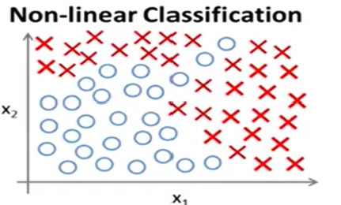
Why do we need for Neural Networks
Simply the Neural Network is the state art technique to address many machine learning problems.
For instance, if you apply Logistic Regression to the housing problem as a classification problem. Consider the housing problem and you want to predict the odd that one of the house will be sold in the next 6monthes. Need for hundreds of features to solve the problem. This involves in quite a lot of features may be hundred different features of different houses. The problem like this if you were to include all the quadratic terms.
For example, think of None-Linear Classification with two features X1 and X2:
There will be all the polynomial terms and a lot of them as two terms like X1²,x1,x2, x1x3. x1x4 … x1x100 then x2 ²,x1x3 …

Slide 3
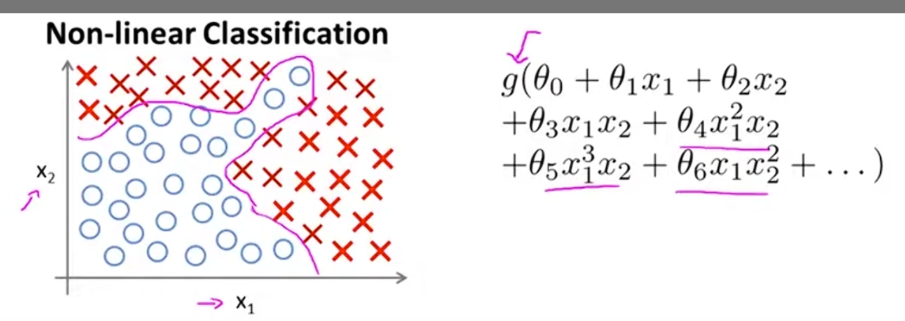
Why do we need for Neural Networks
Consider non learner classification problem: You can apply logistic regression algorithm.
Polynomial terms
If you apply Logistic Regression, then results in none-linear functions:
g(θ₀ + θ₁ X1 + θ₂ X2 + θ₃ X1X2 + θ₄ X1 ² X2 + θ₅ X1 ³ x2 + θ₆ X1 X2 ² + …) and by including a lot of polynomial terms, you may get hypothesis that will separate the positives and negatives.
G is sigmoid function and we include a lot polynomial terms. In this case, we used two features of X1 and x2.

Slide 4
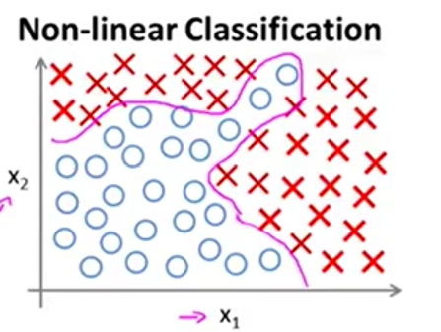
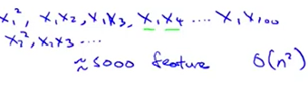
Why do we need for Neural Networks
In this case, the housing problem and prediction for how many houses will be sold in the next 6monthes. Need for hundreds of features to solve the problem. Includes the higher order polynomial degrees. When n is large then ended up with high complexity computational and then the complexity will be higher. Ending up with 170000 cubic feature.
X1 = size
X2 = #bedrooms
X3 = no. of floors
X4 = age
…
X100

Slide 5
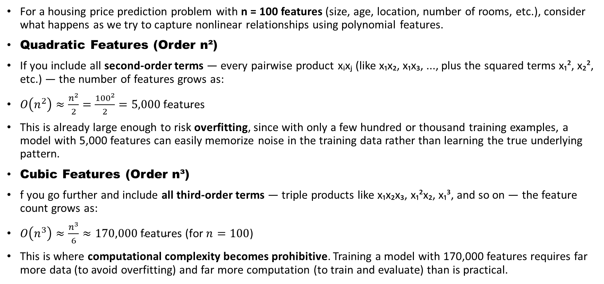
The Housing Price Problem — Feature Explosion
For a housing price prediction problem with n = 100 features (size, age, location, number of rooms, etc.), consider what happens as we try to capture nonlinear relationships using polynomial features.
Quadratic Features (Order n²)
If you include all second-order terms — every pairwise product xᵢxⱼ (like x₁x₂, x₁x₃, ..., plus the squared terms x₁², x₂², etc.) — the number of features grows as:
$O\left(n^{2}\right)≈\frac{n^{2}}{2}=\frac{{100}^{2}}{2}=5,000\text{ features}$
This is already large enough to risk overfitting, since with only a few hundred or thousand training examples, a model with 5,000 features can easily memorize noise in the training data rather than learning the true underlying pattern.
Cubic Features (Order n³)
f you go further and include all third-order terms — triple products like x₁x₂x₃, x₁²x₂, x₁³, and so on — the feature count grows as:
$O\left(n^{3}\right)≈\frac{n^{3}}{6}≈170,000\text{ features (for }n=100\text{)}$
This is where computational complexity becomes prohibitive. Training a model with 170,000 features requires far more data (to avoid overfitting) and far more computation (to train and evaluate) than is practical.

Slide 6
The Restricted Subset Doesn't Help
One might try to limit the damage by only keeping a small, restricted subset of features — for example, only the pure squared terms x₁², x₂², x₃², ..., x₁₀₀² (dropping all cross-terms like x₁x₂).
This gives you back only n = 100 features — but now the model loses expressive power. It can no longer capture interactions between variables (e.g., how size and location jointly affect price), so it becomes too simple to model the true nonlinear relationship. This risks underfitting: the hypothesis class is too restricted to capture the real pattern in the data.

Slide 7
The Fundamental Tradeoff:
Approach | Feature Count | Problem
All quadratic terms | O(n²) ≈ 5,000 | Overfitting risk, growing computation
All cubic terms | O(n³) ≈ 170,000 | Computationally infeasible
Restricted subset (xᵢ² only) | O(n) = 100 | Underfitting — loses feature interactions

Slide 8
You're stuck:
keep all polynomial terms and face overfitting/computational blowup, or restrict the features and lose the expressive power needed to fit the data well.
Why This Motivates Neural Networks
This is exactly the argument for neural networks: instead of manually choosing which polynomial combinations to include, a neural network learns the useful nonlinear feature combinations automatically through its hidden layers — achieving the expressive power of high-order polynomial features without the combinatorial explosion in feature count, because the network shares parameters and composes simple functions in layers rather than enumerating every polynomial term explicitly.

Slide 9
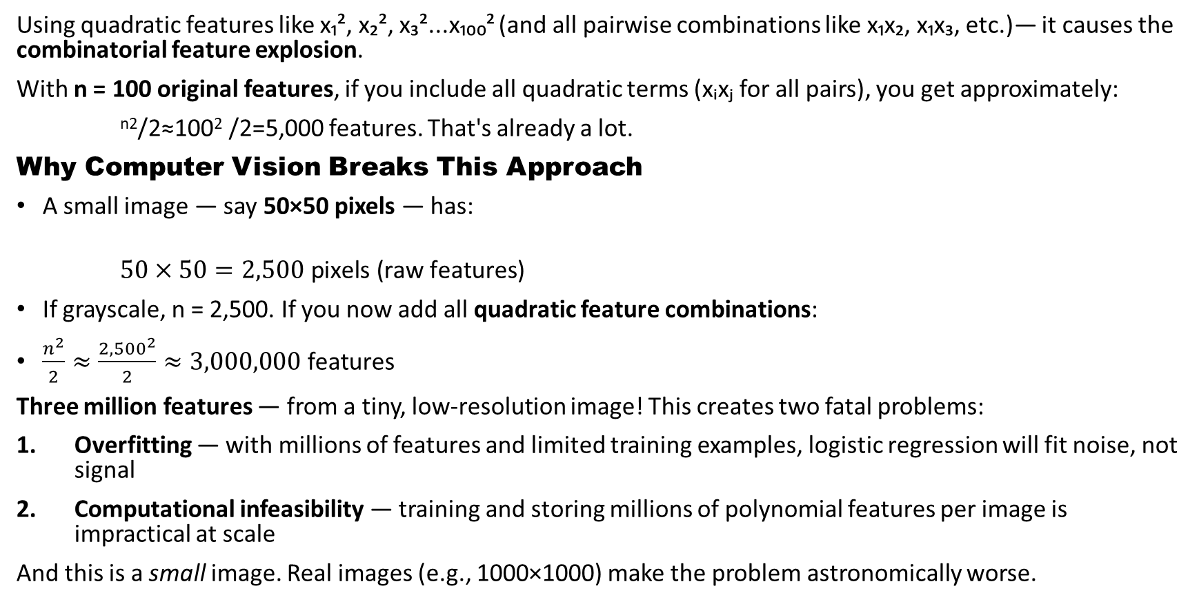
Again: Why do we need for Neural Networks
Using quadratic features like x₁², x₂², x₃²...x₁₀₀² (and all pairwise combinations like x₁x₂, x₁x₃, etc.)— it causes the combinatorial feature explosion.
With n = 100 original features, if you include all quadratic terms (xᵢxⱼ for all pairs), you get approximately:
^{n2}/2​≈100²​ /2=5,000 features. That's already a lot.
Why Computer Vision Breaks This Approach
A small image — say 50×50 pixels — has:
$50×50=2,500\text{ pixels (raw features)}$
If grayscale, n = 2,500. If you now add all quadratic feature combinations:
$\frac{n^{2}}{2}≈\frac{{2,500}^{2}}{2}≈3,000,000\text{ features}$
Three million features — from a tiny, low-resolution image! This creates two fatal problems:
Overfitting — with millions of features and limited training examples, logistic regression will fit noise, not signal
Computational infeasibility — training and storing millions of polynomial features per image is impractical at scale
And this is a small image. Real images (e.g., 1000×1000) make the problem astronomically worse.

Slide 10
Why Neural Networks Solve This: the combinatorial feature explosion.
Neural networks avoid this explosion because they:
Learn features automatically through hidden layers, rather than requiring you to hand-engineer polynomial combinations
Use raw pixel intensities as input (n = 2,500) without needing manual quadratic expansion
Compose simple nonlinear functions in layers to build up complex nonlinear decision boundaries — achieving what polynomial features attempt, but far more efficiently
Scale better — parameter counts grow linearly with architecture design choices (layer sizes), not combinatorially with input dimensionality

Slide 11
The Core Argument
Logistic regression with polynomial features can theoretically represent any nonlinear boundary — but for high-dimensional inputs like images, the number of polynomial terms explodes combinatorially, making it computationally infeasible.
Neural networks solve the same nonlinear classification problem (e.g., "is this a car?") but learn hierarchical, compact feature representations directly from raw pixels — making them practical for real-world, high-dimensional problems like computer vision.

Slide 12
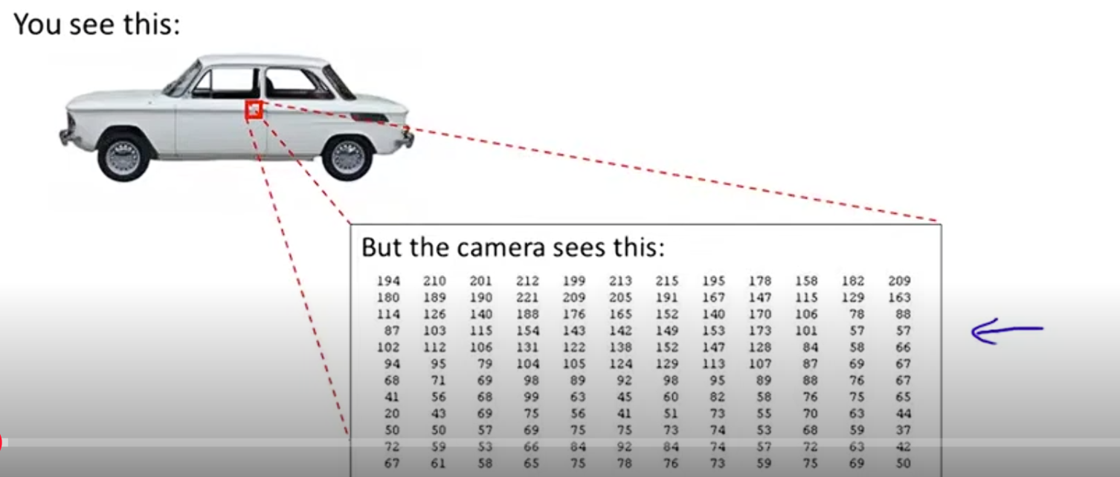
Computer vision problem
Train classifier to examine an image and tell us whether it is the image of a car. Many people wonder the computer vision is difficult to recognize it is an image of a car.
Look at a rectangular of image of this car. Consider the matrix of pixel intensity value and tell us that these numbers represent the door handle of a car.

Slide 13
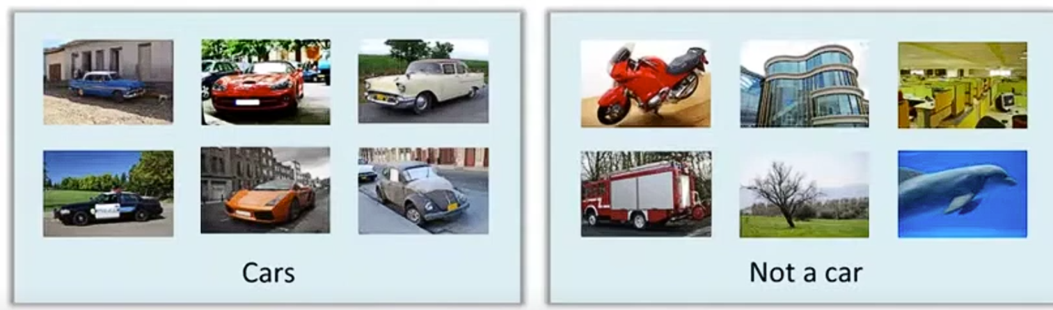
Using a machine learning to build a car detector
Come up with a labeled training set which a few labels of car and with a few labels that are not cars

Slide 14
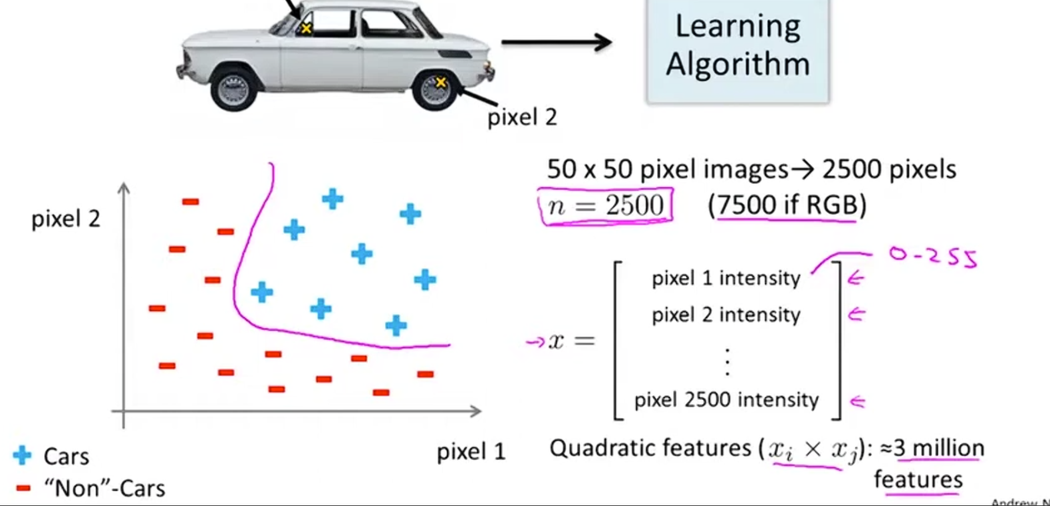
When n is very large logistic regression is not a good algorithm to solve the problem
Pixel has I value and RGB has 3 values
Grayscale images

Slide 15
Cost of 3 million features to find the feature
With a high number of features, it is not a good way of learning for a non-leaning hypothesis
By including all quadratic feature and using a simple logistic regression not a good idea.
The neural network is a better way to learn non-leaner complex hypothesis. The neural network is an old algorithm to mimic the work of brain
Origins: Algorithms that try to mimic the brain. Was very widely used in 80s and early 90; popularity diminished in late 90s.
Recent resurgence: State-of-the art techniques for many applications.

Slide 16
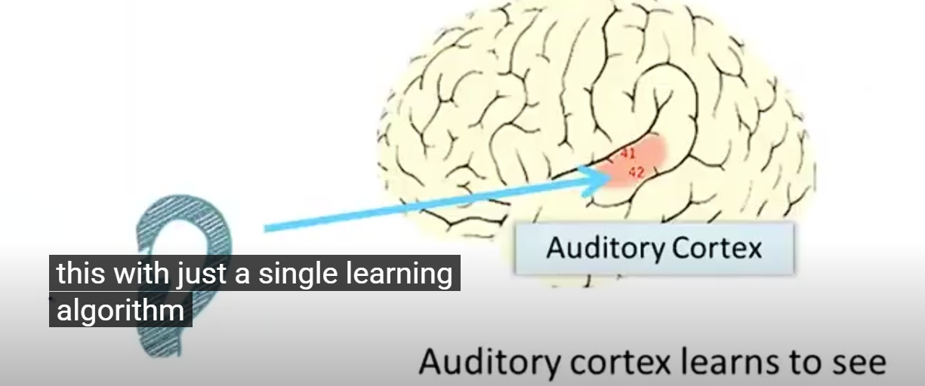
It does not work with 1000s of program instead brain does the way brain does with a single learning algorithm. The way that you understand my voice is to takes the sound signal and direct it to the Auditory Cortex. That is allowing you to understand my words.

Slide 17
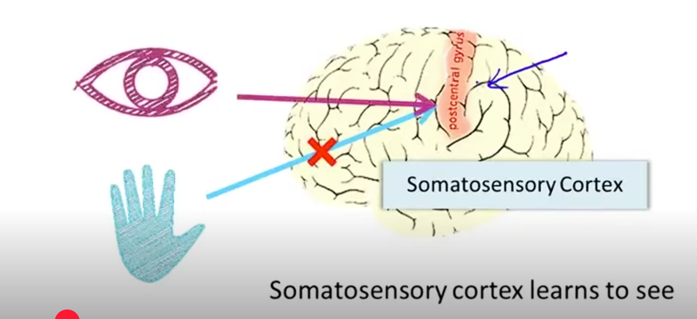
Neuro-scientist experiment
Cut the wire from ear to Auditory Cortex and rewire in the animal brain from eyes, optic nerves, eventually gets routed to the Auditory Cortex. If you do this, it turns out otogi Auditory Cortex will learn to see. This is in every single sense of word see as we know it so if you do this to the animals and animals can perform visual discrimination tasks. And look at the images and make an appropriate decisions. Based on images. Doing it with a piece of brain tissue. That piece tissue is your somatosensory cortex. That is how you process your sense of touch. If you do a similar rewiring process.

Slide 18
Neuro rewiring experiment
Does it make sense that if the same piece of physical brain tissue can process sight, sound, or touch, then maybe there's just one learning algorithm underlying all of it?
Neuroscientists ran an experiment: they severed the wire from the ear to the auditory cortex in an animal's brain, then rewired it — so that signals from the eyes (via the optic nerve) got rerouted to the auditory cortex instead.
The result: the auditory cortex learned to see. Not metaphorically — in every real sense of the word. The animal could perform visual discrimination tasks, looking at images and making appropriate decisions based on them — using a piece of brain tissue that normally processes sound.
The same has been shown with the somatosensory cortex — the part of your brain that processes touch. It too can learn to see, when rewired.
This is called the neural rewiring experiment, and it suggests something profound: if the same physical brain tissue can learn to process sight, sound, or touch, maybe there isn't a separate specialized algorithm for each sense. Maybe there's one general-purpose learning algorithm, and the brain simply learns how to process whatever type of data it receives — rather than needing a thousand different specialized algorithms for a thousand different tasks.
Even more strikingly, researchers have found that you can plug almost any sensor into almost any part of the brain, and — within reason — the brain will learn to make use of it.
Example: Learning to see with your tongue.There's a device (part of a system sometimes called a "BrainPort," originally developed to help blind people) that works like this: you strap a grayscale camera to your forehead, facing forward, capturing a low-resolution image of what's ahead of you. That image is converted into signals sent to an array of electrodes placed on your tongue. Each pixel maps to a specific location on the tongue — a dark pixel might produce a high-voltage pulse, a bright pixel a low-voltage pulse (or vice versa).
Remarkably, after enough practice, people using this device report being able to see — in some meaningful sense — through their tongue.

Slide 19
The Neural Rewiring Experiment
Does it make sense that if the same piece of physical brain tissue can process sight, sound, or touch, then maybe there's just one learning algorithm underlying all of it?
Neuroscientists ran an experiment: they severed the wire from the ear to the auditory cortex in an animal's brain, then rewired it — so that signals from the eyes (via the optic nerve) got rerouted to the auditory cortex instead.
The result: the auditory cortex learned to see. Not metaphorically — in every real sense of the word. The animal could perform visual discrimination tasks, looking at images and making appropriate decisions based on them — using a piece of brain tissue that normally processes sound.
The same has been shown with the somatosensory cortex — the part of your brain that processes touch. It too can learn to see, when rewired.
This is called the neural rewiring experiment, and it suggests something profound: if the same physical brain tissue can learn to process sight, sound, or touch, maybe there isn't a separate specialized algorithm for each sense. Maybe there's one general-purpose learning algorithm, and the brain simply learns how to process whatever type of data it receives — rather than needing a thousand different specialized algorithms for a thousand different tasks.
Even more strikingly, researchers have found that you can plug almost any sensor into almost any part of the brain, and — within reason — the brain will learn to make use of it.
Example: Learning to see with your tongue.There's a device (part of a system sometimes called a "BrainPort," originally developed to help blind people) that works like this: you strap a grayscale camera to your forehead, facing forward, capturing a low-resolution image of what's ahead of you. That image is converted into signals sent to an array of electrodes placed on your tongue. Each pixel maps to a specific location on the tongue — a dark pixel might produce a high-voltage pulse, a bright pixel a low-voltage pulse (or vice versa).
Remarkably, after enough practice, people using this device report being able to see — in some meaningful sense — through their tongue.

Slide 20
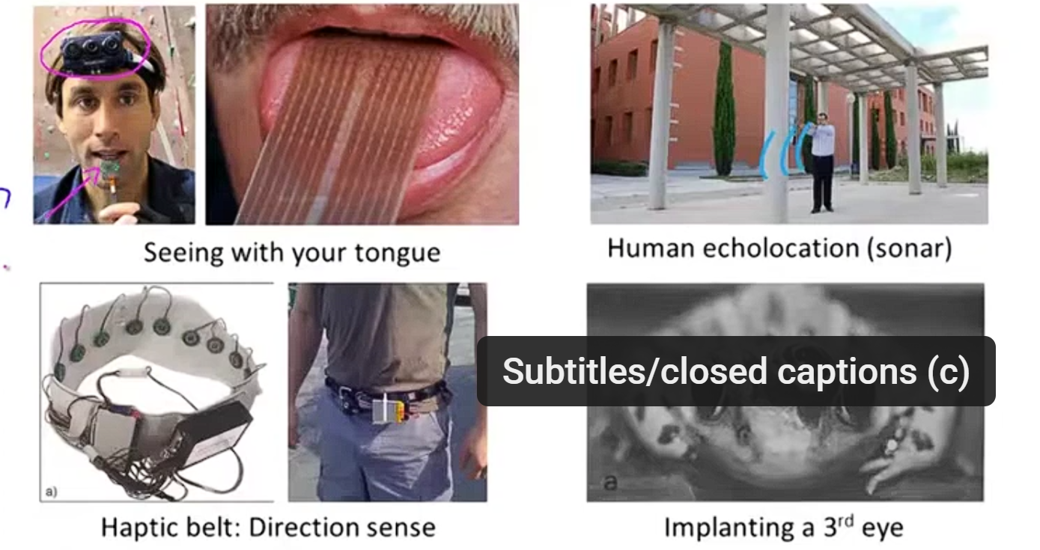
Examples

Slide 21
Second example of Human colocation (sonar)
Minutes without tunnels. Two ways to do this:
You can either snap your figures or
click your tongue or you can do very well( oopah : Oopah is a term used to describe a lively and enthusiastic expression)
Third example : haptic belt- if you a strap around your waist ring of buzzers and always have the northmost one buzzing you can give human directions and similar to may be how birds can you sense that what the sense where north is and
.

Slide 22
Hypothetical example: A "third eye" (concept adapted from Andrew Ng, Machine Learning course)
Hypothetical example: A "third eye"
Extending the logic of the rewiring experiments: suppose you attached an entirely new type of sensor — for example, a laser-based sensor acting as a "third eye" — to the brain. Based on the evidence from sensory rewiring and substitution devices, it's plausible the brain could learn to interpret this novel data too, forming a working sense from it, the same way it learned to see via the tongue or through the auditory cortex.
Why this matters for AI:
If the brain doesn't rely on a thousand different specialized algorithms — one for vision, one for hearing, one for touch — but instead applies one general-purpose learning algorithm that adapts to whatever data it receives, this reframes the goal of AI research.
Rather than hand-engineering separate, task-specific algorithms for every problem, the aim becomes: figure out a good approximation of the brain's general learning algorithm, implement it on a computer, and let the system learn — on its own — to process many different types of data.
If achievable, this could represent genuine progress toward the long-standing goal of artificial general intelligence: building truly intelligent machines.

Slide 23
Study of neural network
Effective study of art techniques for modern day machine learning applications
Thinking of what algorithms might someday to be able to learn manners like the human.
Represent hypothesis and represent our models using neural networks
Simulating neurons of brain:

Slide 24
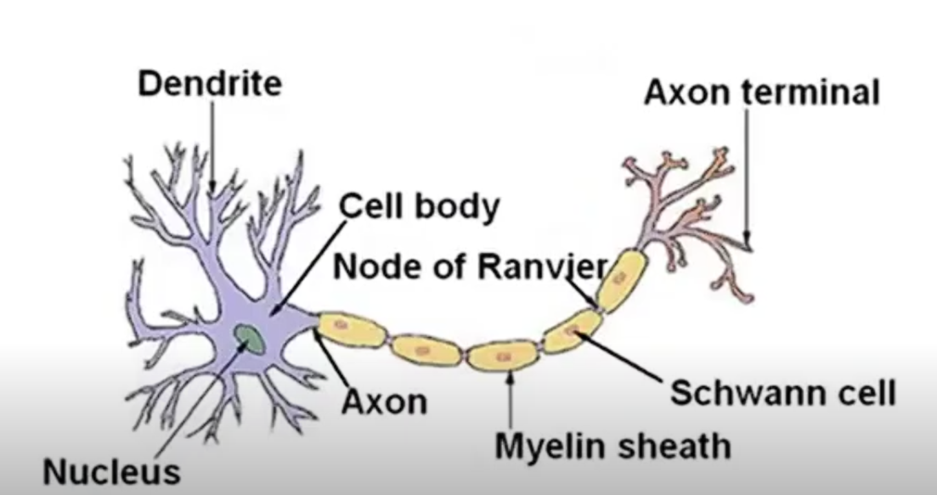
Simulation of neuron or network of neurons in brain

Slide 25
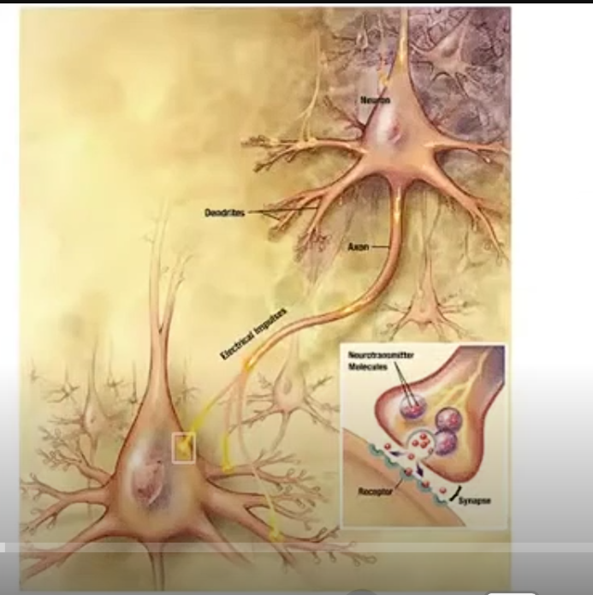
A single neuron: Nucleus , cell body, input wires(dendrites), axon(output wires), illustration of a group of neurons. Communicates with each other with a pulse of electricity which also called spicks. A neuron sends a message what it does sends a little pulse of electricity various axon to some different neurons and axon open wires and connects to info wire and connects to dendrites of a second neuron and accepts the message. This neuron does some computation and decide to send no messages on its axon to other neurons.

Slide 26
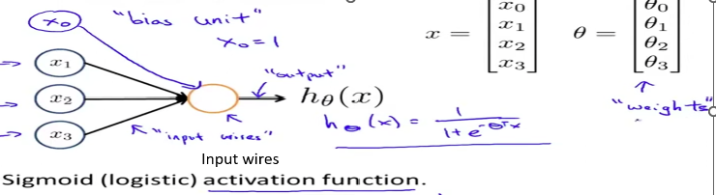
A single neuron model as a logistic model
Neuron Model: Logistic unit.
This is artificial neuron with activation function; with input x and parameter θ (weight)
h_{θ}(x) = 1/ 1+ e^{-θ T} x
^{X} ₀ as bias input and equals 0 . Input x is a vector and also a vector of parameters.
Activation function is equivalent of g(z) : g(z) = 1/ 1+ e ^{-z}
Input wires

Slide 27
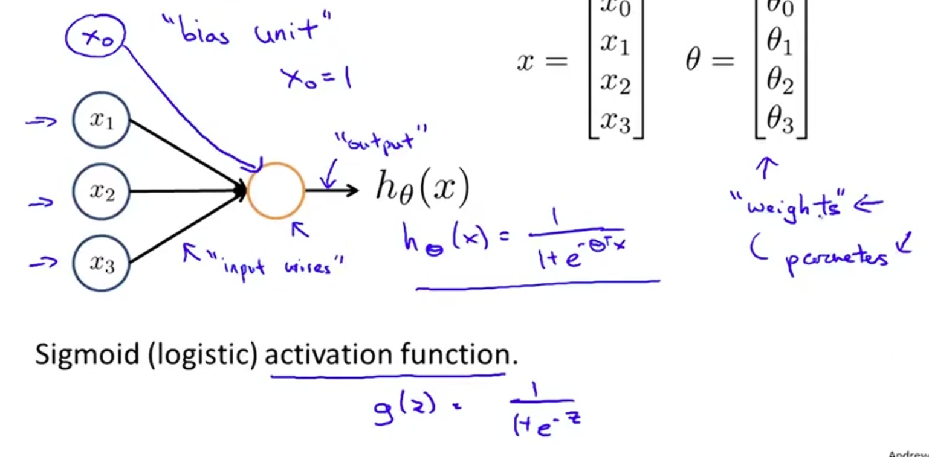
AI Neural Network_single neuron model
g(z) = 1/1 + e^{-z}

Slide 28
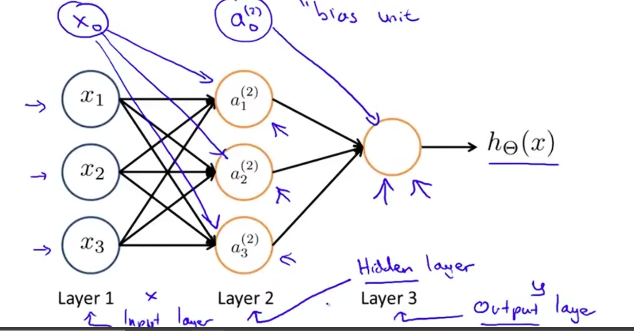
Neural Network as a group of neuron
Input layer, Hidden layer(not input and not output layer) , output layer

Slide 29
Function of the Neural Network
Neural Network Notation: Weight Matrices (θ)
Each connection between layers is parameterized by a matrix of weights, denoted θ^(j), where:
j indicates which layer transition this matrix controls
θ^(1) = weights mapping from Layer 1 → Layer 2
θ^(2) = weights mapping from Layer 2 → Layer 3 (and so on, for however many layers the network has)
v
a ^{j} _{I} = “activation of unit I in layer j
x1
a₁ ²
x2
A
v
Ɵ^{j} = matrix of weights controlling function mapping from layer j to layer j+1
Ɵ⁽¹⁾ ∊ ℝ ^{3x4}
a² ₂
h_{θ} (x)
v
x3
a ² ₃
a ₁² = g(Ɵ(1 )10 x0 + Ɵ⁽¹ ⁾₁₁ x1 + Ɵ⁽¹ ⁾₁₂ x2 + Ɵ⁽¹ ⁾₁₃ x3
a ₂² = g(Ɵ(1 )20 x0 + Ɵ⁽¹ ⁾₂₁ x1 + Ɵ⁽¹ ⁾₂₂ x2 + Ɵ⁽¹ ⁾₂₃ x3
a ₃² = g(Ɵ(1 )30 x0 + Ɵ⁽¹ ⁾₃₁ x1 + Ɵ⁽¹ ⁾₃₂ x2 + Ɵ⁽¹ ⁾₃₃ x3
h_{θ} (x) = a⁽³ ⁾ = g(Ɵ⁽² ⁾₁₀ a⁰ + Ɵ⁽² ⁾₁₁ a¹ + Ɵ⁽² ⁾₁₂ a² + Ɵ⁽² ⁾₁₃ a³

Slide 30
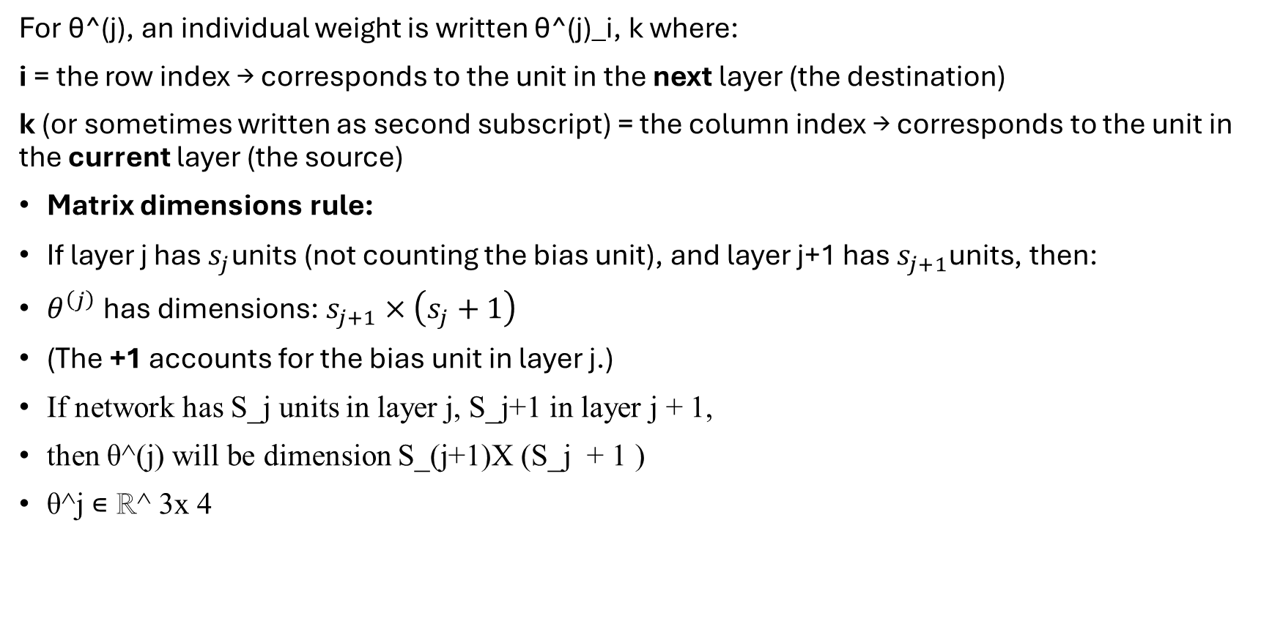
Matrix indexing convention:
For θ^(j), an individual weight is written θ^(j)_i, k where:
i = the row index → corresponds to the unit in the next layer (the destination)
k (or sometimes written as second subscript) = the column index → corresponds to the unit in the current layer (the source)
Matrix dimensions rule:
If layer j has $s_{j}$units (not counting the bias unit), and layer j+1 has $s_{j+1}$units, then:
$θ^{\left(j\right)}\text{ has dimensions: }s_{j+1}×\left(s_{j}+1\right)$
(The +1 accounts for the bias unit in layer j.)
If network has S_j units in layer j, S_j+1 in layer j + 1,
then θ^(j) will be dimension S_(j+1)X (S_j + 1 )
θ^j ∊ ℝ^ 3x 4

Slide 31
If a neural network with x_1, x_2, x_3 inputs and a_1^2, a_2^2, a_3^2 in hidden layer or layer 2 and third layer of output with h_{θ} (x).
Network has S_j units in layer j, S_j+1 in layer j_j+1, then θ^j will be the dimension of S_j+1 x S_j + 1.
Double check: S units in layer 1 (3 units) S_J+1 units in layer 2 or 6 units in my case, S_j + 1 in third layer or 6 + 1 units?
Θ^1 ϵ ꓣ^3x4
Is it a correct notation? 3 row and 4 columns?

Slide 32
WEIGHT MATRIX DEIMENSIONS
The general rules is:
θ^{j} ϵℝ^{s}_{j}^{+1x s}_{j} ⁺ ¹
The rows correspond to units in layer j +1
The columns correspond to units in layer j, plus one for the bias unit
^{Example:}
^{1) From layer 1 to layer 2}
  S1 ^{= 3 units (input units)}
  S2 ^{= 6 units(hidden units)}
  So, θ ⁽¹⁾ ϵ ℝ^{s}_{j}^{+1x s}_{j} ^{+ 1 →} ϵℝ ^{6x (3} ^{+ 1) →} ϵℝ ^{6x 4}
2) From layer 2 to layer 3
  θ ⁽¹⁾ ϵ ℝ^{s}_{j}^{+1x s}_{j} ^{+ 1 →} ϵℝ ^{1 x (6} ^{+ 1) →} ϵℝ ^{1x 7}
θj ϵℝsj+1x sj + 1
Where:
S_{j} : number of non-bias units in layer j
S_{j+1} : number of non-bias units in layer j + 1
+1 accounts for bias unit in layer j

Slide 33
Why this matters
Each row of θ^{(j )} corresponds to one unit in layer j+ 1
Each column corresponds to one unit in layer including the bias unit
So, the matrix maps augmented activations from layer j to pre-activations in layer j + 1

Slide 34
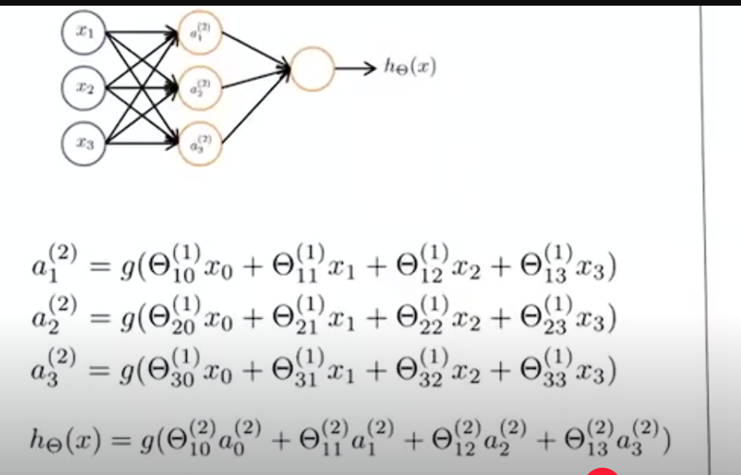
Intuition of what these hypotheses do?
The artificial network which defines the function H that maps from x’s input values to hopefully to space of predictions Y and these hypotheses are parameterized by parameters that are denoted with capital theta so as we wary theta we get different hypotheses or different functions mapping say from x to y. Intuition of what these hypotheses do? Some examples and how to compute these functions efficiently.
How to carry out these computations efficiently and implement them by vectorization. That is to show you a vectorized implementation.
Start to giving you intuition about why these neural network representations might be a good idea and how they can help us to learn complex nonlinear hypothesis. Consider this neural network:

Slide 35
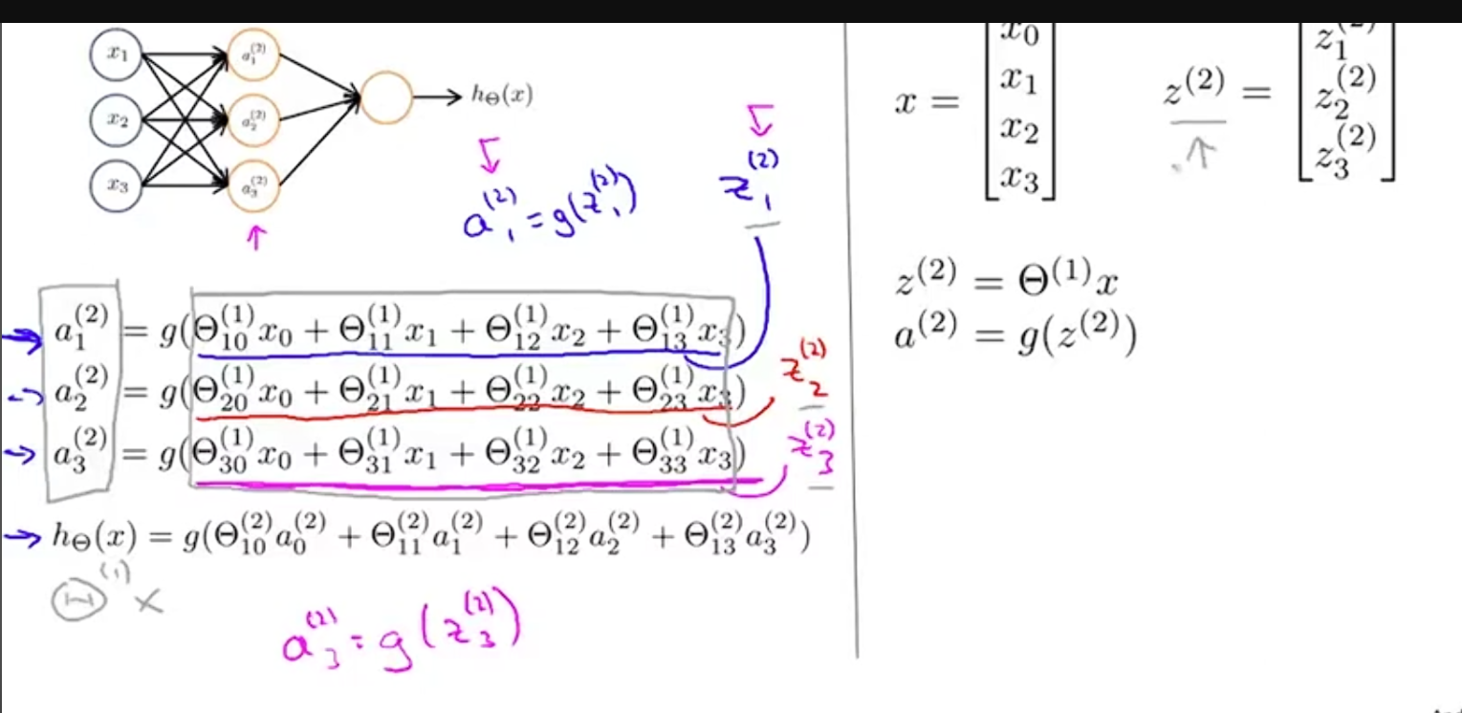
Sequences of steps are needed to compute the output of hypotheses these equations given on the left where we compute the activation values completely need units then we use those to compute the final output out hypotheses H of x. Now, we define a few extra terms. So, this term underlining here
2= indicate Hidden layer

Slide 36
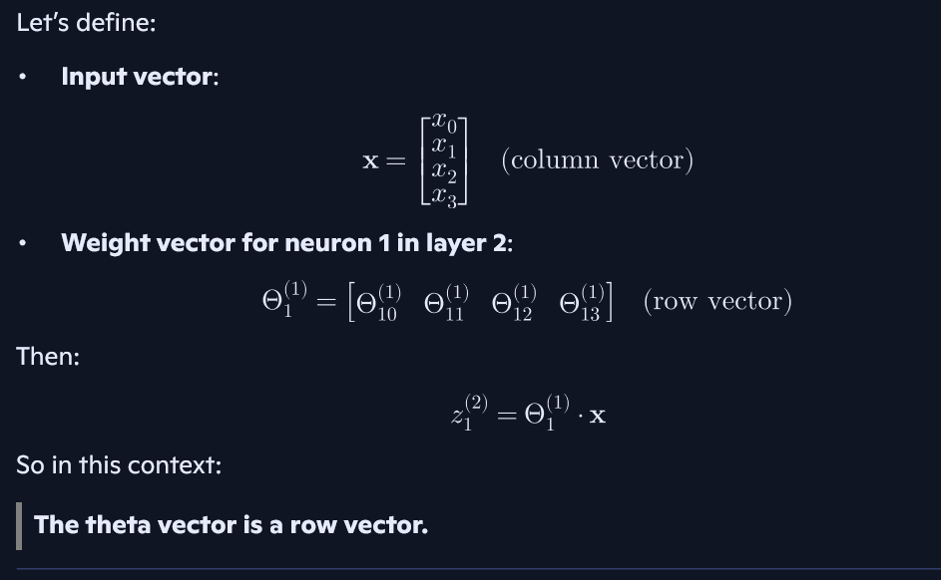

Slide 37
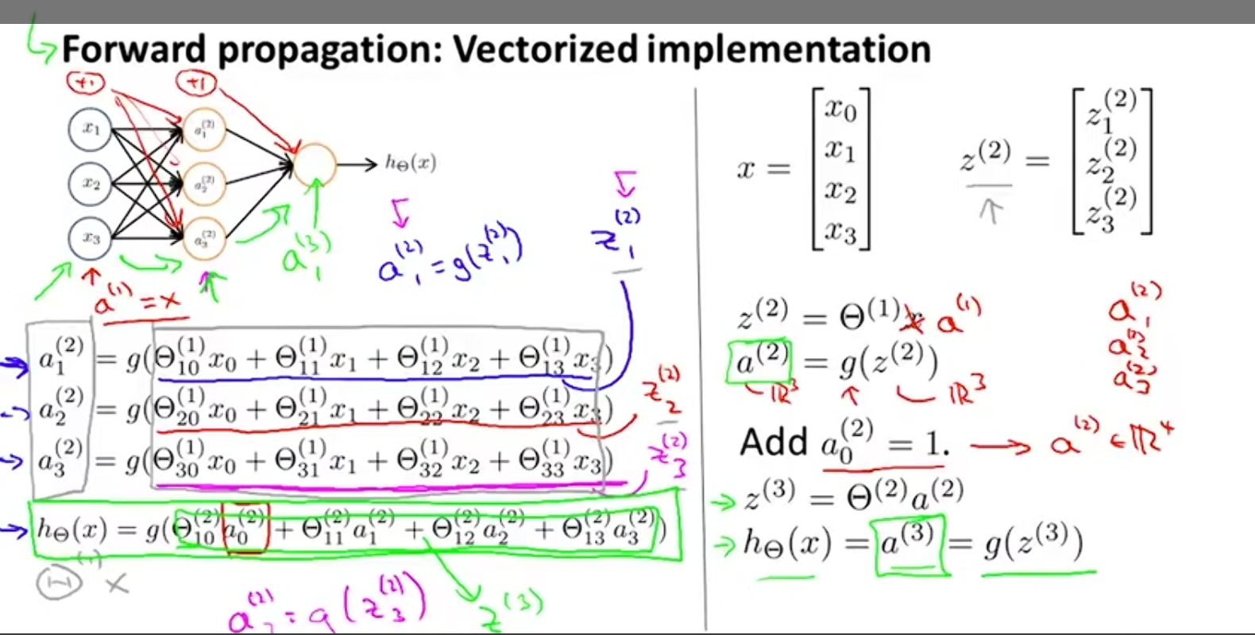

Slide 38

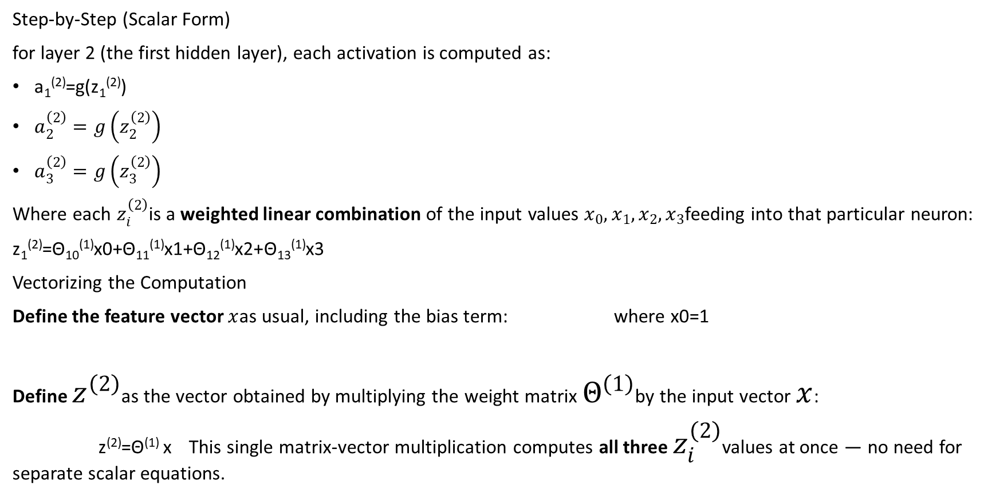
Vectorizing Forward Propagation
Step-by-Step (Scalar Form)
for layer 2 (the first hidden layer), each activation is computed as:
a₁⁽²⁾​=g(z₁^{(2)​})
$a_{2}^{\left(2\right)}=g\left(z_{2}^{\left(2\right)}\right)$
$a_{3}^{\left(2\right)}=g\left(z_{3}^{\left(2\right)}\right)$
Where each $z_{i}^{\left(2\right)}$is a weighted linear combination of the input values $x_{0},x_{1},x_{2},x_{3}$feeding into that particular neuron:
z₁^{(2)​}=Θ₁₀^{(1)​}x0​+Θ₁₁⁽¹⁾​x1​+Θ₁₂⁽¹⁾​x2​+Θ₁₃⁽¹⁾​x3​
Vectorizing the Computation
Define the feature vector $x$as usual, including the bias term: where x0​=1
Define $z^{\left(2\right)}$as the vector obtained by multiplying the weight matrix $Θ^{\left(1\right)}$by the input vector $x$:
z⁽²⁾=Θ⁽¹⁾ x This single matrix-vector multiplication computes all three $z_{i}^{\left(2\right)}$values at once — no need for separate scalar equations.

Slide 39
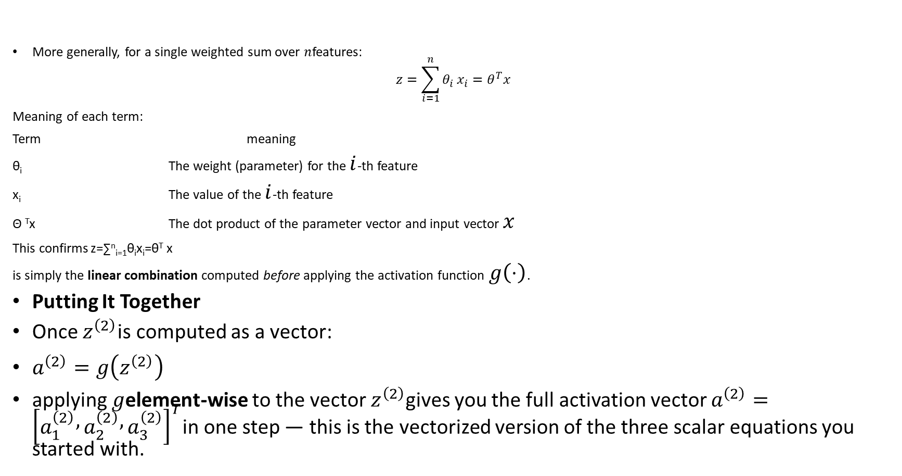
The General Linear Combination (Dot Product Form)
More generally, for a single weighted sum over $n$features:
$$z=\sum_{i=1}^{n}{θ_{i}}x_{i}=θ^{T}x$$
Meaning of each term:
Term meaning
θ_{i​} The weight (parameter) for the $i$-th feature
x_{i​} The value of the $i$-th feature
Θ ^{T}x The dot product of the parameter vector and input vector $x$
This confirms z=∑^{n}_{i=1}θ_{i​}x_{i}​=θ^{T} x
is simply the linear combination computed before applying the activation function $g\left(⋅\right)$.
Putting It Together
Once $z^{\left(2\right)}$is computed as a vector:
$a^{\left(2\right)}=g\left(z^{\left(2\right)}\right)$
applying $g$element-wise to the vector $z^{\left(2\right)}$gives you the full activation vector $a^{\left(2\right)}={\left[a_{1}^{\left(2\right)} , a_{2}^{\left(2\right)} , a_{3}^{\left(2\right)}\right]}^{T}$in one step — this is the vectorized version of the three scalar equations you started with.

Slide 40
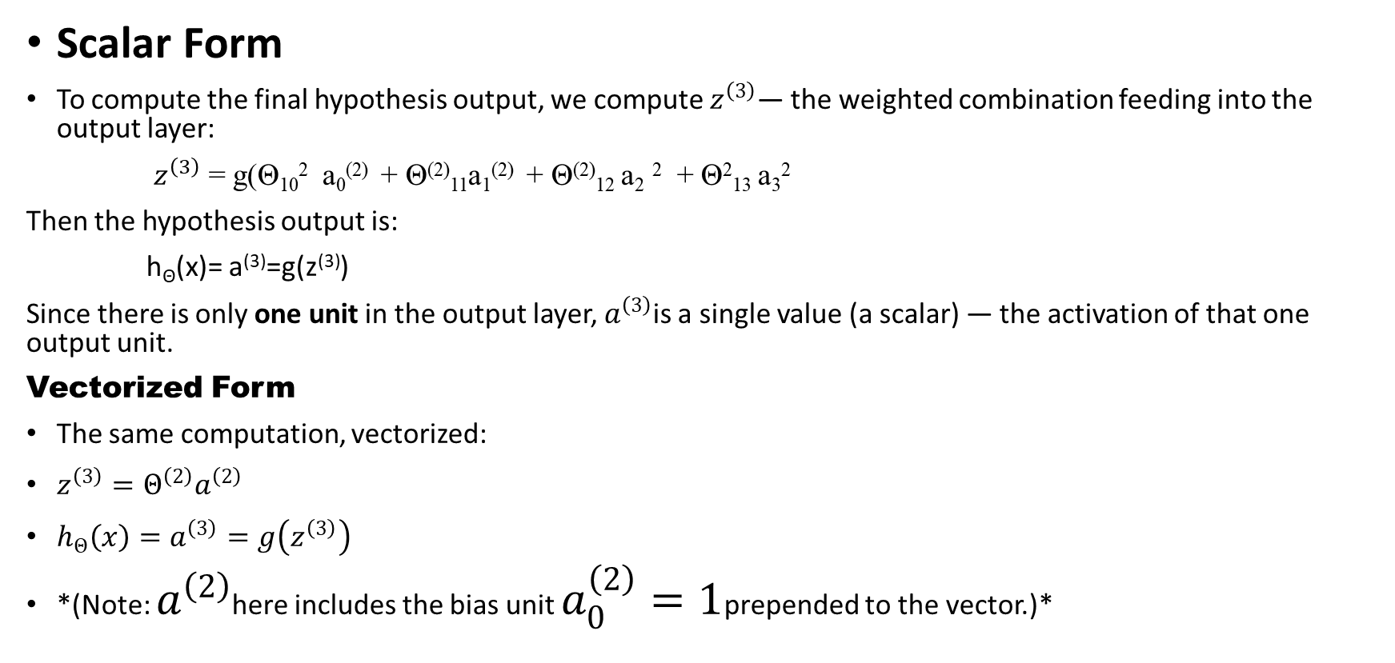
Computing the Output Layer (Forward Propagation, Final Step)
Scalar Form
To compute the final hypothesis output, we compute $z^{\left(3\right)}$— the weighted combination feeding into the output layer:
$z^{\left(3\right)}$= g(Θ₁₀² a₀⁽²⁾ + Θ⁽²⁾₁₁a₁⁽²⁾ + Θ⁽²⁾₁₂ a₂ ² + Θ²₁₃ a₃²
Then the hypothesis output is:
h_{Θ​}(x)= a⁽³⁾=g(z⁽³⁾)
Since there is only one unit in the output layer, $a^{\left(3\right)}$is a single value (a scalar) — the activation of that one output unit.
Vectorized Form
The same computation, vectorized:
$z^{\left(3\right)}=Θ^{\left(2\right)}a^{\left(2\right)}$
$h_{Θ}\left(x\right)=a^{\left(3\right)}=g\left(z^{\left(3\right)}\right)$
*(Note: $a^{\left(2\right)}$here includes the bias unit $a_{0}^{\left(2\right)}=1$prepended to the vector.)*

Slide 41

Breaking Down the Dimensions
$a^{\left(2\right)}$—
a⁽²⁾=​
a₀⁽²⁾
a​₁^{(2)​}
a₂^{(2)​}
​​​a₃⁽²⁾ ∈R⁴
A vector of 4 elements (bias + 3 activations). ✅
Θ(2) — This is a matrix, with dimensions determined by the rule from earlier:
$Θ^{\left(j\right)}\text{ has dimensions: }s_{j+1}×\left(s_{j}+1\right)$
Here:
$s_{2}=3$(3 units in layer 2, not counting bias)
$s_{3}=1$(1 unit in the output layer, layer 3)
So:
$Θ^{\left(2\right)}\text{ has dimensions: }1×4$

Slide 42
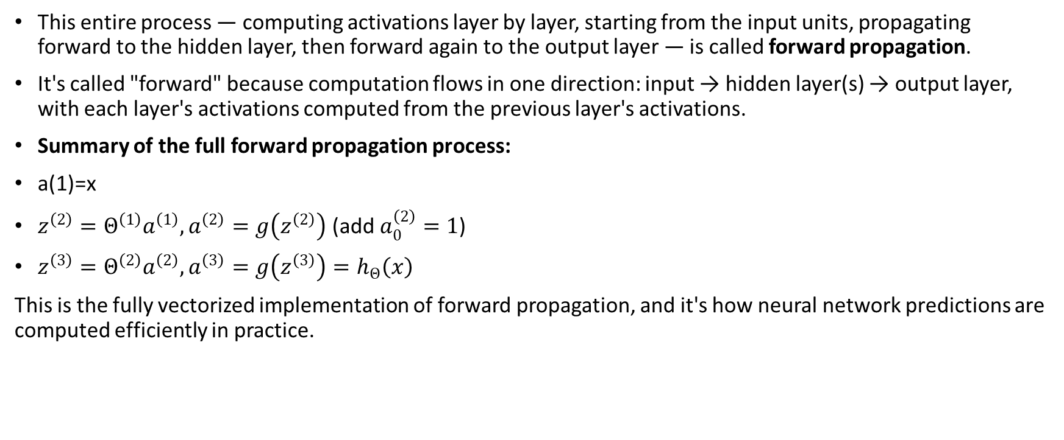
What This Process Is Called
This entire process — computing activations layer by layer, starting from the input units, propagating forward to the hidden layer, then forward again to the output layer — is called forward propagation.
It's called "forward" because computation flows in one direction: input → hidden layer(s) → output layer, with each layer's activations computed from the previous layer's activations.
Summary of the full forward propagation process:
a(1)=x
$z^{\left(2\right)}=Θ^{\left(1\right)}a^{\left(1\right)}, a^{\left(2\right)}=g\left(z^{\left(2\right)}\right)\text{ (add }a_{0}^{\left(2\right)}=1\text{)}$
$z^{\left(3\right)}=Θ^{\left(2\right)}a^{\left(2\right)}, a^{\left(3\right)}=g\left(z^{\left(3\right)}\right)=h_{Θ}\left(x\right)$
This is the fully vectorized implementation of forward propagation, and it's how neural network predictions are computed efficiently in practice.

Slide 43
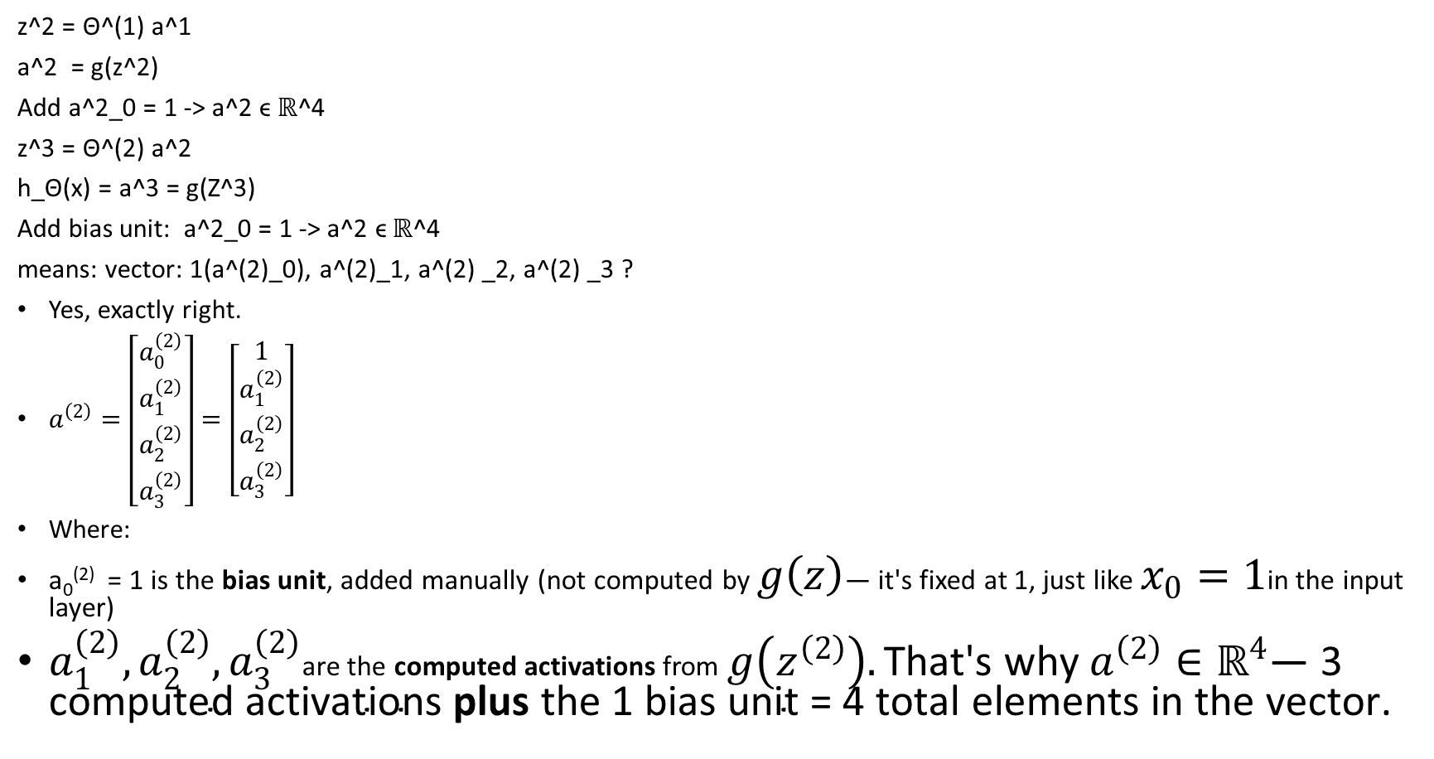
z^2 = Θ^(1) a^1
a^2 = g(z^2)
Add a^2_0 = 1 -> a^2 ϵ ℝ^4
z^3 = Θ^(2) a^2
h_Θ(x) = a^3 = g(Z^3)
Add bias unit: a^2_0 = 1 -> a^2 ϵ ℝ^4
means: vector: 1(a^(2)_0), a^(2)_1, a^(2) _2, a^(2) _3 ?
Yes, exactly right.
$a^{\left(2\right)}=\left[\begin{matrix}a_{0}^{\left(2\right)} \\ a_{1}^{\left(2\right)} \\ a_{2}^{\left(2\right)} \\ a_{3}^{\left(2\right)}\end{matrix}\right]=\left[\begin{matrix}1 \\ a_{1}^{\left(2\right)} \\ a_{2}^{\left(2\right)} \\ a_{3}^{\left(2\right)}\end{matrix}\right]$
Where:
a₀⁽²⁾​ = 1 is the bias unit, added manually (not computed by $g\left(z\right)$— it's fixed at 1, just like $x_{0}=1$in the input layer)
$a_{1}^{\left(2\right)},a_{2}^{\left(2\right)},a_{3}^{\left(2\right)}$are the computed activations from $g\left(z^{\left(2\right)}\right).\text{That′s why }a^{\left(2\right)}∈ℝ^{4}\text{— 3 computed activations }\text{plus}\text{ the 1 bias unit = 4 total elements in the vector.}$

Slide 44
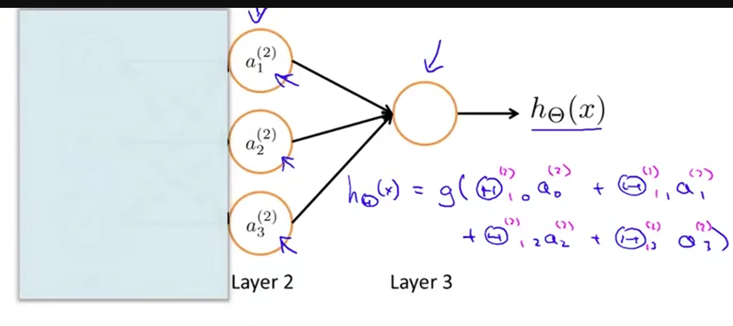
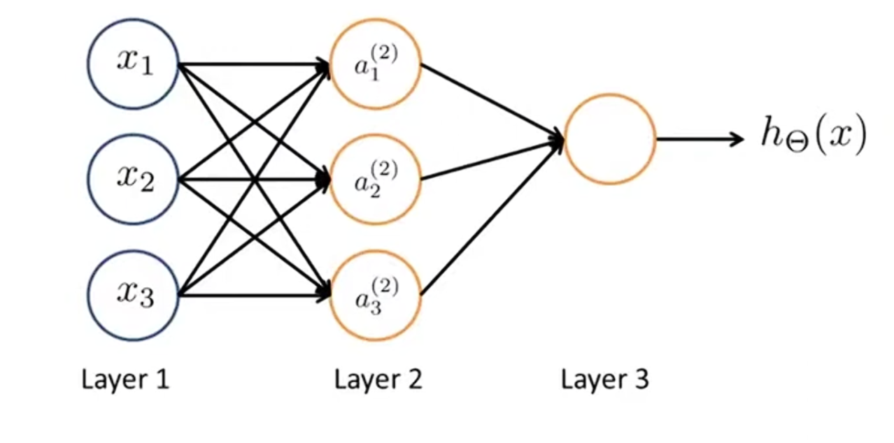
This will give an efficient way a relatively efficient of computing H of X this forward propagation view. Consider the following diagram of the neural network and cover up the left part. This looks a lot logistic regression
What we are doing is using bad node that is just a logistic regression unit to predict H of X. and concretely what the hypothesis outputting H of X is going equal to G which is my sigmoid activation function times θ₀ times our a₀ plus θ ₁ times a₁ plus θ₂ times a₂ plus θ₃ times a₃ where values a₁ a₂ a₃ are those given by these 3 units now.
This is jus a logistic regression, but the features get into logistic regression are these values computed by the hidden layer just . Neural network doing same as the logistic regression except that rather than using the original feature x1 x2 x3 now using new a₁ a₂ a_{3 .} a₁ a₂ a₃ they themselves learned as function of input concretely the function mapping from layer 1 to layer 2 that determined by set of other parameters θ _{1.} “It’s as if, instead of being constrained to feed the raw input features x1 x2 x3 directly into logistic regression, the neural network learns its own intermediate features 𝑎1,𝑎2,𝑎3, which are then passed to logistic regression.”

Slide 45
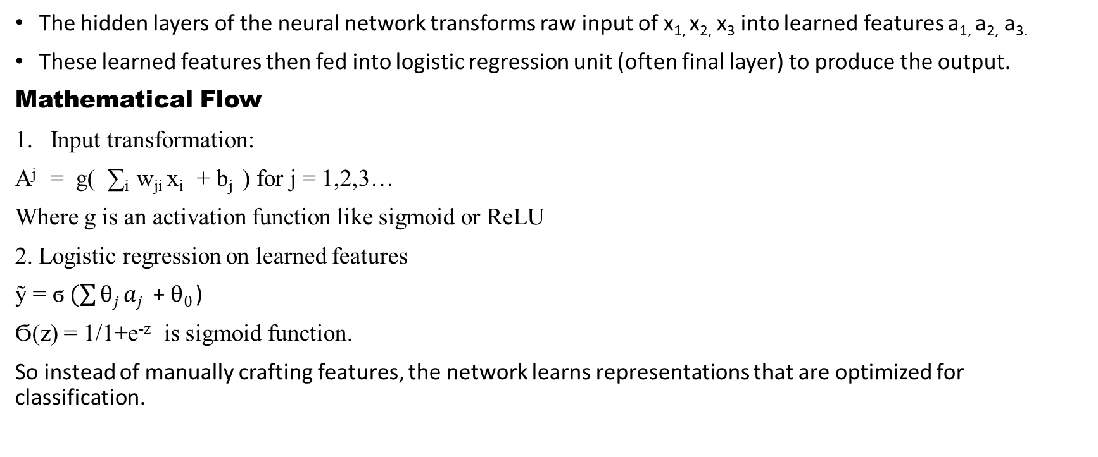
The architecture
The hidden layers of the neural network transforms raw input of x_{1,} x_{2,} x₃ into learned features a_{1,} a_{2,} a_{3.}
These learned features then fed into logistic regression unit (often final layer) to produce the output.
Mathematical Flow
Input transformation:
A^{j} = g( ∑_{i} w_{ji} x_{i} + b_{j} ) for j = 1,2,3…
Where g is an activation function like sigmoid or ReLU
2. Logistic regression on learned features
ỹ = ϭ$(\sum{θj aj }$+ $θ0$ )
Ϭ(z) = 1/1+e^{-z} is sigmoid function.
So instead of manually crafting features, the network learns representations that are optimized for classification.

Slide 46
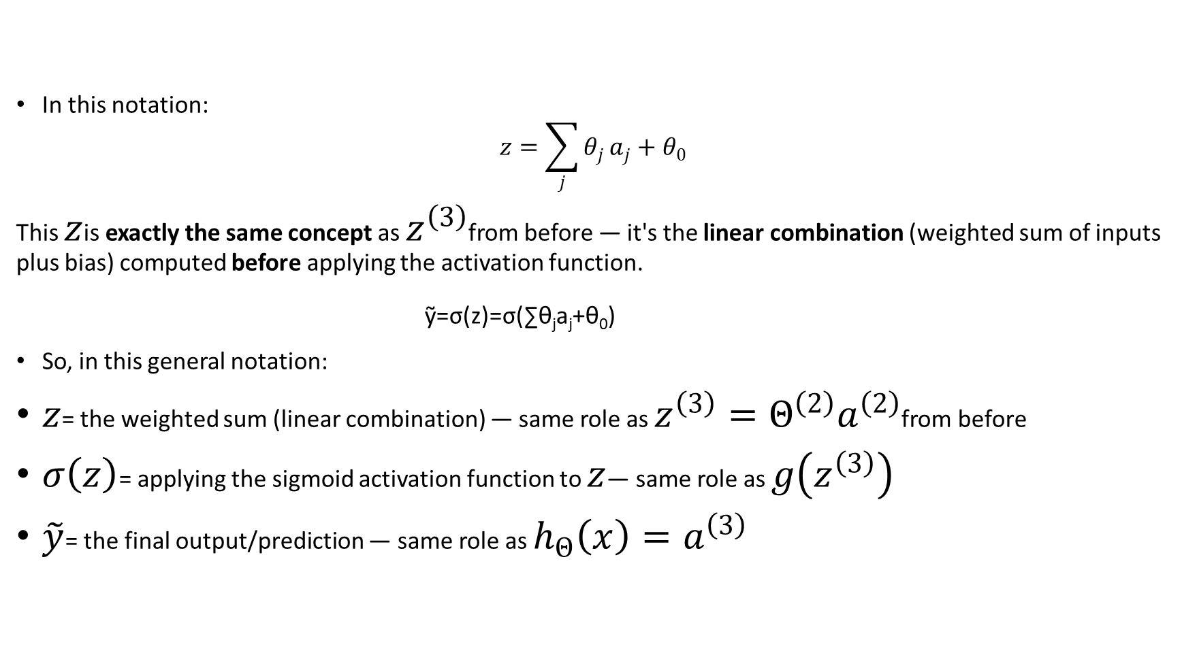
What is $z$ Here?
In this notation:
$$z=\sum_{j}{θ_{j}}a_{j}+θ_{0}$$
This $z$is exactly the same concept as $z^{\left(3\right)}$from before — it's the linear combination (weighted sum of inputs plus bias) computed before applying the activation function.
ỹ​=σ(z)=σ(∑​θ_{j}​a_{j}​+θ₀​)
So, in this general notation:
$z$= the weighted sum (linear combination) — same role as $z^{\left(3\right)}=Θ^{\left(2\right)}a^{\left(2\right)}$from before
$σ\left(z\right)$= applying the sigmoid activation function to $z$— same role as $g\left(z^{\left(3\right)}\right)$
$\tilde{y}$= the final output/prediction — same role as $h_{Θ}\left(x\right)=a^{\left(3\right)}$

Slide 47
Why This Matters
This is the core of deep learning’s power:
  It automates feature engineering.
  It adapts to complex, nonlinear patterns.
  It builds hierarchical representations—especially in deeper networks.

Slide 48
Example of how neural network can use hidden layer to compute more complex features to feed into this final output layer
How that can learn more complex hypotheses .
Neural network architecture: How the second layer here we have three hidden units that are computing more complex functions maybe of the compeller then the third layer can take the second layer’s features and compute even more complex features in layer three so by the time get upper layer therefore you can have even more complex features .
The next detailed examples show how neural network can use to compute non leaner functions of input and hope fully now give you good sense of the sorts of non-linear hypothesis we can get out of our neural networks in.

Slide 49
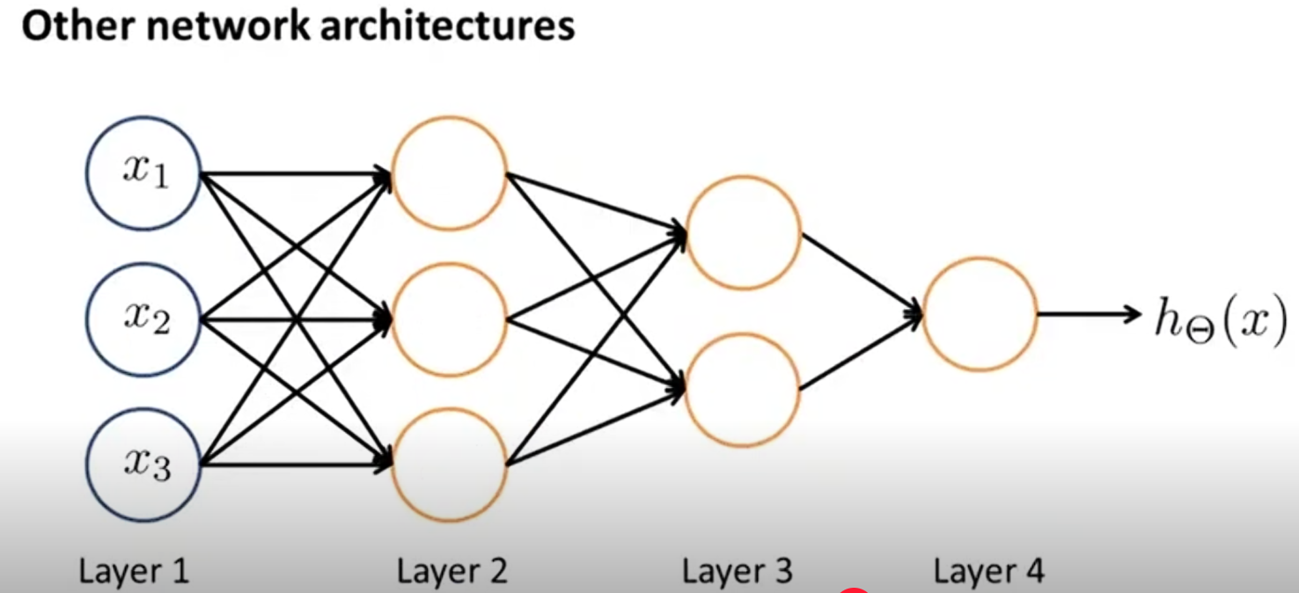
Other types of neural network architecture

Slide 50
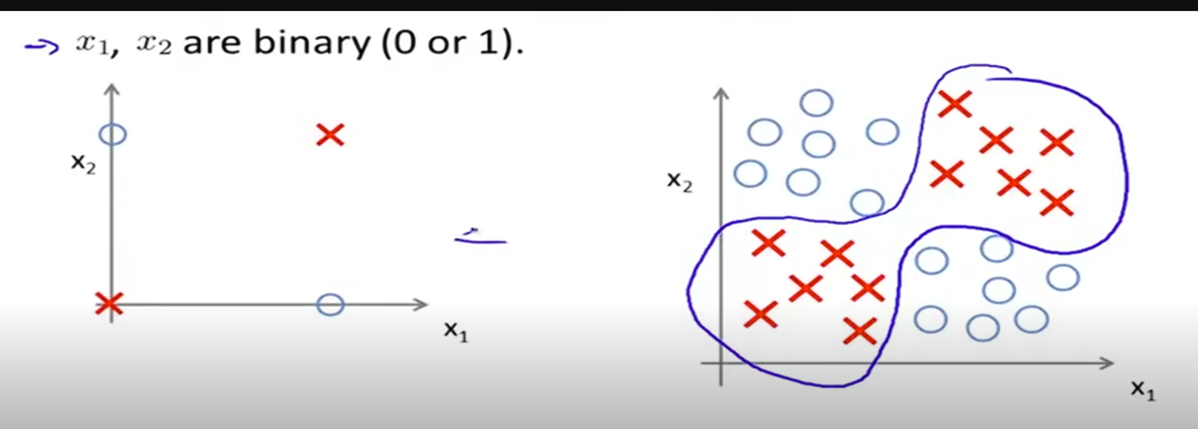

Consider: a simple classification problem with two binary input features, $x_{1},x_{2}∈\left\{0 , 1\right\}$.
Plotted on a graph, the positive and negative examples cannot be separated by a single straight line — this is a non-linear decision boundary problem, even though it looks simple. It's a simplified stand-in for more complex, real-world non-linear classification problems.
what we would like to do is learn a non liner decision boundary there may be to separate the positive and negative .
So, how can neural network do this? Let’s work on a simple example rather than on the complex example on the right.

Slide 51
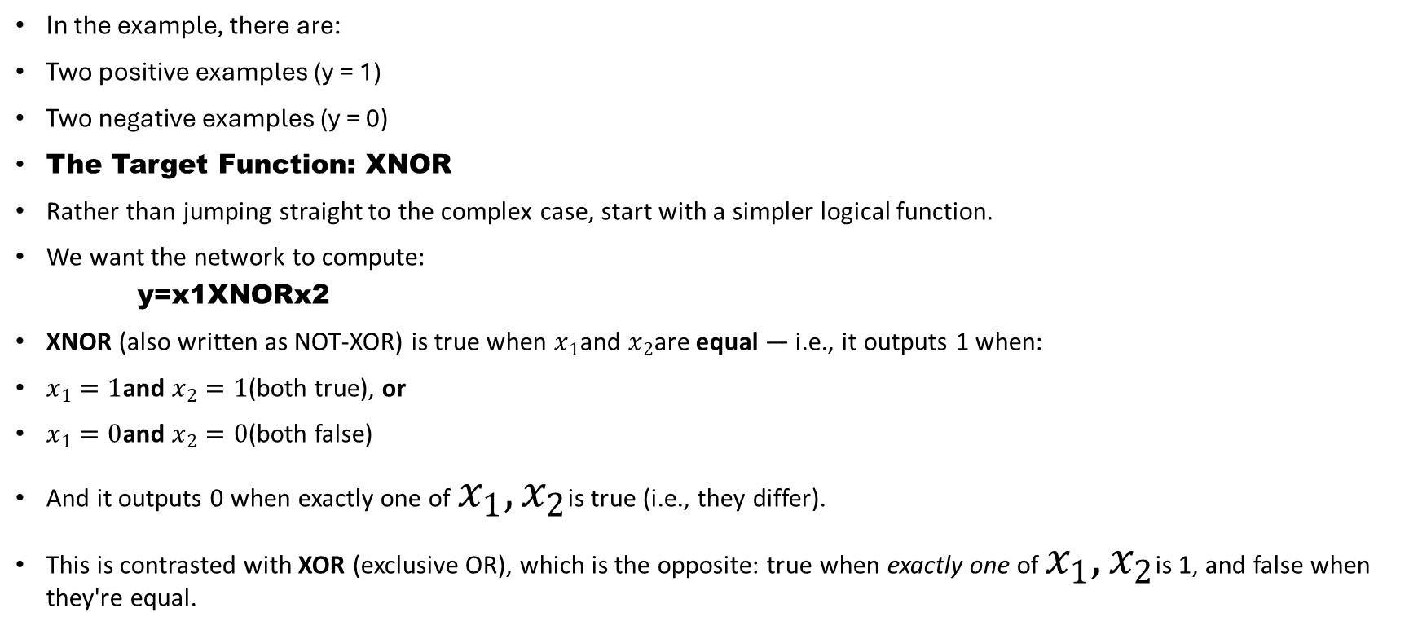
Non-Linear Decision Boundaries: The XNOR Example
In the example, there are:
Two positive examples (y = 1)
Two negative examples (y = 0)
The Target Function: XNOR
Rather than jumping straight to the complex case, start with a simpler logical function.
We want the network to compute:
    y=x1​XNORx2​
XNOR (also written as NOT-XOR) is true when $x_{1}$and $x_{2}$are equal — i.e., it outputs 1 when:
$x_{1}=1$and $x_{2}=1$(both true), or
$x_{1}=0$and $x_{2}=0$(both false)
And it outputs 0 when exactly one of $x_{1},x_{2}$is true (i.e., they differ).
This is contrasted with XOR (exclusive OR), which is the opposite: true when exactly one of $x_{1},x_{2}$is 1, and false when they're equal.

Slide 52

Plotting these four points, the two positive examples (0,0) and (1,1) sit on opposite corners, and the two negative examples (0,1) and (1,0) sit on the other opposite corners. No single straight line can separate the positives from the negatives — this requires a non-linear decision boundary.

Slide 53
The Strategy: Build XNOR from Simpler Logical Gates
Since XNOR itself is non-linear and hard to learn directly, the approach is to build it up from simpler logical functions that a single-layer network can represent:
AND
OR
NOT (or equivalently, NOR)
Each of these simpler logical functions is linearly separable, and can be represented by a single neuron (single layer of computation). By combining multiple such neurons in a multi-layer network, you can construct the more complex, non-linear XNOR function.
This demonstrates a key idea: a neural network builds complex, non-linear functions by composing simpler linear/logical building blocks across layers — which is exactly why depth (multiple layers) gives neural networks their expressive power.

Slide 54
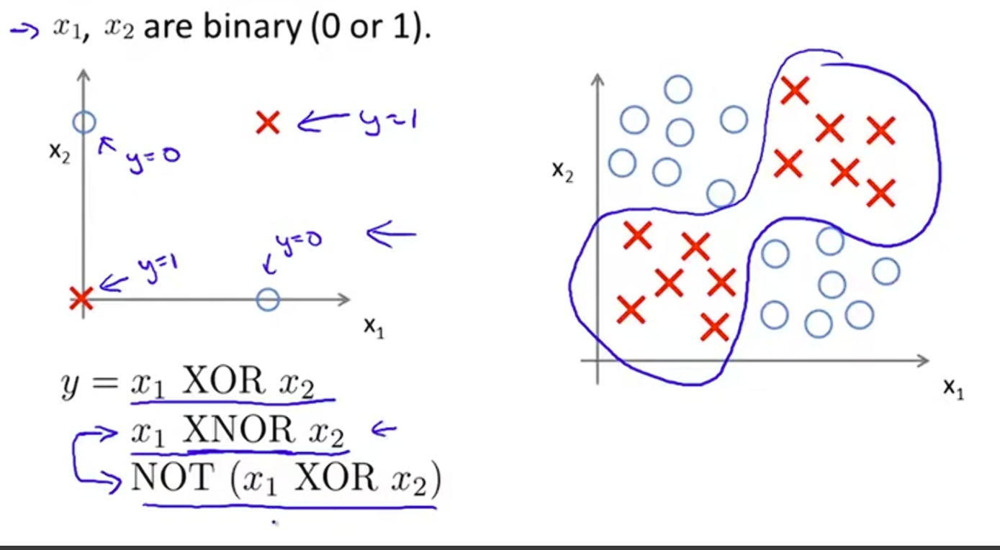
Both x ₁ and x₂ are not true
Both x ₁ and x₂ are true
Target value of y = x1 or x2
Not equal to x1 or x2.
Alter notation id Not(X1 XOR x2)

Slide 55
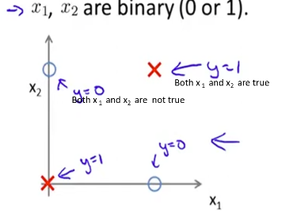
Truth table for XNOR(y)
X₁ | X₂ | Both x ₁ and x₂ are true
0 | 0 | 1
0 | 1 | 0
1 | 0 | 0
1 | 1 | 1

Slide 56
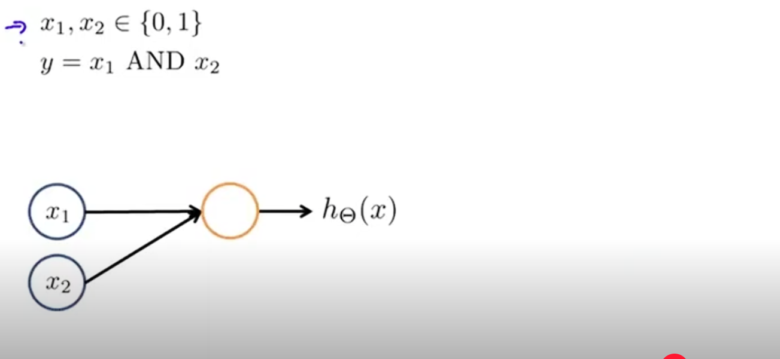
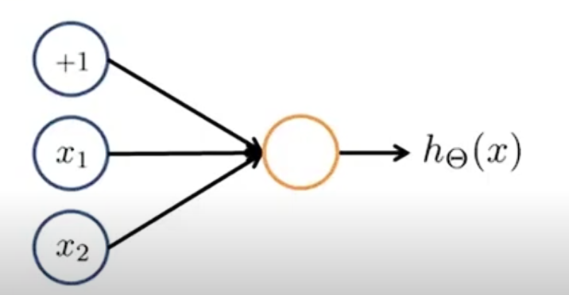
Show “and” network
x₁,x₂ ϵ {0,1}
y = x₁ AND x₂
Draw a bias unit to this net. assign some values: parameters with values -30 , + 20 , + 20
One logic unit to complete AND computation

Slide 57
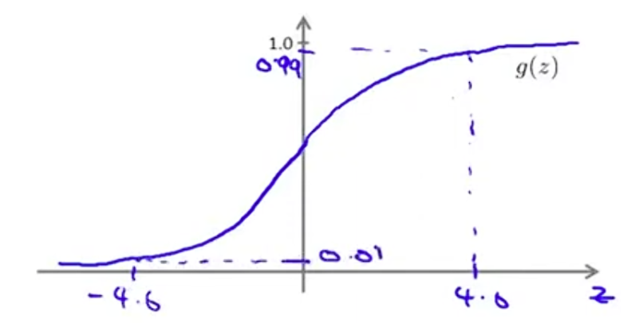
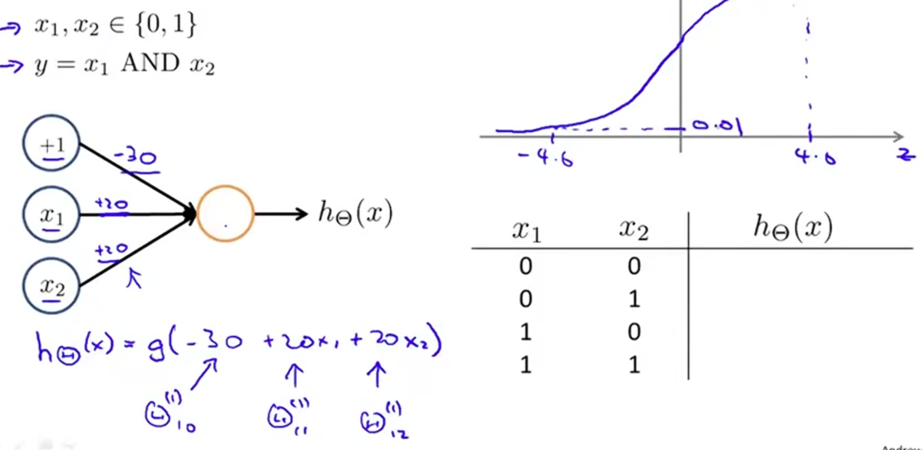
h_{Ѳ} (x) = Ѳ⁽¹⁾₁₀ + Ѳ⁽¹⁾₁₁ + Ѳ⁽¹⁾₁₂
Value of σ function
Value of z

Slide 58
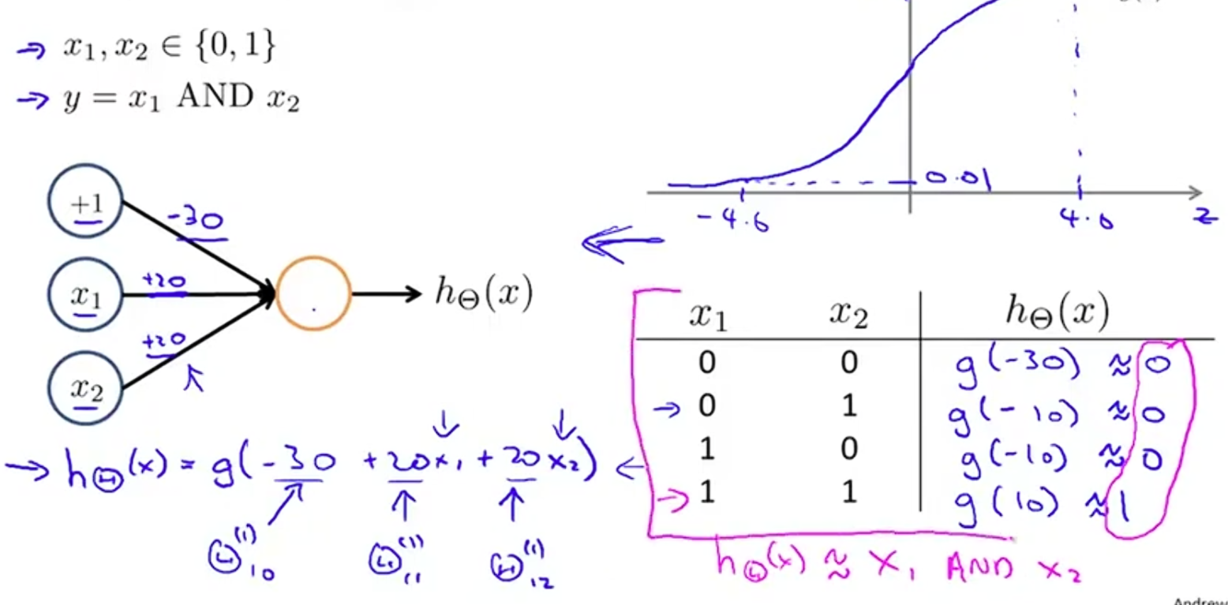
hθ (x)=g(-10) g(-10 ) = 1/(1+ 𝑒 −(−10)) = = 1/(1+ 𝑒+10)) = 1/(1+22026.465795) = 0.000045

Slide 59
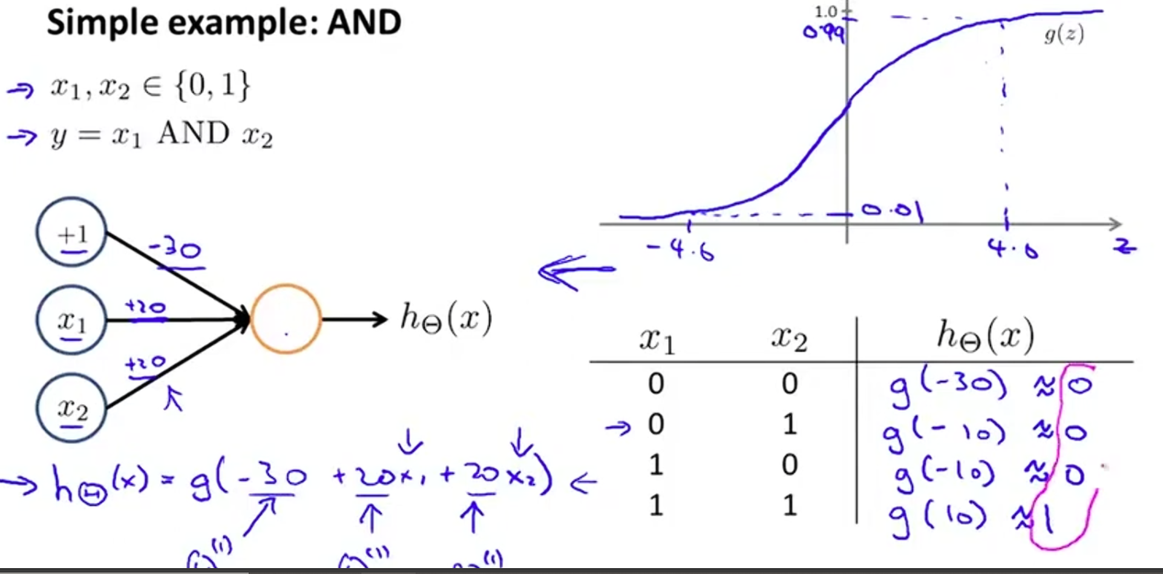
Logical AND function

Slide 60
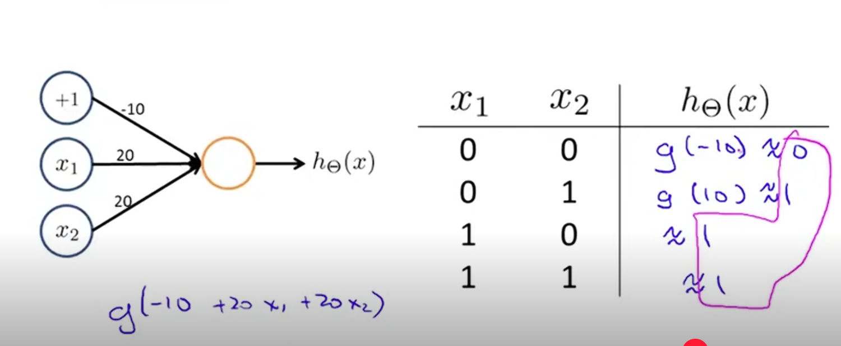
Simple example for or function:
0 0 = 0 means logical OR
0 = 1
….
Logical OR

Slide 61
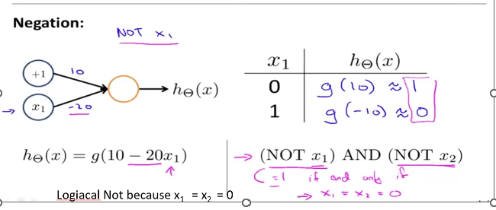
Neural network with a complex non-linear hypthses
Logiacal Not because x₁ = x₂ = 0

Slide 62
Negation

Slide 63
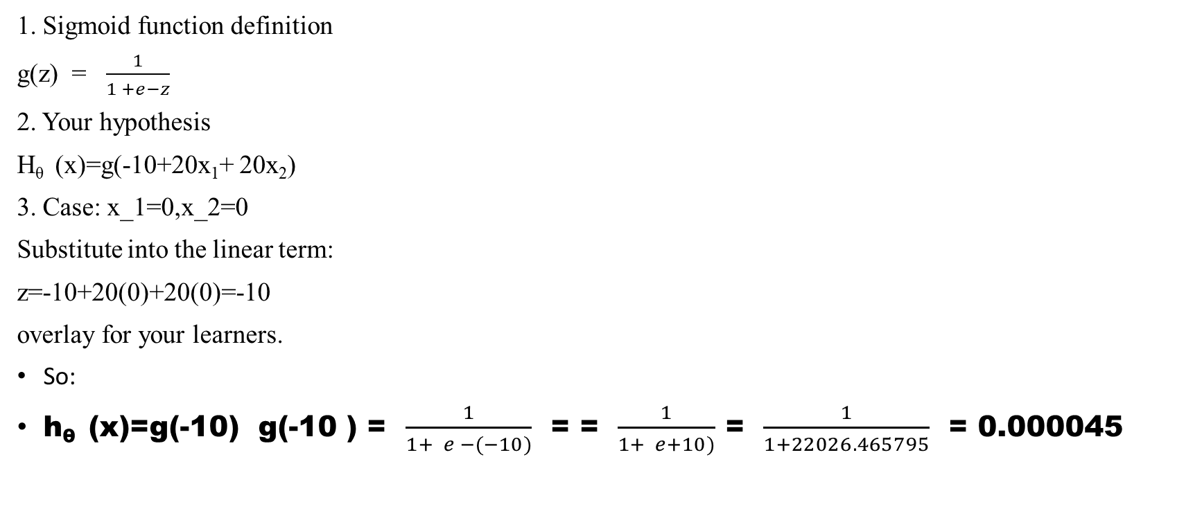
1. Sigmoid function definition
g(z) = $\frac{1}{1 +e−z}$
2. Your hypothesis
H_{θ} (x)=g(-10+20x₁+ 20x₂)
3. Case: x_1=0,x_2=0
Substitute into the linear term:
z=-10+20(0)+20(0)=-10
overlay for your learners.
So:
h_{θ} (x)=g(-10) g(-10 ) = $\frac{1}{1+ e −(−10)}$ = = $\frac{1}{1+ e+10)}$ = $\frac{1}{1+22026.465795}$ = 0.000045

Slide 64
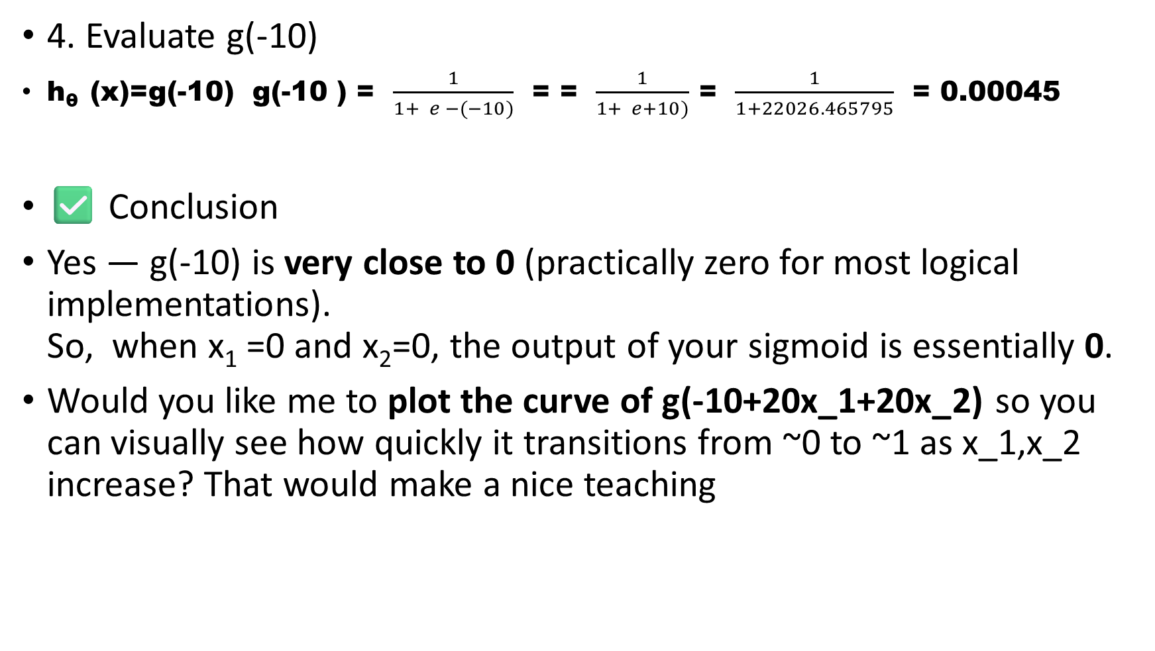
4. Evaluate g(-10)
h_{θ} (x)=g(-10) g(-10 ) = $\frac{1}{1+ e −(−10)}$ = = $\frac{1}{1+ e+10)}$ = $\frac{1}{1+22026.465795}$ = 0.00045
✅ Conclusion
Yes — g(-10) is very close to 0 (practically zero for most logical implementations).
So, when x₁ =0 and x₂=0, the output of your sigmoid is essentially 0.
Would you like me to plot the curve of g(-10+20x_1+20x_2) so you can visually see how quickly it transitions from ~0 to ~1 as x_1,x_2 increase? That would make a nice teaching

Slide 65
Negation

Slide 66
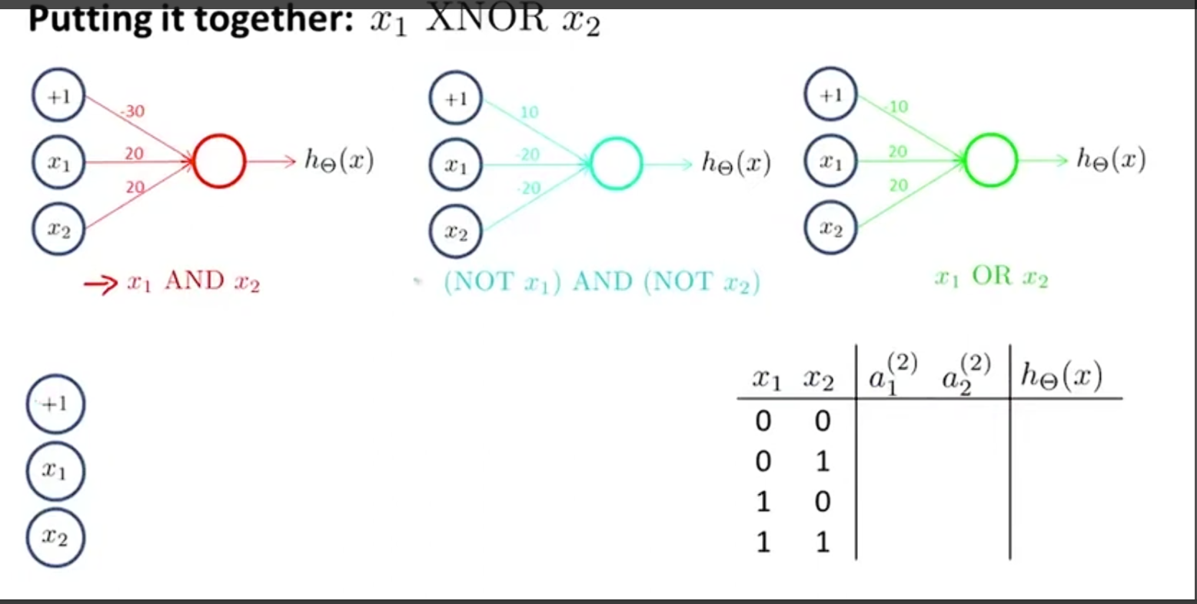

Slide 67
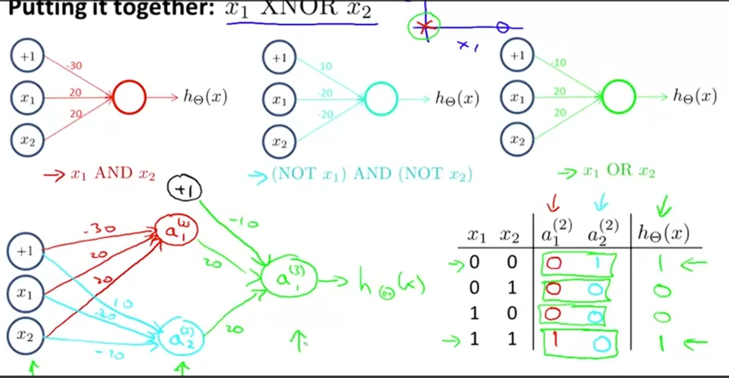

Slide 68

The third layer compute even more complex function

Slide 69
Application of neural network
The deeper layers computing more complex features. Second hidden layer compute complex problem and next hidden layer even compute more complex problem.
Recognition of handwriting : Prof. Yann LeCun NYU
This algorithm is trying to address the problem of reading zip code.
In the late 1980s and 1990s, LeCun developed CNNs, a technology modeled after the biological visual cortex. This breakthrough revolutionized how computers process images, directly enabling modern facial recognition, self-driving cars, and medical imaging analysis.

Slide 70

let’s take a look at video (from Prof. Andrew Ng)
The main content or input area contains handwritten characters shown to the network.
The left column shows a visualization of figures computed by first hidden layer of neural network. This visualization shows different figures and different ages and lines.
The visualization of next hidden layer is hard to see and understand. It is hard to see what is going on beyond of the first hidden layer, but then finally all of these learned figures get sent to the output layer.
And shown over here is the final predicted value for recognition of digits by neural network. The video can be watched by clicking the link on the next slide.
https://youtu.be/SGEroEKFbnY?t=3390

Slide 71
Video Demo: Neural Network Handwritten Digit Recognition
Main/input area: Handwritten digits are shown to the network as input.
Left column — First hidden layer visualization: shows a visualization of figures computed by first hidden layer of neural network. — typically, simple visual features of different figures and different ages and lines at different orientations and positions. These are the low-level building blocks the network uses to begin interpreting the raw pixel input.
Subsequent hidden layers: As you move deeper into the network, the learned representations become increasingly abstract and difficult to visually interpret. While the first layer's edge/stroke detectors are intuitive to look at, the deeper layers combine these into more complex patterns that don't correspond to anything humans can easily name or recognize — even though they're doing meaningful work in identifying the digit.
Output layer: After passing through all hidden layers, the network produces its final prediction — its best guess at which digit (0–9) was written, shown as the output classification.
Key takeaway: This visually demonstrates the core idea of deep neural networks — early layers learn simple, interpretable features (edges, strokes), while deeper layers build increasingly abstract representations that are harder for humans to interpret directly, but which the network uses to arrive at an accurate final classification.

Slide 72
Multiclass classification
When there are more than one category, each needs to be classified.
Hammer transitional recognition problem was actually multi-class classification problem with ten class/categories for recognizing digits from 0 to 9
Multi classification is the extension One_VS_ALL methods.
Consider the Computer Vision example. Given an image as input, we trying to recognize four categories of objects
A neural network with 4 output units: we want to decide if it is Pedestrian, Car, Motorcycle or a truck.
If that is the case what we would do is we go to the neural network with
Four output units and output a vector of 4 numbers.
  Get the first output unit to classify that the output is pedestrian( yes or no)?
  Second output unit to classify if it is Car ( yes or no)?
  Third output unit to classify if it is Motorcycle ( yes or no)?
  Fourth output unit to classify if it is Truck (yes or no)?

Slide 73
Multiple out put units: One_VS_ALL
If the output is Pedestrian, we want to have hθ (x) ≈ a vector of 1;0;0;0
If the output is Car, we want to have hθ (x) ≈ a vector of 0;1;0;0
If the output is Motorcycle, we want to have hθ (x) ≈ a vector of 0;0;1;0
If the output is Truck, we want to have hθ (x) ≈ a vector of 0;0;0;1
This resembles the logistic regression and here we have essentially 4 regression qualifiers. Each of these qualifiers is trying to recognize one of four cases.
The neural network has 4 units, and each gets input of X as a different images. training set with different images of Pedestrian, Car, Motorcycle and Truck.
Previously label Y has written out as integers from 1 2 3 4. Now, Y represented as a vector of 4 numbers.
One training example would be: (x^{i}, y^{i}). x^{i} is the feature as an image. Y^{i} is the value of a vector. Both are 4-dimensional vector. hθ (x^{(i)}) ≈ y ^{(i)}

Slide 74

Multiple out put units: One_VS_ALL

Slide 75

Multiple out put units: One_VS_ALL

