Slide 1
Lecture9_Neural_Network
https://www.youtube.com/watch?v=UVjj2fHu9YU
Cost function and setting of parameters
Application of the neural networks to the classification problems

Slide 2
Neural Network :5
Weighted Sum of Inputs notation clarification:7
Odds and log odds:: 8
Neural Network : 11
How do you get from log odds to sigmoid: 10\ How do you get from log odds to sigmoid : 20
Cost function: 20
Sigmoid function : 26
Logistic regression cost function using Cross Entropy Loss: 29-31
Using Bernoulli formula : 43
Deriving the Cost Function via Maximum Likelihood Estimation:33
Why Use Logarithms?: 42
Log-Likelihood Function: 45
Minimizing cost and backpropagation, components : 56
Why Measure Activations? :65
Matrix Dimensions:72
Compute activation input: 83, 84
Gradient checking :97
Puttin all together:104
Random Initialization:104
Back propagation Algorithm :84

Slide 3
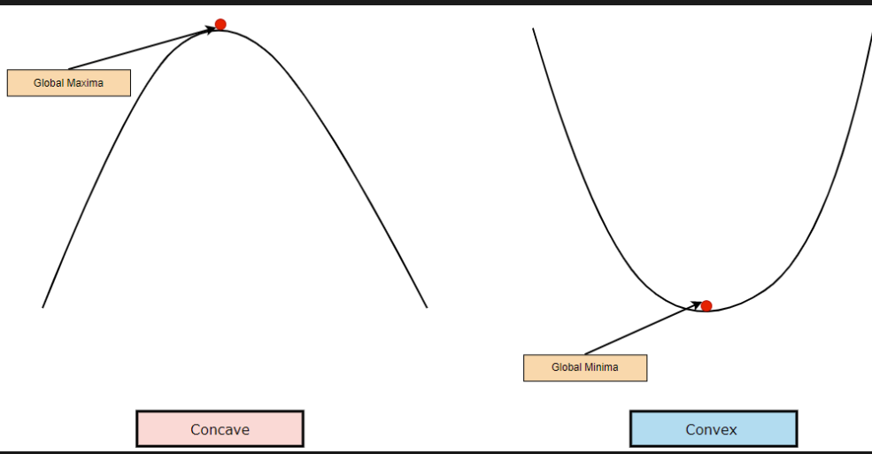
What a convex?
Global Maxima
Global Minima

Slide 4
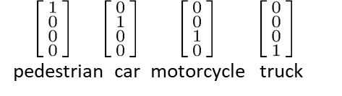
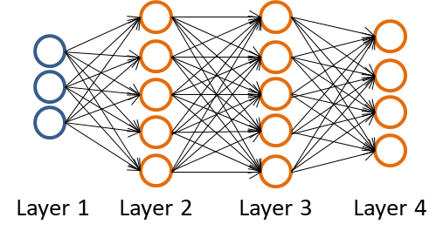
Neural Network classification
Training set: { (x¹ , y¹ ), (x² , y² ), (x³ , y³ ), … ((x^{m} , y^{m} )}
(an element of the k-dimensional Euclidean space). y ∈ ℝ ^{K}
L = number of layers in network
S₁ = number of units(not counting bias unit) in layer l.
Binary classification
y = 0 or 1
1 output unit
S_{L} is final out put layer
S_{L} = 1 k = 1
h_{θ}^{(x) ℝ real numbers}
K output units
L = 4, S₁ = 3, S₂= 5, S₃ = 5, S₄ =L
h_{θ}^{(x)}
^{One output}
Output layer
Final layer/ output units
If k =2 then use binary classification for Neural Network classification

Slide 5
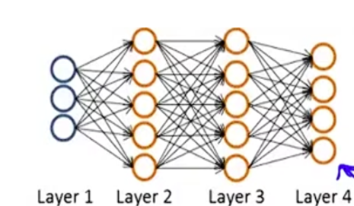
Neural Network
{ (x¹ , y¹ ), (x² , y² ), (x³ , y³ ), … ((x^{m} , y^{m} )} //data examples
L = total number of layer in network, L =4
S_{i} = number of units( Not counting the bias unit) in layer l. S₁ = 3, S₂ = 5, S₃ = 5, S₄ = S_{l} = 4(output layer) (OUTPUT LAYER
Multi- Class Classification ( K classes)
Binary classification
y = 0, 0r 1
1 output unit h_{θ}^{(x)}
h_{θ}^{(x)} ∈ ℝ ^{E.G.}
S_{L} = 1 k = 1
y ∈ ℝ ^{K}
1 0 0 0
0 1 0 0
0 0 1 0
0 0 0 1
Pedestrian, Car, Motorcycle truck
K output units h_{θ}^{(x)} ∈ ℝ ^{K output is a vector of k}
^{dimensional}
^{S}_{l} = k k >= 3
Final layer and number of unit = 1
One output unit

Slide 6
y ∈ ℝ ^{K}
y ∈ ℝ ^{K}
  y is a member of k dimensional real number
  y represents a vector(an ordered set of numbers)
  ℝ: This is the "double-struck" letter R, representing the set of all real numbers (including all positive and negative numbers, integers, fractions, and irrational numbers).
  ^{K :} The superscript k indicates the dimension of the space. It means the vector has k components.
For example:
If k=2, y = ℝ² means y = y₁,y₂, where y_1 and y_2 are both real numbers. This represents a point in a 2D plane.
(0,1)
(2,π)

Slide 7
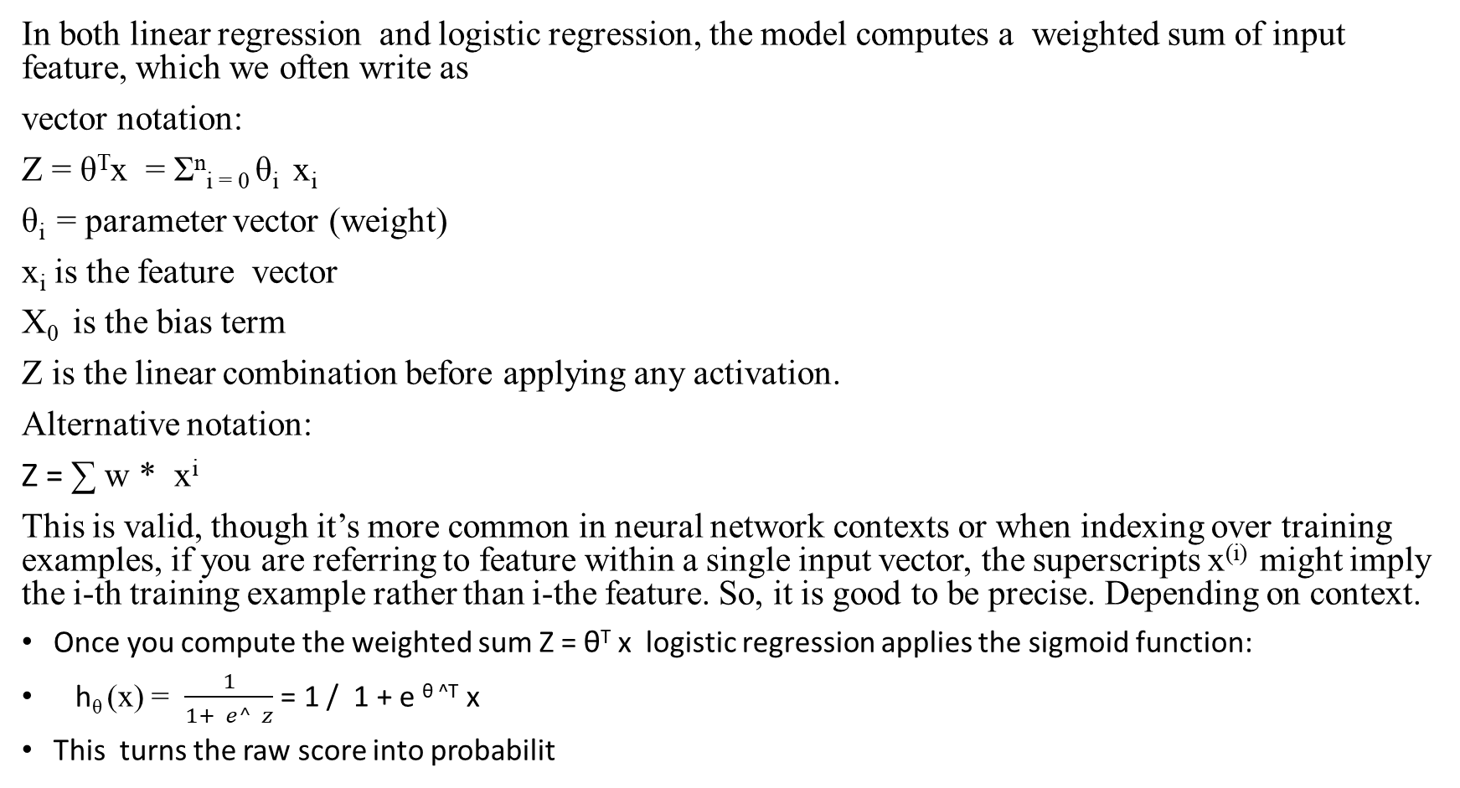
Weighted Sum of Inputs notation clarification
In both linear regression and logistic regression, the model computes a weighted sum of input feature, which we often write as
vector notation:
Z = θ^{T}x = Σ^{n}_{i = 0} θ_{i} x_{i}
θ_{i} = parameter vector (weight)
x_{i} is the feature vector
X₀ is the bias term
Z is the linear combination before applying any activation.
Alternative notation:
Z = ∑ w * x^{i}
This is valid, though it’s more common in neural network contexts or when indexing over training examples, if you are referring to feature within a single input vector, the superscripts x^{(i)} might imply the i-th training example rather than i-the feature. So, it is good to be precise. Depending on context.
Once you compute the weighted sum Z = θ^{T} x logistic regression applies the sigmoid function:
h_{θ} (x) = $\frac{1}{1+ e^ z}$ = 1 / 1 + e ^{θ ^T} x
This turns the raw score into probabilit

Slide 8
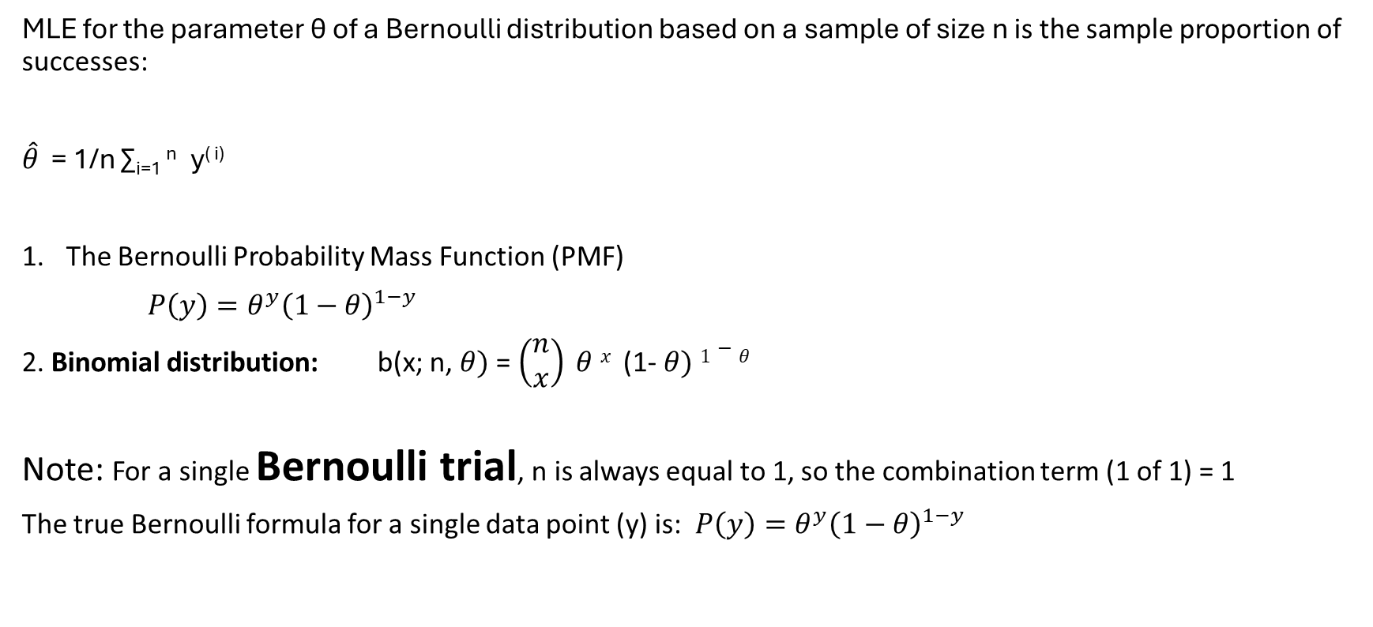
The maximum likelihood estimator (MLE)
MLE for the parameter θ of a Bernoulli distribution based on a sample of size n is the sample proportion of successes:
$\hat{θ}$ = 1/n ∑_{i=1} ^{n} y^{( i)}
The Bernoulli Probability Mass Function (PMF)
$P\left(y\right)=θ^{y}{\left(1−θ\right)}^{1−y}$
2. Binomial distribution: b(x; n, $θ)$ = $\left(\begin{matrix}n \\ x\end{matrix}\right) θ x$ (1- $θ) 1−θ$
Note: For a single Bernoulli trial, n is always equal to 1, so the combination term (1 of 1) = 1
The true Bernoulli formula for a single data point (y) is: $P\left(y\right)=θ^{y}{\left(1−θ\right)}^{1−y}$

Slide 9
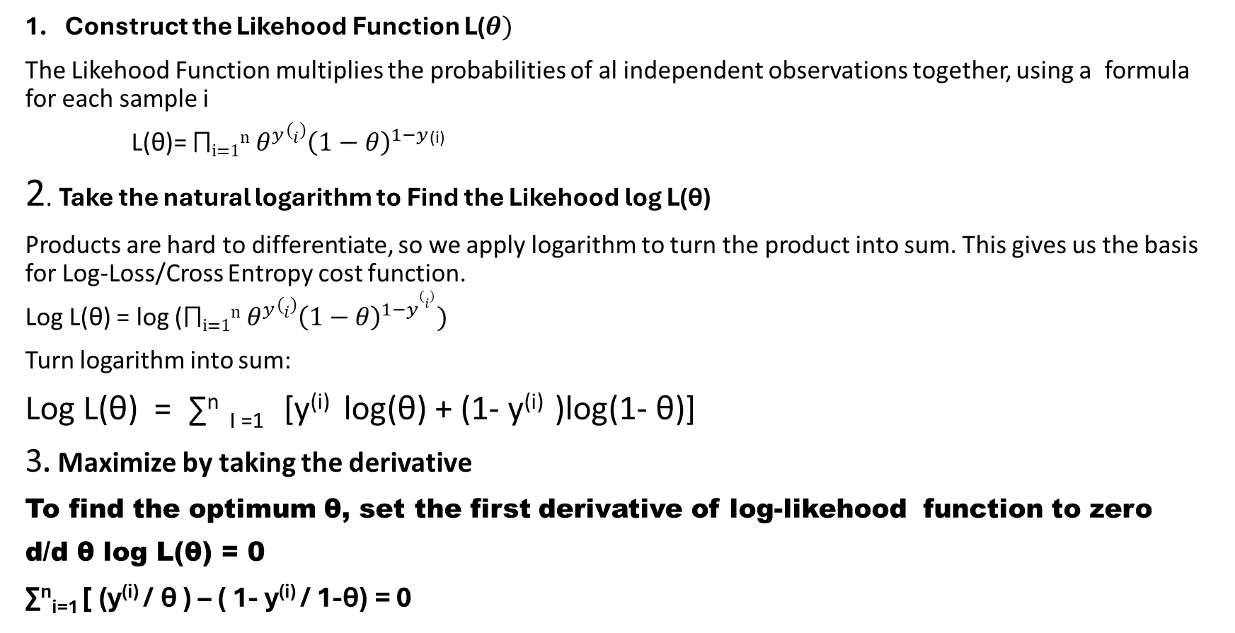
Step by step derivation of Bernoulli MLE:
Construct the Likehood Function L($θ)$
The Likehood Function multiplies the probabilities of al independent observations together, using a formula for each sample i
L(θ)= $\text{⨅}\text{i=1}\text{n}$ $θ^{y}{(i)\left(1−θ\right)}^{1−y}$^{(i)}
2. Take the natural logarithm to Find the Likehood log L(θ)
Products are hard to differentiate, so we apply logarithm to turn the product into sum. This gives us the basis for Log-Loss/Cross Entropy cost function.
Log L(θ) = log ($\text{⨅}\text{i=1}\text{n}$ $θ^{y}{(i)\left(1−θ\right)}^{1−y(i)})$
Turn logarithm into sum:
Log L(θ) = ∑^{n} _{I =1} [y^{(i)} log(θ) + (1- y^{(i)} )log(1- θ)]
3. Maximize by taking the derivative
To find the optimum θ, set the first derivative of log-likehood function to zero
d/d θ log L(θ) = 0
∑^{n}_{i=1} [ (y^{(i)} / θ ) – ( 1- y^{(i)} / 1-θ) = 0

Slide 10
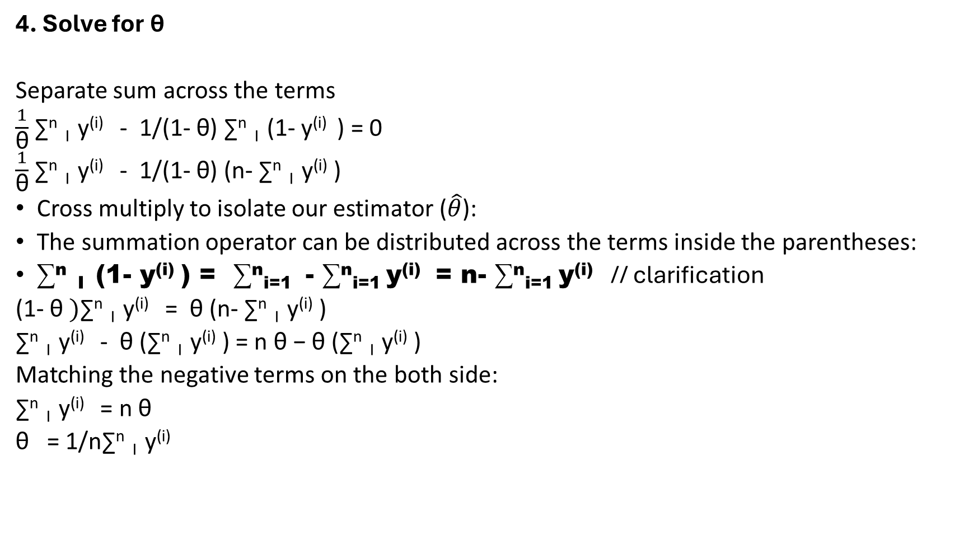
4. Solve for $\text{θ}$
Separate sum across the terms
$\frac{1}{\text{θ}}$ ∑^{n} _{I} y^{(i)} - 1/(1- $\text{θ}\text{) }$∑^{n} _{I} (1- y^{(i)} ) = 0
$\frac{1}{\text{θ}}$ ∑^{n} _{I} y^{(i)} - 1/(1- $\text{θ}\text{) }$(n- ∑^{n} _{I} y^{(i)} )
Cross multiply to isolate our estimator ($\hat{θ}$):
The summation operator can be distributed across the terms inside the parentheses:
∑^{n} _{I} (1- y^{(i)} ) = ∑^{n}_{i=1} - ∑^{n}_{i=1} y^{(i)} = n- ∑^{n}_{i=1} y^{(i)} // clarification
(1- $\text{θ} )$∑^{n} _{I} y^{(i)} = $\text{θ}$(n- ∑^{n} _{I} y^{(i)} )
∑^{n} _{I} y^{(i)} - $\text{θ}$(∑^{n} _{I} y^{(i)} ) = n $\text{θ}\text{ − }\text{θ}$(∑^{n} _{I} y^{(i)} )
Matching the negative terms on the both side:
∑^{n} _{I} y^{(i)} = n $\text{θ}$
$\text{θ} \text{ = 1/n}$∑^{n} _{I} y^{(i)}

Slide 11
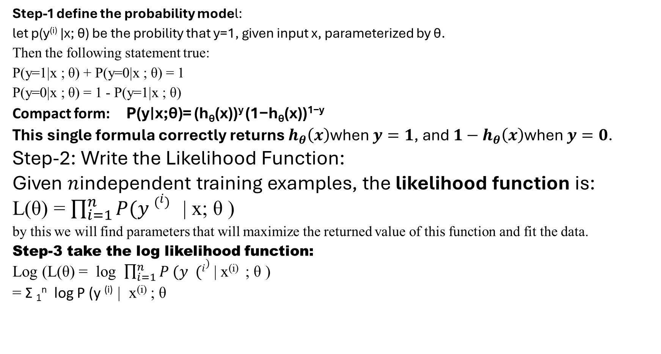
Deriving the Cost Function via Maximum Likelihood Estimation
Step-1 define the probability model:
let p(y^{(i)} |x; θ) be the probility that y=1, given input x, parameterized by θ.
Then the following statement true:
P(y=1|x ; θ) + P(y=0|x ; θ) = 1
P(y=0|x ; θ) = 1 - P(y=1|x ; θ)
Compact form: P(y∣x;θ)= (h_{θ}​(x))^{y} (1−h_{θ}​(x))^{1−y}
This single formula correctly returns $h_{θ}\left(x\right)\text{when }y=1\text{, and }1−h_{θ}\left(x\right)\text{when }y=0\text{.}$
Step-2: Write the Likelihood Function:
Given $n$independent training examples, the likelihood function is:
L(θ) = $\prod_{i=1}^{n}{P(y \left(i\right) }$| x; θ )
by this we will find parameters that will maximize the returned value of this function and fit the data.
Step-3 take the log likelihood function:
Log (L(θ) = log $\prod_{i=1}^{n}{P (y (i)}$ | x^{(i)} ; θ )
= Σ ₁^{n} log P (y ^{(i)} | x^{(i)} ; θ

Slide 12
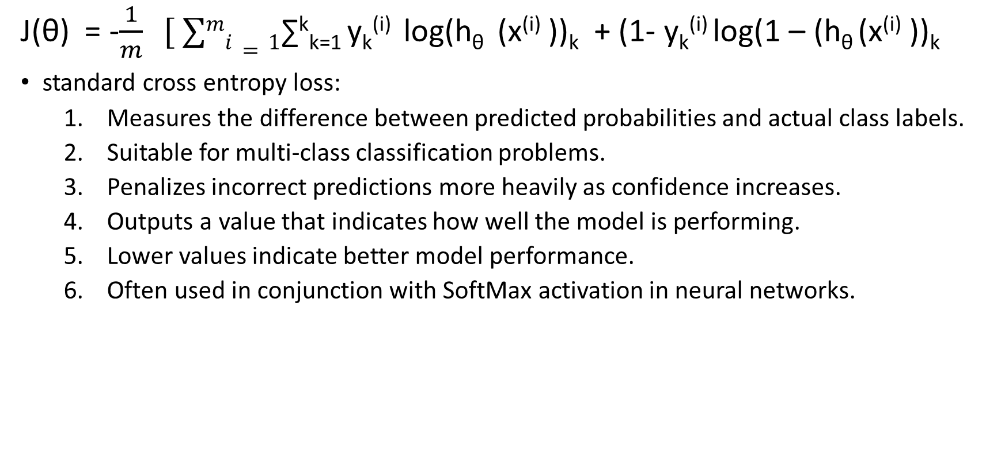
Cost function is the generalization of the logistic regression.
J(θ) = -$\frac{1}{m} [ ∑mi=1$∑^{k}_{k=1} y_{k}^{(i)} log(h_{θ} (x^{(i)} ))_{k} + (1- y_{k}^{(i)} log(1 – (h_{θ} (x^{(i)} ))_{k}
standard cross entropy loss:
  Measures the difference between predicted probabilities and actual class labels.
  Suitable for multi-class classification problems.
  Penalizes incorrect predictions more heavily as confidence increases.
  Outputs a value that indicates how well the model is performing.
  Lower values indicate better model performance.
  Often used in conjunction with SoftMax activation in neural networks.

Slide 13
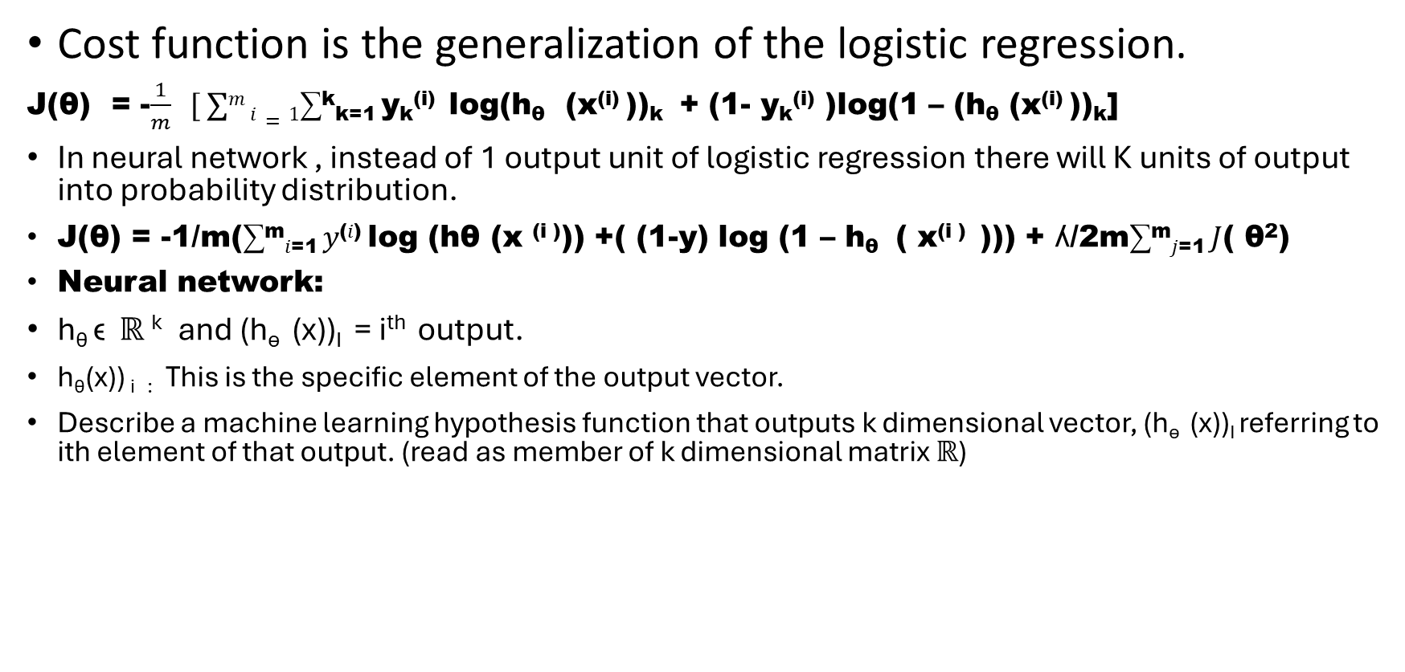
Regularized
Cost function is the generalization of the logistic regression.
J(θ) = -$\frac{1}{m} [ ∑m i=1$∑^{k}_{k=1} y_{k}^{(i)} log(h_{θ} (x^{(i)} ))_{k} + (1- y_{k}^{(i)} )log(1 – (h_{θ} (x^{(i)} ))_{k}]
In neural network , instead of 1 output unit of logistic regression there will K units of output into probability distribution.
J(θ) = -1/m(∑^{m}_{𝑖=1} 𝑦^{(𝑖)} log (hθ (x ^{(i )})) +( (1-y) log (1 – h_{θ} ( x^{(i )} ))) + ʎ/2m∑^{m}_{𝑗=1} 𝐽( θ²)
Neural network:
h_{θ} ϵ ℝ ^{k} and (h_{ѳ} (x))_{I} = i^{th} output.
h_{θ}(x)) _{i} : This is the specific element of the output vector.
Describe a machine learning hypothesis function that outputs k dimensional vector, (h_{ѳ} (x))_{I} referring to ith element of that output. (read as member of k dimensional matrix ℝ)

Slide 14
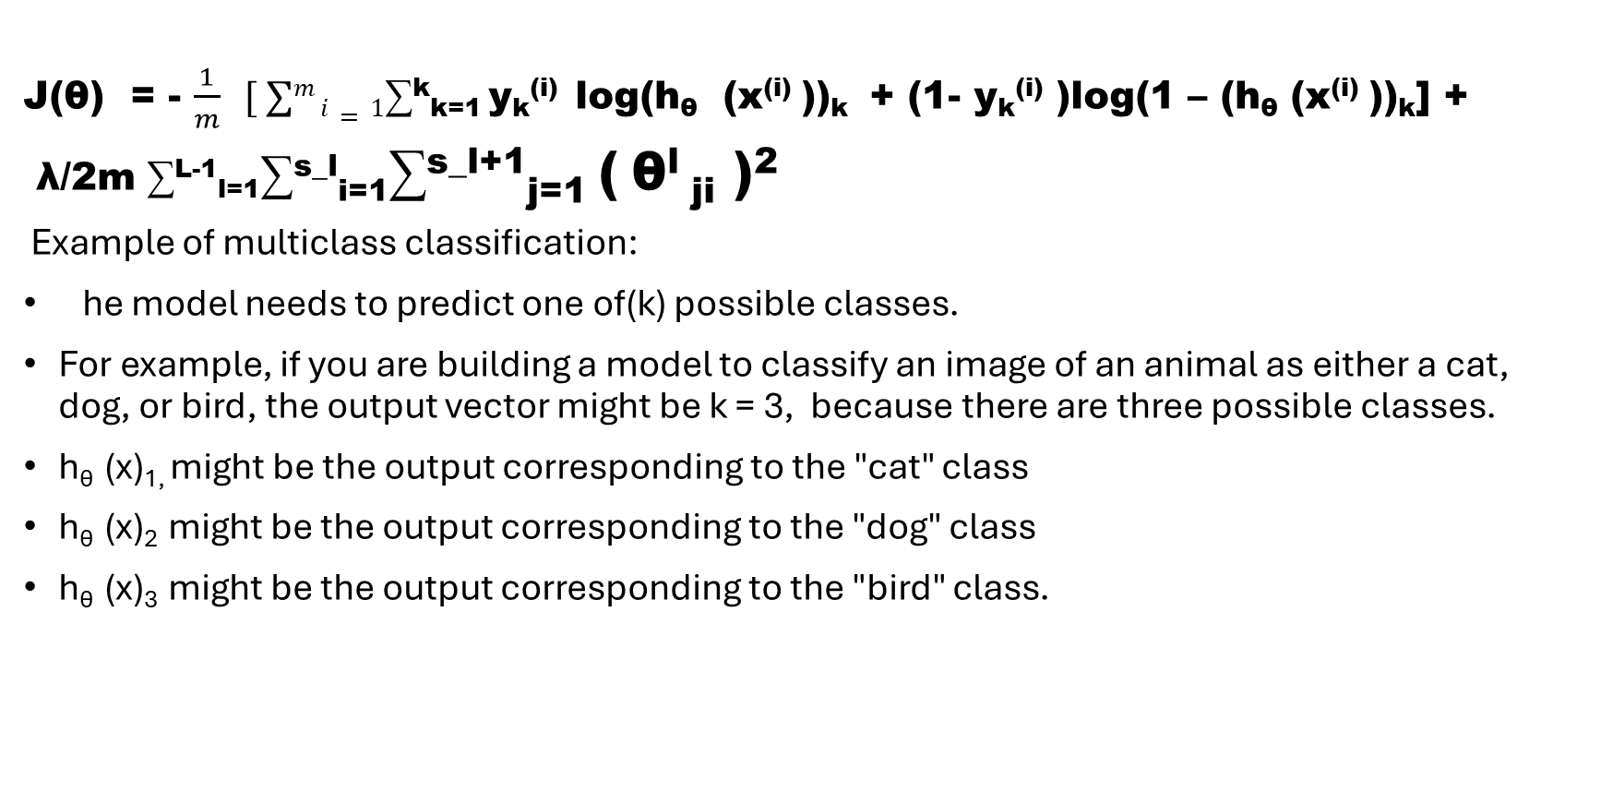
J(θ) = - $\frac{1}{m} [ ∑m i=1$∑^{k}_{k=1} y_{k}^{(i)} log(h_{θ} (x^{(i)} ))_{k} + (1- y_{k}^{(i)} )log(1 – (h_{θ} (x^{(i)} ))_{k}] +
λ/2m ∑^{L-1}_{l=1}∑^{s_l}_{i=1}∑^{s_l+1}_{j=1} ( θ^{l} _{ji} )²
Example of multiclass classification:
he model needs to predict one of(k) possible classes.
For example, if you are building a model to classify an image of an animal as either a cat, dog, or bird, the output vector might be k = 3, because there are three possible classes.
h_{θ} (x)_{1,} might be the output corresponding to the "cat" class
h_{θ} (x)₂ might be the output corresponding to the "dog" class
h_{θ} (x)₃ might be the output corresponding to the "bird" class.
1 0 0
0 1 0 `
0 0 1
Cat dog bird

Slide 15
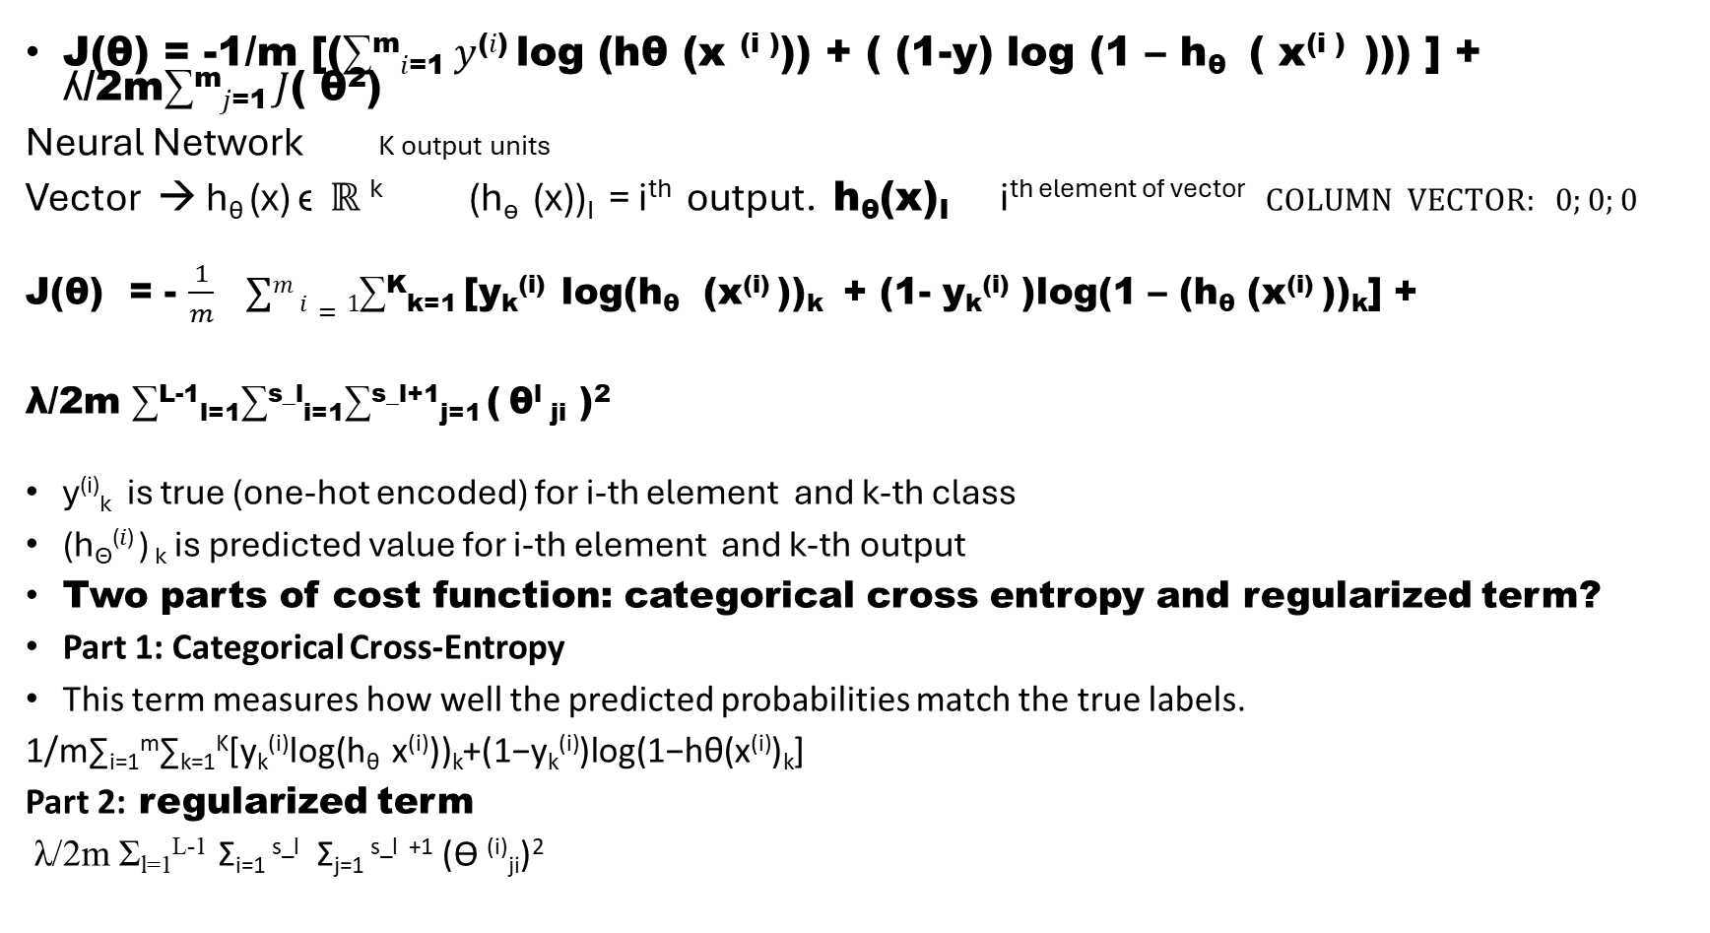
Logistic regression:
1 output unit
J(θ) = -1/m [(∑^{m}_{𝑖=1} 𝑦^{(𝑖)} log (hθ (x ^{(i )})) + ( (1-y) log (1 – h_{θ} ( x^{(i )} ))) ] + ʎ/2m∑^{m}_{𝑗=1} 𝐽( θ²)
Neural Network K output units
Vector → h_{θ} (x) ϵ ℝ ^{k} (h_{ѳ} (x))_{I} = i^{th} output. h_{θ}(x)_{I} i^{th element of vector} $COLUMN VECTOR: 0;0;0$
J(θ) = - $\frac{1}{m} ∑m i=1$∑^{K}_{k=1} [y_{k}^{(i)} log(h_{θ} (x^{(i)} ))_{k} + (1- y_{k}^{(i)} )log(1 – (h_{θ} (x^{(i)} ))_{k}] +
λ/2m ∑^{L-1}_{l=1}∑^{s_l}_{i=1}∑^{s_l+1}_{j=1} ( θ^{l} _{ji} )²
y^{(i)}_{k} is true (one-hot encoded) for i-th element and k-th class
(h_{ϴ}^{(𝑖)} ) _{k} is predicted value for i-th element and k-th output
Two parts of cost function: categorical cross entropy and regularized term?
Part 1: Categorical Cross-Entropy
This term measures how well the predicted probabilities match the true labels.
1/m∑_{i=1}^{m}∑_{k=1}^{K}[y_{k}^{(i)}log⁡(h_{θ} x^{(i)}))_{k}+(1−y_{k}^{(i)})log⁡(1−hθ(x^{(i)})_{k}]
Part 2: regularized term
λ/2m Σ_{l=1}^{L-1} Σ_{i=1} ^{s_l} Σ_{j=1} ^{s_l +1} (ϴ ^{(i)}_{ji})²

Slide 16
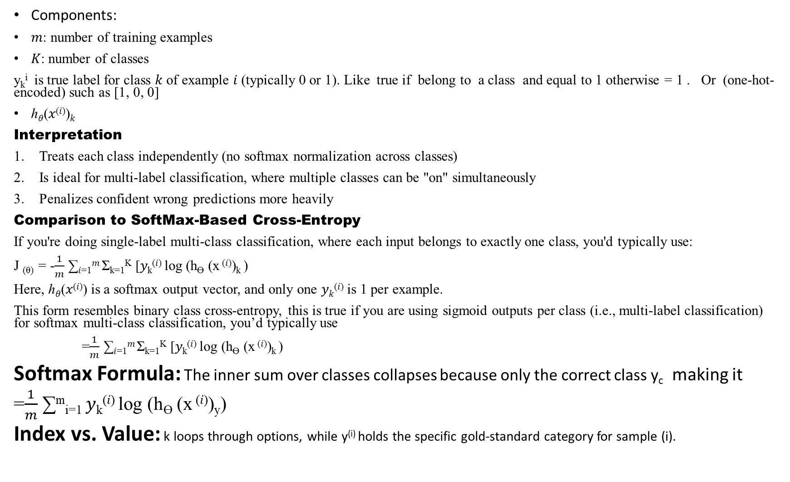
Components:
𝑚: number of training examples
𝐾: number of classes
y_{k}^{i} is true label for class 𝑘 of example 𝑖 (typically 0 or 1). Like true if belong to a class and equal to 1 otherwise = 1 . Or (one-hot-encoded) such as [1, 0, 0]
ℎ_{𝜃}(𝑥^{(𝑖)})_{𝑘}
Interpretation
Treats each class independently (no softmax normalization across classes)
Is ideal for multi-label classification, where multiple classes can be "on" simultaneously
Penalizes confident wrong predictions more heavily
Comparison to SoftMax-Based Cross-Entropy
If you're doing single-label multi-class classification, where each input belongs to exactly one class, you'd typically use:
J _{(θ)} = -$\frac{1}{m}$ ∑_{𝑖=1}^{𝑚} Σ_{k=1}^{K} [𝑦_{k}^{(𝑖)} log (h_{ϴ} (x ^{(𝑖)})_{k} )
Here, ℎ_{𝜃}(𝑥^{(𝑖)}) is a softmax output vector, and only one 𝑦_{𝑘}^{(𝑖)} is 1 per example.
This form resembles binary class cross-entropy, this is true if you are using sigmoid outputs per class (i.e., multi-label classification) for softmax multi-class classification, you’d typically use
=$\frac{1}{m}$ ∑_{𝑖=1}^{𝑚} Σ_{k=1}^{K} [𝑦_{k}^{(𝑖)} log (h_{ϴ} (x ^{(𝑖)})_{k} )
Softmax Formula: The inner sum over classes collapses because only the correct class y_{c} making it
=$\frac{1}{m}$ ∑^{m}_{i=1} 𝑦_{k}^{(𝑖)} log (h_{ϴ} (x ^{(𝑖)})_{y})
Index vs. Value: k loops through options, while y^{(i)} holds the specific gold-standard category for sample (i).

Slide 17

This term penalizes large weights to prevent overfitting
Expression:
λ/2m Σ_{l=1} ^{L-1} Σ_{i=1}^{s_l} Σ_{j=1} ^{s}_{l} ⁺¹(θ^(i)_ji)^2 ➔
λ: regularization strength
^{L: number of layers}
^{S}_{l} : number of units in layer l
θ_{ij}^{(i)} : weight from unit I in layer l to unit j in layer l+1
This sums the squared weights across all layers (excluding biases, scaled by λ/2m

Slide 18
1. cost function(Binary Cross Entropy across classes)
J(θ)= -1/𝑚 ∑_{𝑖=1}^{𝑚} Σ_{k=1}^{K} [𝑦_{k}^{(𝑖)} log (h_{θ} (x^{(𝑖)} )_{k} ) + (1−y_{k} ^{(i)}) log(1−h_{θ}(x ^{(i)})_{k} )]
This is binary cross-entropy applied per class, ideal for multi-label classification, where each class predication is independent and uses sigmoid activation.
2. Label encoding: One-Hot vs binary
One-Hot encoding : for a single label multi-class tasks e.g., [0, 1, 0] means class 1 is correct.
Binary-encoding: for multi label tasks e.g., [1, 0, 1] means 0 and 2 are active
When each example belongs to one class then use sigmoid.

Slide 19
Binary vs Categorical Cross Entropy
Losss Type | Activation | Output layer | Use case
Binary Cross Entropy | Sigmoid | 1 unit per class | Multi-label-classification
Categorical Cross Entropy | SoftMax | 1 unit per class | Single-label-multi-class classification
Key differences:
Sigmoid: Each output is independent, values in [0, 1], no constraint that they sum to 1
SoftMax : output form a probability distribution over classes, sum to 1
If output layer has 1 unit per class, each example belongs exactly to one class, then SoftMax, Categorical Cross Entropy is the more natural and efficient choice.

Slide 20
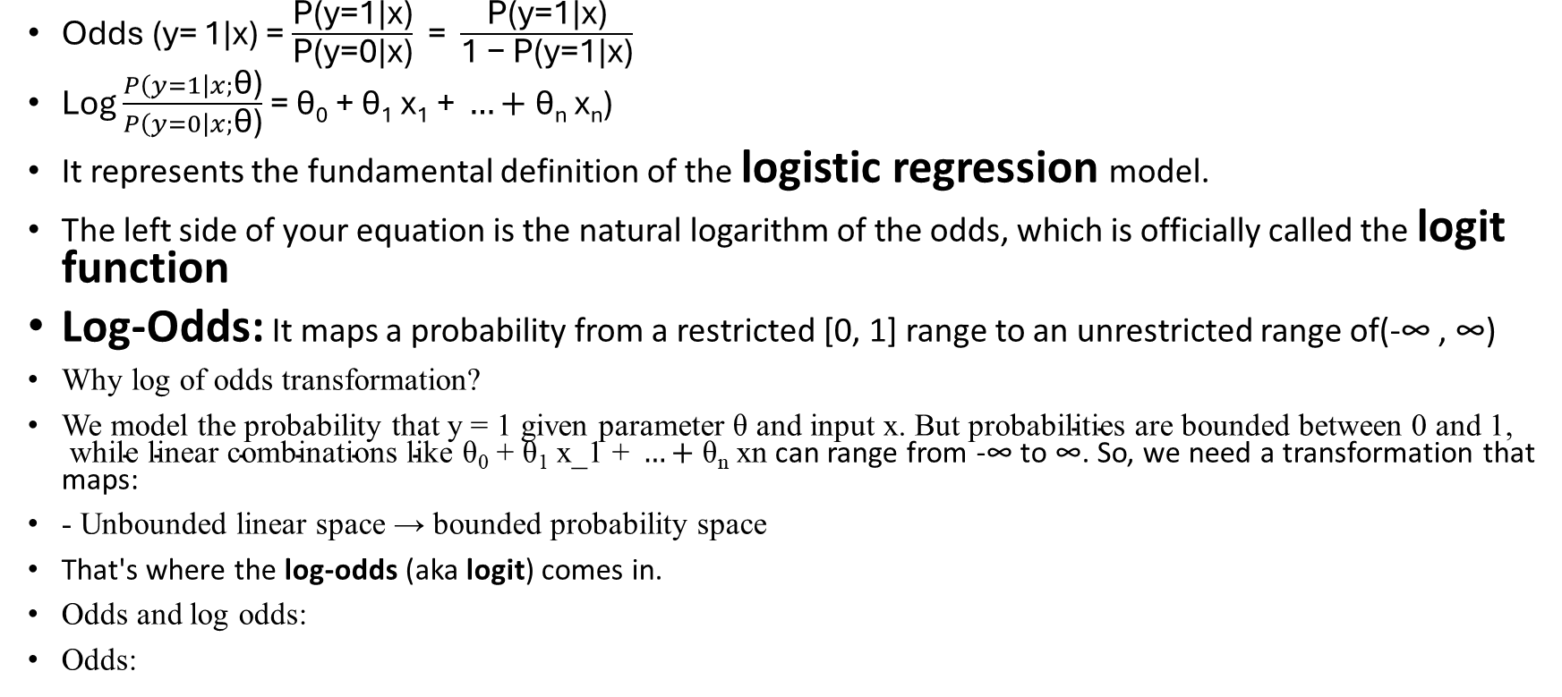
Odds and log odds:
Odds (y= 1|x) = $\frac{\text{P(y=1|x)}}{\text{P(y=0|x)}}$ = $\frac{\text{P(y=1|x)}}{\text{1 − P(y=1|x)}}$
Log $\frac{P\left(y=1\right|x;\text{θ}\text{)}}{P\left(y=0\right|x;\text{θ}\text{)}}$ = $\text{θ}\text{0}\text{ + }\text{θ}\text{1}\text{ x}\text{1}\text{ + }…+\text{θ}\text{n}\text{ xn}\text{)}$
It represents the fundamental definition of the logistic regression model.
The left side of your equation is the natural logarithm of the odds, which is officially called the logit function
Log-Odds: It maps a probability from a restricted [0, 1] range to an unrestricted range of(-∞ , ∞)
Why log of odds transformation?
We model the probability that y = 1 given parameter $\text{θ}\text{ and input x. }\text{But probabilities are bounded between 0 and 1, while linear combinations like}$ $\text{θ}\text{0}\text{ + }\text{θ}\text{1}\text{ x_1 + }…+\text{θ}\text{n}\text{ xn}$ can range from -∞ to ∞. So, we need a transformation that maps:
- Unbounded linear space → bounded probability space
That's where the log-odds (aka logit) comes in.
Odds and log odds:
Odds:

Slide 21
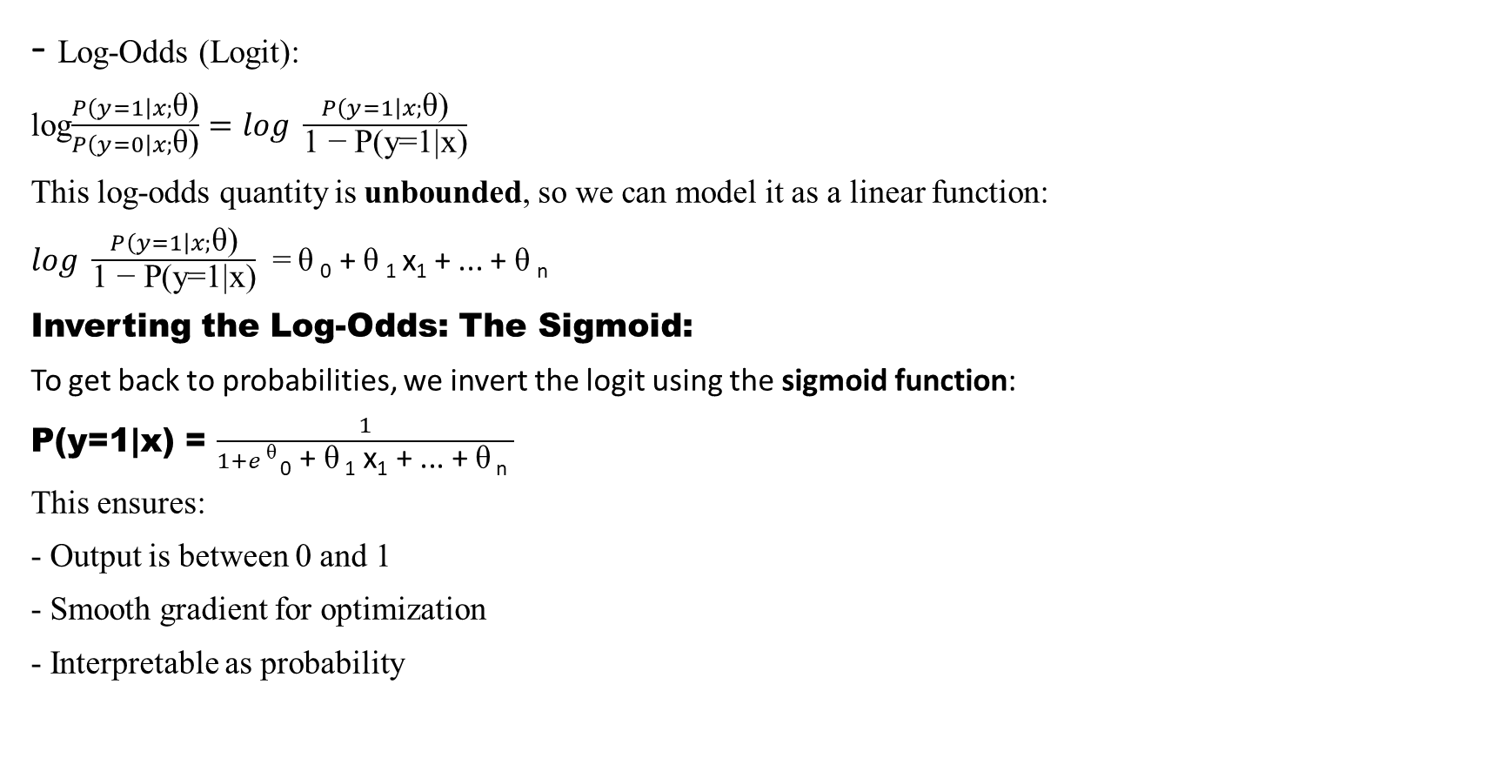
- Log-Odds (Logit):
log$\frac{P\left(y=1\right|x;\text{θ}\text{)}}{P\left(y=0\right|x;\text{θ}\text{)}}=log \frac{P\left(y=1\right|x;\text{θ}\text{)}}{\text{1 − P(y=1|x)}}$
This log-odds quantity is unbounded, so we can model it as a linear function:
$log \frac{P\left(y=1\right|x;\text{θ}\text{)}}{\text{1 − P(y=1|x)}}$ = $\text{θ}$₀ + $\text{θ}$₁ x₁ + ... + $\text{θ}$_{n}
Inverting the Log-Odds: The Sigmoid:
To get back to probabilities, we invert the logit using the sigmoid function:
P(y=1|x) = $\frac{1}{1+e \text{θ} \text{0}\text{ + }\text{θ} \text{1}\text{ x}\text{1}\text{ + ... + }\text{θ} \text{n} }$
This ensures:
- Output is between 0 and 1
- Smooth gradient for optimization
- Interpretable as probability

Slide 22
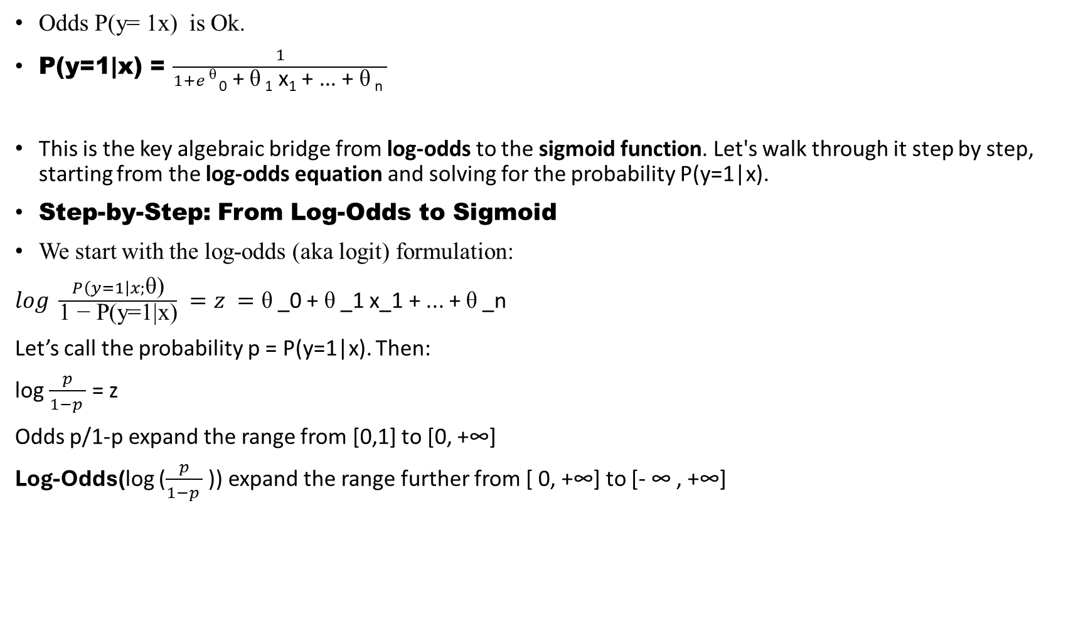
Odds P(y= 1x) is Ok.
P(y=1|x) = $\frac{1}{1+e \text{θ} \text{0}\text{ + }\text{θ} \text{1}\text{ x}\text{1}\text{ + ... + }\text{θ} \text{n} }$
This is the key algebraic bridge from log-odds to the sigmoid function. Let's walk through it step by step, starting from the log-odds equation and solving for the probability P(y=1|x).
Step-by-Step: From Log-Odds to Sigmoid
We start with the log-odds (aka logit) formulation:
$log \frac{P\left(y=1\right|x;\text{θ}\text{)}}{\text{1 − P(y=1|x)}} =z =\text{θ}$_0 + $\text{θ}$_1 x_1 + ... + $\text{θ}$_n
Let’s call the probability p = P(y=1|x). Then:
log $\frac{p}{1−p }$ = z
Odds p/1-p expand the range from [0,1] to [0, +∞]
Log-Odds(log ($\frac{p}{1−p }$ )) expand the range further from [ 0, +∞] to [- ∞ , +∞]

Slide 23
Step 1: Exponentiate both side
e ^{log 𝑝/(1−𝑝 )} = e ^{z} ➔ 𝑝/(1−𝑝 )
The solution to the equation is 𝑝/(1−𝑝 ) = e ^{z}
Exponentiate both sides of the equation using the base of the logarithm.
Step 2: Solve for
Multiply both sides by 1 - p:
P = e z (1-p)
Distribute:
p = e^z - e^z p
P = e^{z} / 1+ e^{z}

Slide 24

Bring all p-terms to one side:
p + e^z p = e^z
Factor out p:
p(1 + e^z) = e^z
Divide both sides:
P = $\frac{\text{e^z}}{\text{1 + e^z}}$
Step 3: Simplify
Divide numerator and denominator by e^z:
P = $\frac{1}{1+e^z}$ = 1/ 1 + e^-( θ_0 + θ_1 x_1 + … + θ_n x_n)
P= $\frac{1}{1+\text{e^z}}$ = $\frac{1}{1+ e ^−z }$

Slide 25
Final Result: The Sigmoid Function
P( y = 1|x) = 1/ 1 + e^-( θ_0 + θ_1 x_1 + … + θ_n x_n)
This transformation ensures:
Output is between 0 and 1
Smooth gradient for optimization
Interpretable as probability

Slide 26

Starting Point:
We want to simplify:
$\frac{1}{\text{(}\text{1 + e}\text{−z}\text{)}}$ . $\frac{\text{e}\text{z}}{\text{e} \text{z}}$ = $\frac{\text{e}\text{z}}{\text{e}\text{z}\text{( 1 + e}\text{−z}\text{)}}$
Step-by-Step Denominator Expansion:
e^{z}(1 + e^{-z}) = e^{z} .1 + (e^{z} .e^{-z})
= e^z + e^0 = e^z + 1
$\frac{1}{\text{1 + e^−z)}}$ . $\frac{\text{e^z}}{\text{e^z}}$ = $\frac{\text{e^z}}{\text{e^z( 1 + e^−z)}}$ = $\frac{\text{e^z}}{\text{e^z}\text{ + 1}}$

Slide 27
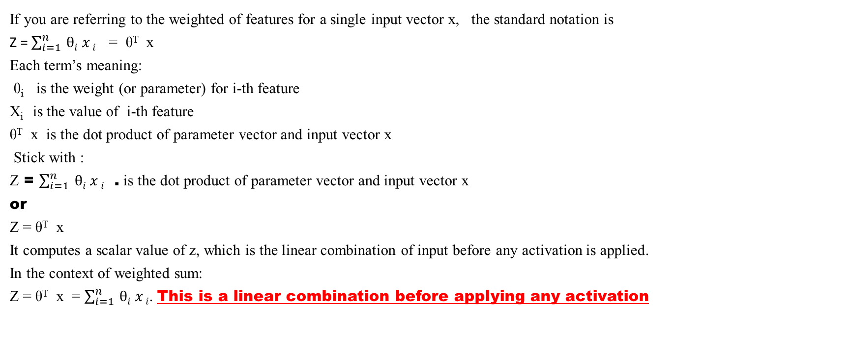
weighted sum
If you are referring to the weighted of features for a single input vector x, the standard notation is
Z = $\sum_{i=1 }^{n}{θi x i}$ = θ^{T} x
Each term’s meaning:
θ_{i} is the weight (or parameter) for i-th feature
X_{i} is the value of i-th feature
θ^{T} x is the dot product of parameter vector and input vector x
Stick with :
Z = $\sum_{i=1 }^{n}{θi x i}$ . is the dot product of parameter vector and input vector x
or
Z = θ^{T} x
It computes a scalar value of z, which is the linear combination of input before any activation is applied.
In the context of weighted sum:
Z = θ^{T} x = $\sum_{i=1 }^{n}{θi x i}$. This is a linear combination before applying any activation

Slide 28
Cost function
Logistic regression:
y is either 0 or 1
h_{θ} (x) = Ѳ^{T} x where define g(z) z is a real number and g(z) = 1/(1 + e^{-z})
Hypothesis can give values large than 1 or less than 0
For classification hypothesis representation we do h_{θ}(x) = g((θ^{T} x))
This is the sigmoid function, or the logistic function, not included bias.
If we combine these equations, we can write out the hypothesis as: h_{θ}(x) = 1/ (1+ e – θ^{T} x)
Example: x₀ =1, x = tumor size. h_{θ} (x) = 0.7 tells patient 70 % of chance of having cancer
What does it mean that :
Probability that y=1, given x, parameterized by θ Then the following statement true:
P(y=1|x ; θ) + P(y=0|x ; θ) = 1
P(y=0|x ; θ) = 1 - P(y=1|x ; θ)

Slide 29
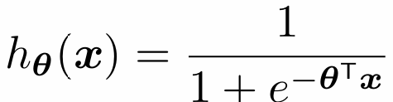
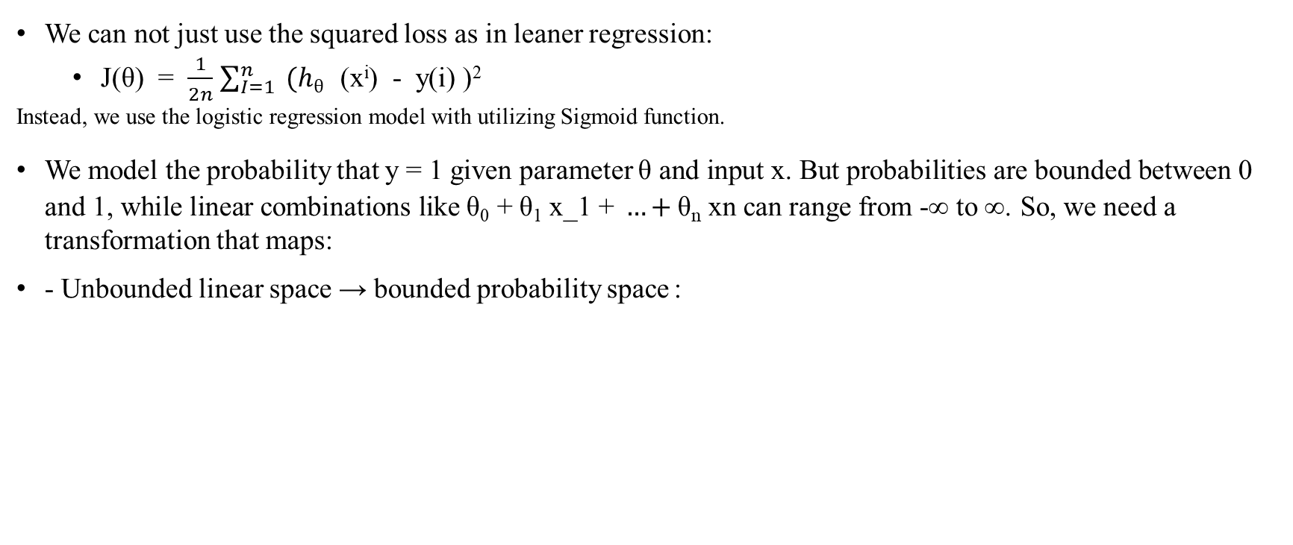
Logistic Regression Objective Function
We can not just use the squared loss as in leaner regression:
  J(θ) = $\frac{1}{2n}$ $\sum_{I=1}^{n}{ (hθ }$(x^{i}) - y(i) )²
Instead, we use the logistic regression model with utilizing Sigmoid function.
We model the probability that y = 1 given parameter $\text{θ}\text{ and input x. }\text{But probabilities are bounded between 0 and 1, while linear combinations like}$ $\text{θ}\text{0}\text{ + }\text{θ}\text{1}\text{ x_1 + }…+\text{θ}\text{n}\text{ xn}$ can range from -∞ to ∞. So, we need a transformation that maps:
- Unbounded linear space → bounded probability space :

Slide 30
For a binary label y = 0,1 input x, and model h_{θ} (x) (e.g., logistic regression), the likelihood of observing y is:
P(y | x; θ) = h _{θ}(x)^{y} (1 - h θ (x))1 – y
This compact expression handles both cases:
If y = 1: P = h _{θ}(x)
If y = 0: P = 1 - h _{θ}(x)
How It Connects to the Bernoulli Formula
The classic Bernoulli PMF is:
f(y; θ ) = θ^{y} (1 - θ )^{1-y} y = 0, 1
In the classification, we replace the fixed parameter θ with a function of input:
Θ ===> h_{θ} (x)
So now the probability of label y depends on input x and model parameters θ. This gives us:
P(y | x; θ) = h_{θ} (x) ^{y} (1- h_{θ} (x))^{1-y}
Why This Matters
It's the likelihood function for logistic regression.
It’s differentiable and leads to the log-likelihood and cross-entropy loss.
It’s a direct implementation of the Bernoulli formula, adapted for supervised learning.

Slide 31
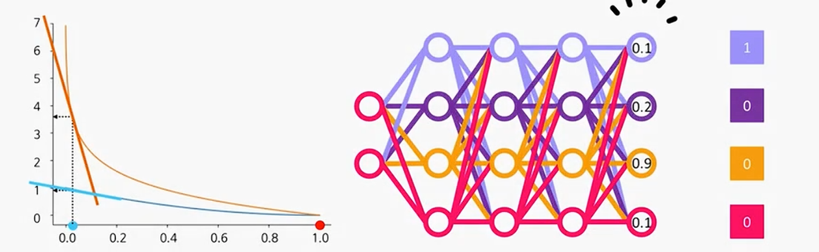
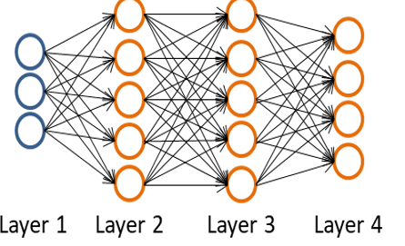

Regularized Cross Entropy Loss function
Used in the binary classification problems and penalize overly complex models that might overfit the training data.
The regularized Cross Entropy Loss Function combine the standard cross entropy loss with a penalty term.
L₂ formula: Loss = Cross Entropy Loss + λ $\sum{w2}$
  λ = regularization rate
  W model’s weight

Slide 32
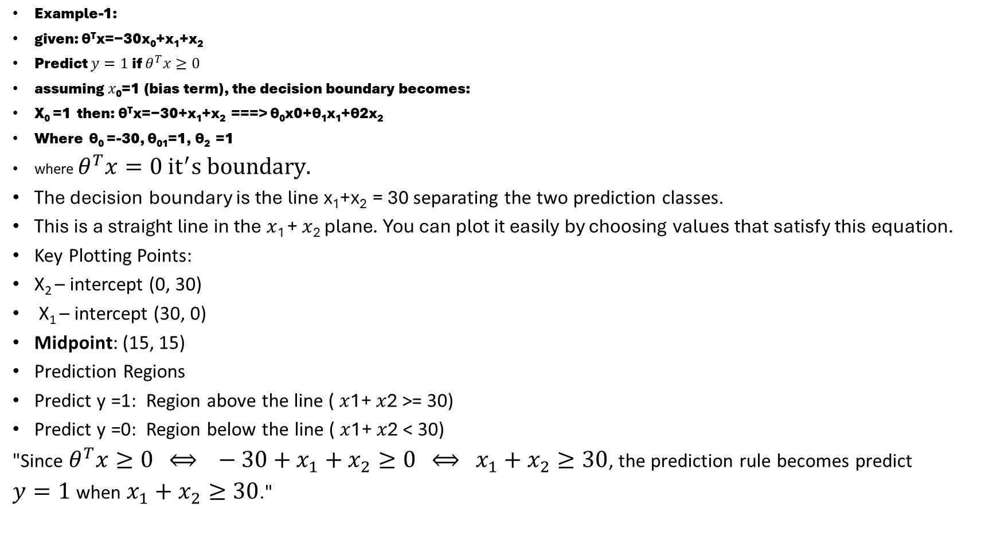
Example-1:
given: θ^{T}x=−30x₀+x₁+x₂
Predict $y=1$ if $θ^{T}x≥0$
assuming 𝑥₀=1 (bias term), the decision boundary becomes:
X₀ =1 then: θ^{T}x=−30+x₁+x₂ ===> θ₀x0+θ₁x₁+θ2x₂
Where θ₀ =-30, θ₀₁=1, θ₂ =1
where $θ^{T}x=0 {it}^{′}s boundary.$
The decision boundary is the line x₁+x₂ = 30 separating the two prediction classes.
This is a straight line in the 𝑥₁ + 𝑥₂ plane. You can plot it easily by choosing values that satisfy this equation.
Key Plotting Points:
X₂ – intercept (0, 30)
X₁ – intercept (30, 0)
Midpoint: (15, 15)
Prediction Regions
Predict y =1: Region above the line ( 𝑥1+ 𝑥2 >= 30)
Predict y =0: Region below the line ( 𝑥1+ 𝑥2 < 30)
"Since $θ^{T}x≥0 ⟺ −30+x_{1}+x_{2}≥0 ⟺ x_{1}+x_{2}≥30$, the prediction rule becomes predict
$y=1$when $x_{1}+x_{2}≥30$."

Slide 33
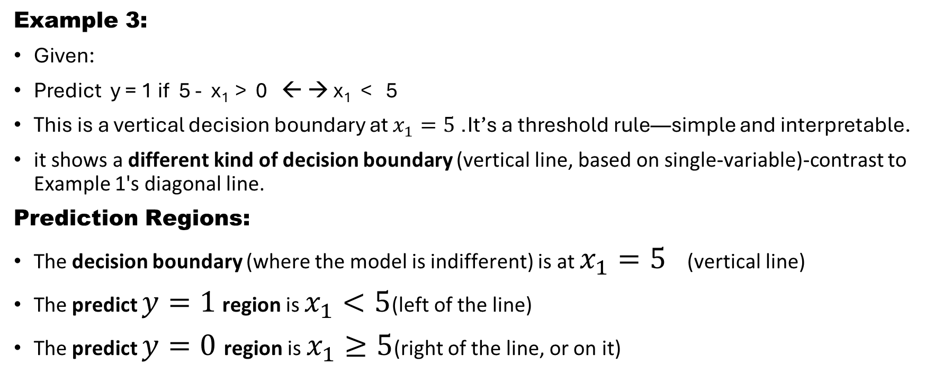
Vertical Decision Boundary
Example 3:
Given:
Predict y = 1 if 5 - x₁ > 0 ← → x₁ < 5
This is a vertical decision boundary at $x_{1}=5$. It’s a threshold rule—simple and interpretable.
it shows a different kind of decision boundary (vertical line, based on single-variable)-contrast to Example 1's diagonal line.
Prediction Regions:
The decision boundary (where the model is indifferent) is at $x_{1}=5$(vertical line)
The predict $y=1$ region is $x_{1}<5$(left of the line)
The predict $y=0$region is $x_{1}≥5$(right of the line, or on it)

Slide 34
The decision boundary
The decision boundary is the line x₁+x₂ = 30 separating the two prediction classes.
Key Plotting Points:
X₂ – intercept (0, 30)
X₁ – intercept (30, 0)
Midpoint: (15, 15)
Prediction Regions
Predict y =1: Region above the line ( 𝑥1+ 𝑥2 >= 30)
Predict y =0: Region below the line ( 𝑥1+ 𝑥2 < 30)

Slide 35
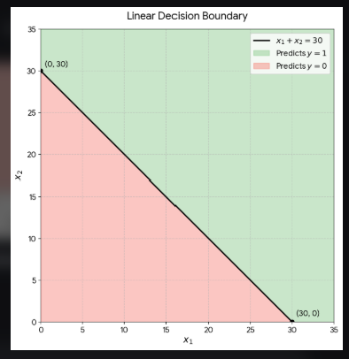
This is a straight line in the 𝑥₁ + 𝑥₂ plane. You can plot it easily by choosing values that satisfy this equation.

Slide 36
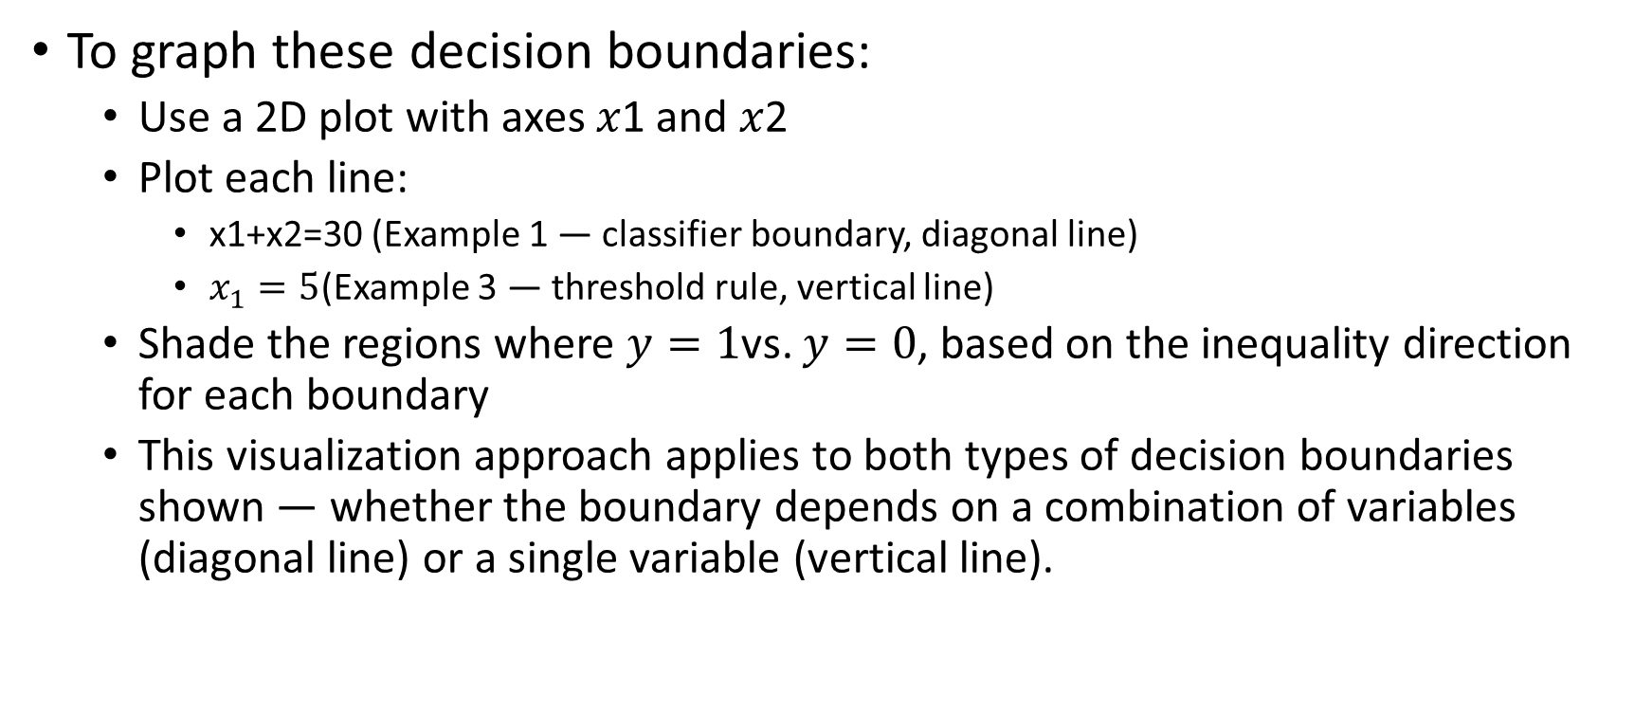
Visualization Strategy
To graph these decision boundaries:
  Use a 2D plot with axes 𝑥1 and 𝑥2 ​
  Plot each line:
    x1​+x2​=30 (Example 1 — classifier boundary, diagonal line)
    $x_{1}=5$(Example 3 — threshold rule, vertical line)
  Shade the regions where $y=1$vs. $y=0$, based on the inequality direction for each boundary
  This visualization approach applies to both types of decision boundaries shown — whether the boundary depends on a combination of variables (diagonal line) or a single variable (vertical line).

Slide 37
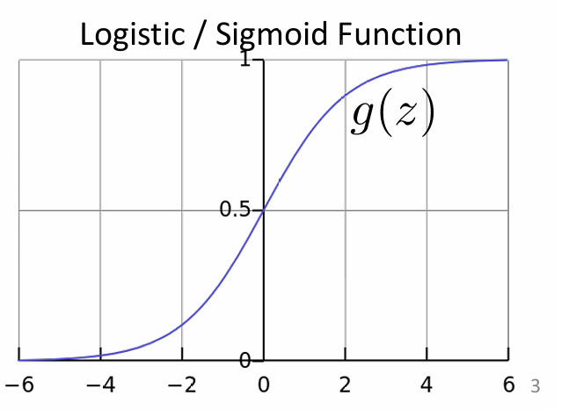
Sigmoid function and decision boundary notes
What is σ(z)? It is a sigmoid function: σ (z) = 1/(1 + e^{-z}). It maps any real number z to a value between0 and 1
It is used to model probabilities in Logistic Regression and Neural Networks
What is σ(z)? It is a generic function and is a placeholder name
In logistic regression, we define g(z) = sigma(z). But in neural networks, g(z) could be
  Sigmoid: g(z) = sigma(z)
  ReLU: g(z) = max(0,z)
  Tanh : g(z) = tanh(z)
  Softmax, leaky ReLU
Think of sigma(z) as a specific tool like – a wrench – and g(z) as
a general idea of a tool. In logistic regression, we use wrench. In neural
Nets, we might use a hammer wrench, drill we call it g(z)
Decision boundary: The set of points where h_{θ} (x) = 0.5↔ θ^{T} x = 0. This a linear equation in the input space
It looks that the sigmoid function and decision is made based on the value of z. So, if z is positive , if g(z) > 0.5

Slide 38
Linear Combination and Decision Rule
Start with z = θ^{T} x = 30 x₀ + x₁ + x₂
assuming 𝑥₀=1 (bias term), this becomes:
Z = -30 + x₁ + x₂
So, the decision rule is :
. Predict y = 1 if x> 0
x₁ + x₂ >= 30
θ^{T} x = 30 x₀ + x₁ + x₂
So, θ = [-3,1,1]
This illustrate how the decision boundary has been defined θ-not ts data.

Slide 39
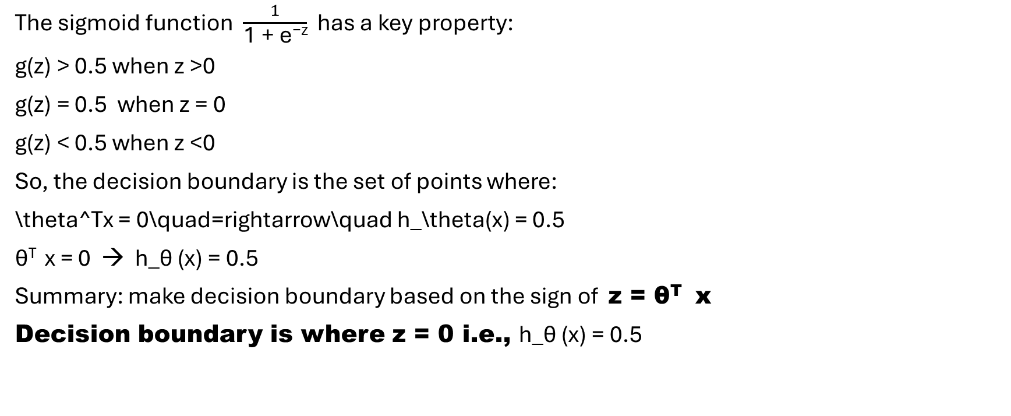
Decision boundary and sigmoid activation
The sigmoid function $\frac{1}{\text{1 + e}\text{−z}}$ has a key property:
g(z) > 0.5 when z >0
g(z) = 0.5 when z = 0
g(z) < 0.5 when z <0
So, the decision boundary is the set of points where:
\theta^Tx = 0\quad=rightarrow\quad h_\theta(x) = 0.5
θ^{T} x = 0 → h_θ (x) = 0.5
Summary: make decision boundary based on the sign of z = θ^{T} x
Decision boundary is where z = 0 i.e., h_θ (x) = 0.5

Slide 40
Logistic regression cost function or log loss
Quantifies errors or ensures convex optimization problems.
What is the predicted value as h_{θ} (x) and the actual value in hand.
Logistic regression use Logarithmic Cost Function to ensure that the optimization problem is convex, which guarantees that an algorithm like gradient descent will find the global minimum.
binary cross-entropy loss
Cost function formula for Logistic Regression: For a single training example, the loss function is defined as:
cost(h_θ(x), y) = -log(h_θ(x)) if y = 1
cost(h_θ(x), y) = -log(1- h_θ(x) if y = 0

Slide 41
Logistic regression cost function
cost(h_θ(x), y) = -log(h_θ(x)) if y = 1
-log(1- h_θ(x) if y = 0
and you're now stepping into the heart of logistic regression's cost function, where probability theory meets optimization.
The Core Idea: Penalize Wrong Predictions:
In logistic regression, the hypothesis ℎ𝜃(𝑥) outputs a probability that 𝑦=1. So, we want a cost function that:
  Rewards confident correct predictions
  Penalizes confident wrong predictions
  Is convex, so gradient descent can find the global minimum
Case-by-Case Breakdown:
If 𝑦=1:We want ℎ_{𝜃}(𝑥) to be close to 1. So, the cost is: cost(h_θ(x), y) = -log(h_θ(x))
  If ℎ𝜃(𝑥)=1, cost = 0 (perfect prediction).
  if ℎ𝜃(𝑥)→0, cost → ∞ (very wrong)
If y = 0 : We want ℎ𝜃(𝑥) to be close to 0. So, the cost is: -log(1- h_θ(x) )
  If ℎ_𝜃(𝑥)=0, cost = 0 (perfect prediction)
  If ℎ𝜃(𝑥)→1, cost → ∞ (very wrong): Like that a restaurant got 4.5 over 5 score but the food quality is very poor

Slide 42
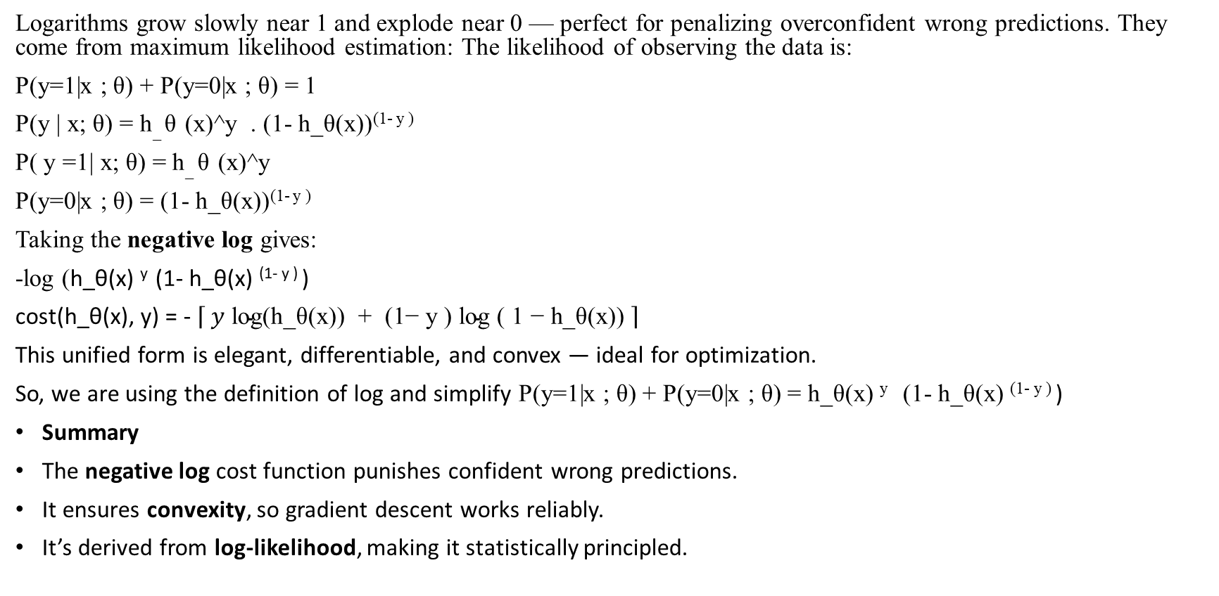
Why Use Logarithms?
Logarithms grow slowly near 1 and explode near 0 — perfect for penalizing overconfident wrong predictions. They come from maximum likelihood estimation: The likelihood of observing the data is:
P(y=1|x ; θ) + P(y=0|x ; θ) = 1
P(y | x; θ) = h_ θ (x)^y . (1- h_θ(x))^{(1- y )}
P( y =1| x; θ) = h_ θ (x)^y
P(y=0|x ; θ) = (1- h_θ(x))^{(1- y )}
Taking the negative log gives:
-log (h_θ(x) ^{y} (1- h_θ(x) ^{(1- y )} )
cost(h_θ(x), y) = - $\left\lceil y \text{log(h_}\text{θ}\text{(x)) + (1− y ) log ( 1 − h_}\text{θ}\text{(x)) }\right\rceil$
This unified form is elegant, differentiable, and convex — ideal for optimization.
So, we are using the definition of log and simplify P(y=1|x ; θ) + P(y=0|x ; θ) = h_θ(x) ^{y} (1- h_θ(x) ^{(1- y )} )
Summary
The negative log cost function punishes confident wrong predictions.
It ensures convexity, so gradient descent works reliably.
It’s derived from log-likelihood, making it statistically principled.

Slide 43
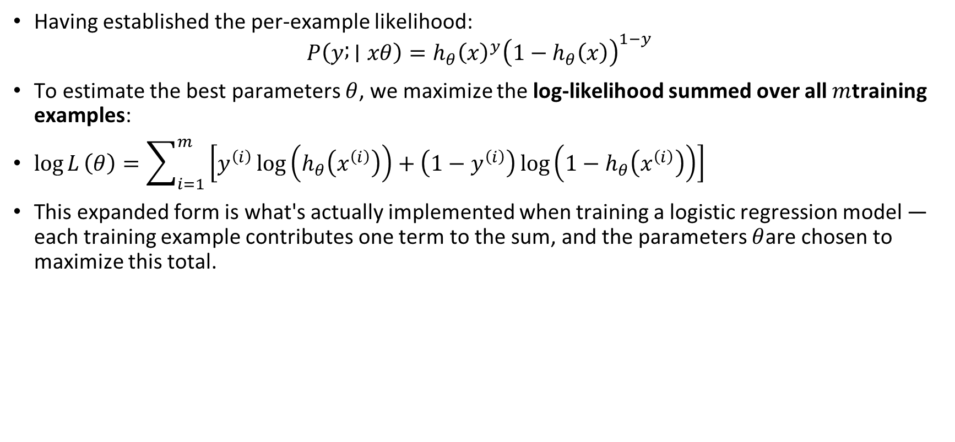
From Likelihood to Log-Likelihood — The Full Training Set
Having established the per-example likelihood:
$$P\left(y ; ∣xθ\right)=h_{θ}{\left(x\right)}^{y}{\left(1−h_{θ}\left(x\right)\right)}^{1−y}$$
To estimate the best parameters $θ$, we maximize the log-likelihood summed over all $m$training examples:
$\log{L}\left(θ\right)=\sum_{i=1}^{m}{\left[y^{\left(i\right)}\log\left(h_{θ}\left(x^{\left(i\right)}\right)\right)+\left(1−y^{\left(i\right)}\right)\log\left(1−h_{θ}\left(x^{\left(i\right)}\right)\right)\right]}$
This expanded form is what's actually implemented when training a logistic regression model — each training example contributes one term to the sum, and the parameters $θ$are chosen to maximize this total.

Slide 44
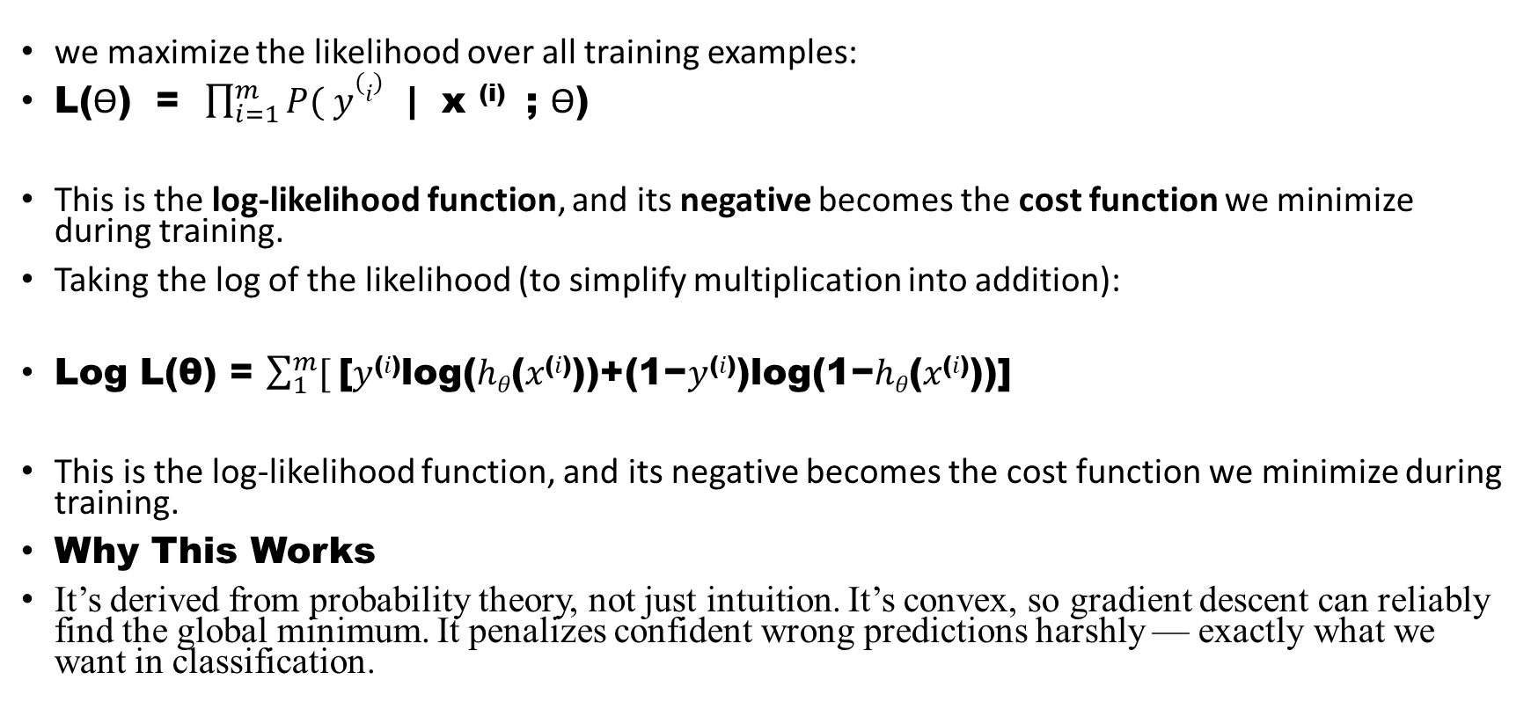
2. Log-Likelihood Function
we maximize the likelihood over all training examples:
L(ϴ) = $\prod_{i=1}^{m}{P( y(i)}$ | x ^{(i)} ; ϴ)
This is the log-likelihood function, and its negative becomes the cost function we minimize during training.
Taking the log of the likelihood (to simplify multiplication into addition):
Log L(θ) = $\sum_{1}^{m}{[ }$[𝑦^{(𝑖)}log⁡(ℎ_{𝜃}(𝑥^{(𝑖)}))+(1−𝑦^{(𝑖)})log⁡(1−ℎ_{𝜃}(𝑥^{(𝑖)}))]
This is the log-likelihood function, and its negative becomes the cost function we minimize during training.
Why This Works
It’s derived from probability theory, not just intuition. It’s convex, so gradient descent can reliably find the global minimum. It penalizes confident wrong predictions harshly — exactly what we want in classification.

Slide 45
Why This Works
It’s derived from probability theory, not just intuition. It’s convex, so gradient descent can reliably find the global minimum. It penalizes confident wrong predictions harshly — exactly what we want in classification.
Finalize the neural network modules
  Backpropagation intuition
  Cost surface visualization
  Regularization and dropouts
  SoftMax and multiclass classification
Probability foundations
  Discrete vs Continuous Distributions
  Probability mass vs density functions
  Expectation , variance, and entropy
  Bays’ theorem and conditional probability
Probabilistic Modeling in ML
  Likelihood and Loglikelihood
  Maximum Likelihood Estimation(MLE)
  Map estimation :Maximum a Posteriori (MAP) estimation

Slide 46
4. Information theory
  Cross Entropy and KL divergence. D _{KL} Divergence (P‖Q): Measures the relative entropy, which is the exact amount of extra surprise or information wasted by using Q instead of P. P (The Truth): The actual, real-world data distribution (e.g., the true labels). Q (The Model): Your estimated or predicted probability distribution.
  Mutual information
  Bits, Entrop, Compression
5. Transition to RAG AI
  Retrieve mechanism
  Embedding similarity
  Fusion of retrieved context with generation. Fusion is the specific mechanism or step where a model combines retrieved background information with its own internal knowledge to generate a final response
  Probabilistic scoring of retrieved documents

Slide 47
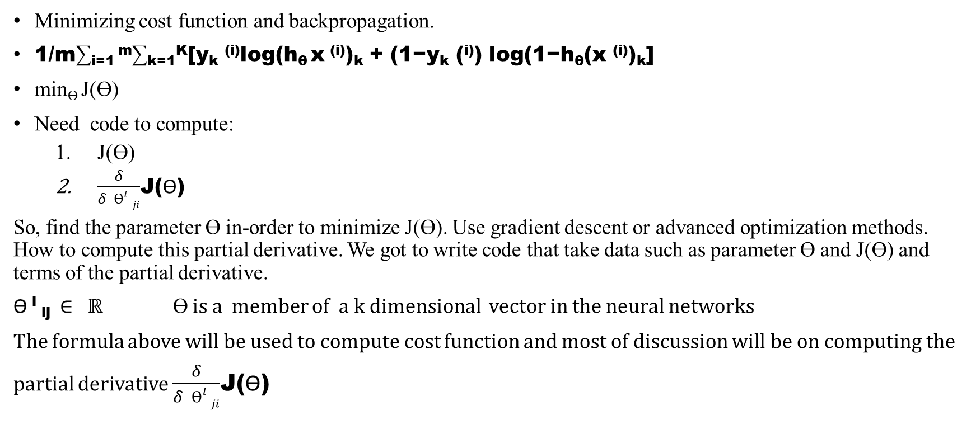
https://www.seas.upenn.edu/~cis5190/spring2019/lectures/05_LogisticRegression.pdf https://www.seas.upenn.edu/~cis5190/spring2019/lectures/05_LogisticRegression.pdf
Minimizing cost function and backpropagation.
1/m∑_{i=1} ^{m}∑_{k=1}^{K}[y_{k} ^{(i)}log(h_{θ} x ^{(i)})_{k} + (1−y_{k} (^{i)}) log(1−h_{θ}(x ^{(i)})_{k}]
min_{ϴ} J(ϴ)
Need code to compute:
  J(ϴ)
  $\frac{δ}{δ ϴl ji}$J(ϴ)
So, find the parameter ϴ in-order to minimize J(ϴ). Use gradient descent or advanced optimization methods. How to compute this partial derivative. We got to write code that take data such as parameter ϴ and J(ϴ) and terms of the partial derivative.
ϴ ^{l} _{ij} ∈ ℝ ϴ is a member of a k dimensional vector in the neural networks
The formula above will be used to compute cost function and most of discussion will be on computing the
partial derivative $\frac{δ}{δ ϴl ji}$J(ϴ)

Slide 48
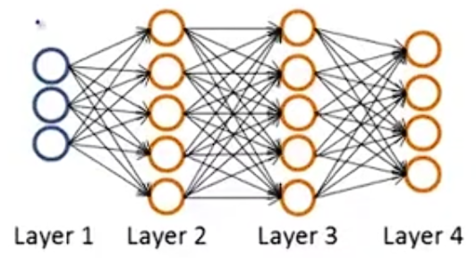
Gradient computation
Given one training example (x , y)
Let’s check the sequences of calculation with a single training example
Forward propagation:
a(¹ ) = x
Z⁽²⁾ = ϴ ⁽¹⁾ a ⁽¹⁾
a ⁽²⁾ = g( z (²⁾ ) (add a₀ ⁽²⁾ )
Z⁽³⁾ = ϴ ⁽²⁾ a ⁽²⁾
a ⁽³⁾ = g( z (³⁾ ) (add a₀ ⁽³⁾ )
Z⁽⁴⁾ = ϴ ⁽³⁾ a ⁽³⁾
a ⁽⁴⁾ = h_{ϴg}( z (⁴⁾ ) = g(z ⁽⁴⁾ )
Forward propagation and vectorization allows us to compute the values of activation to all neurons
a²
a³
a¹
a⁴ output

Slide 49
compute derivation: backpropagation. Intuition : δ_{j}^{l} = “ error of node j in layer l” (delta symbol)
Gradient computation : Backpropagation Algorithm
In Neural Networking model:
For each output unit (L= 4) :
δ_{j}⁴ = a⁴ _{j} - y_{j}
δ, a, y are vectors, then the vectorization of : δ4 = a4 - y . Each of these vectors whose dimension is equal to number of output units.
We computed δ4 for our output layer. We can compute the error term (δ) for another layer such l₃,l₂,…
^{a l}_{j} activation of node a at j in layer l
In vector y j-th element the label of training set
h_{θ} ((x))_{j}
hypothesis output
Also, we call it the actual value in our training set

Slide 50
Backpropagation Delta Terms (Sigmoid Activation)
𝛿^{𝑙} is the error term for layer 𝑙
𝑎^{𝑙} is the activation of layer 𝑙
𝑧^{𝑙} is the weighted input to layer 𝑙
Θ^{(𝑙)} is the weight matrix connecting layer 𝑙 to 𝑙+1
𝑔′(𝑧^{𝑙})=𝑎^{𝑙}⋅(1−𝑎^{𝑙}) for sigmoid activation

Slide 51
This derivative comes from applying the chain rule to the sigmoid function
d/dz (1/1 +e^{-(-z)} ) = e^{-z} / (1 + e^{(-z)} )²
Rewrite the expression (1/1 +e^{-(-z)} ) = (1 + e^{-(-z)} )⁻¹
Apply the Chain Rule: states that: d/dz[ f(g(z))] = f’ (g(z)).g’(z)
Let the outer function be f(u) = u⁻¹ and u = (1 +e^{-(z)} )
u⁻¹ = (1 +e^{-(-z)} )⁻¹
Derivative of outer function :
= -1 (1 +e-(-z) )⁻²
Multiply the derivative of inner function: -1 (1 +e-(z) )⁻² d/dz ((1 +e^{-(z)} ))
3. Differentiate the inner function: derivative a constant is 0 and derivative of e^{-(z)} requires a chain rule.
d/dz ((1 +e^{-(z)} ))= 0 + (e^{-(z) .} (-1) ) = - e^{-(z)}
4. Combine and simplify: - e^{-(z)} (-1 (1 +e-(z) )⁻² ) = e^{-(z)} (1+ e^{-(z)})⁻²
Convert the negative exponent back into a fraction format:
= e^{-(z)} / (1+ e^{-(z)})²
This derivative is frequently used in machine learning algorithms.

Slide 52
d/dz (1/1 +e^{-(z)} ) = e^{-z} / (1 + e^{(-z)} )²
= σ(z)(1- σ(z))
Proof:
Step-1: e^{-z} / (1 + e^{(-z)} )² = 1/(1 +e^{-(z)}) . (e^{-z} )/1 +e^{-(z)} )
or σ(z) . (e^{-z} )/1 +e^{-(z)} )
Step-2: add 1 and subtract -1 in numerator:
(e^{-z} )/1 +e^{-(z)} ) → (1 + (e^{-z} ) -1 ) /1 +e^{-(z)} )
Step-3 split: 1 + (e^{-z} ) / 1 + e^{-z} - -1 /1 +e^{-(z)} )
Step 4: substitute: 1 - σ(z)
Step-5 combine parts (σ(z) . (e^{-z} )/1 +e^{-(z)} )
multiply results: σ(z) (1 - σ(z))
So, in practice once you compute a², immediately use:
g’ = a² (1- a²)

Slide 53
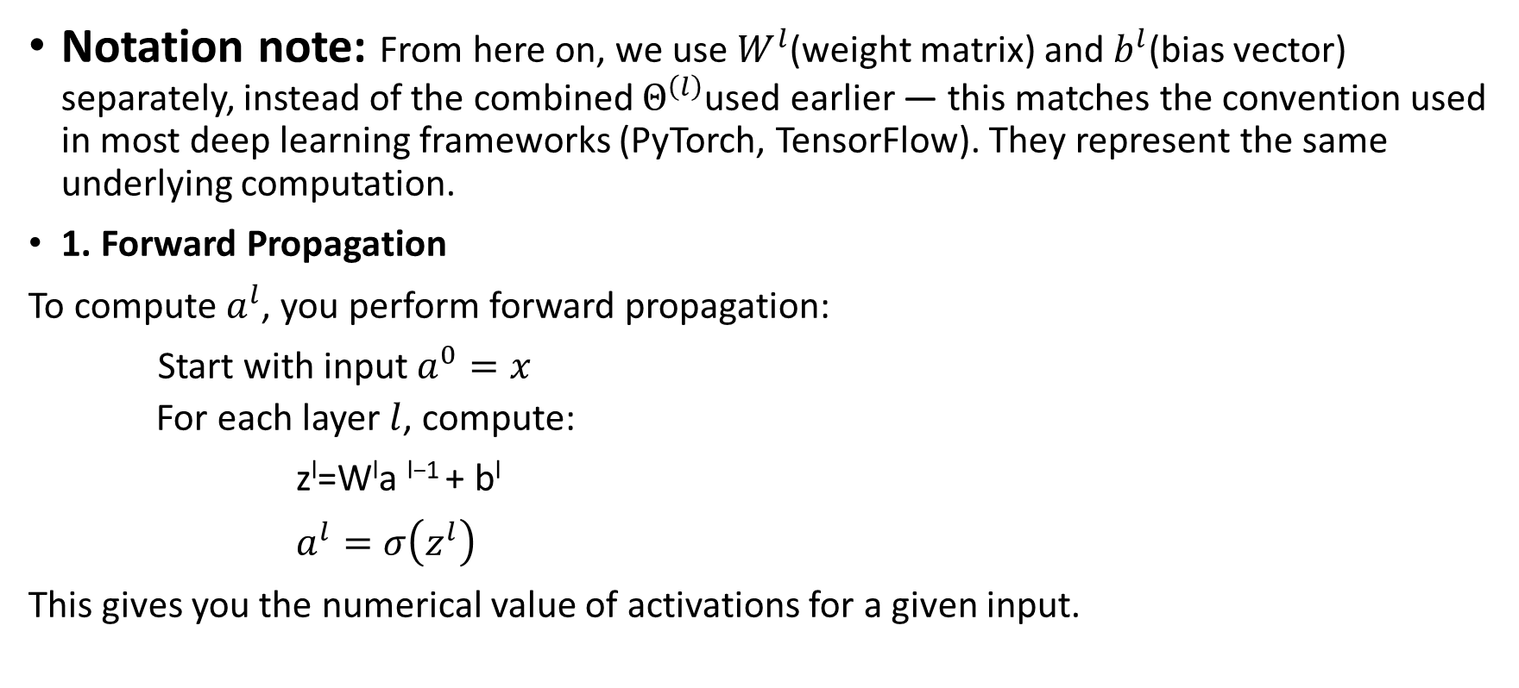
How to Measure or Compute a^{l}
Notation note: From here on, we use $W^{l}$(weight matrix) and $b^{l}$(bias vector) separately, instead of the combined $Θ^{\left(l\right)}$used earlier — this matches the convention used in most deep learning frameworks (PyTorch, TensorFlow). They represent the same underlying computation.
1. Forward Propagation
To compute $a^{l}$, you perform forward propagation:
Start with input $a^{0}=x$
  For each layer $l$, compute:
z^{l}=W^{l}a ^{l−1} + b^{l}
$a^{l}=σ\left(z^{l}\right)$
This gives you the numerical value of activations for a given input.

Slide 54
2. Inspecting Activations
If you're using a framework like PyTorch or TensorFlow:
- You can print or visualize a ^{l} during forward passes.
def forward(self, x):
z1 = self.fc1(x)
a1 = torch.relu(z1)
print("Activation of layer 1:", a1)
3. Statistical Summary
To measure activations across a dataset:
- Compute mean, variance, sparsity (fraction of near-zero activations), or histograms of a ^{l}
- This helps diagnose vanishing gradients or dead neurons
Why Measure Activations?
Debugging: Check if activations are saturating (e.g., sigmoid outputs near 0 or 1)
Visualization: Understand what features each layer is learning
Optimization: Adjust architecture or initialization if activations are poorly distributed

Slide 55
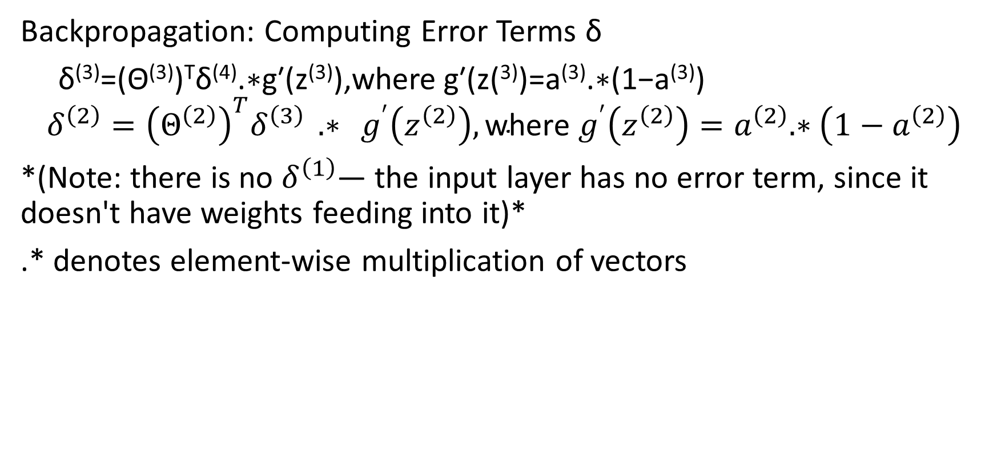
Backpropagation: Computing Error Terms δ
δ⁽³⁾=(Θ⁽³⁾)^{T}δ⁽⁴⁾.∗g′(z⁽³⁾),where g′(z(³⁾)=a⁽³⁾.∗(1−a⁽³⁾)
$$δ^{\left(2\right)}={\left(Θ^{\left(2\right)}\right)}^{T}δ^{\left(3\right)} .∗ g^{′}\left(z^{\left(2\right)}\right), \text{where }g^{′}\left(z^{\left(2\right)}\right)=a^{\left(2\right)}.∗\left(1−a^{\left(2\right)}\right)$$
*(Note: there is no $δ^{\left(1\right)}$— the input layer has no error term, since it doesn't have weights feeding into it)*
.* denotes element-wise multiplication of vectors

Slide 56
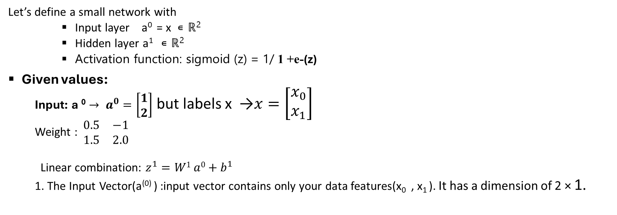
Example: 2- Node Input->2-Node Hidden layer
Let’s define a small network with
    Input layer a⁰ = x ∊ ℝ²
    Hidden layer a¹ ∊ ℝ²
    Activation function: sigmoid (z) = 1/ 1 +e-(z)
Given values:
  Input: a ⁰ $→ a^{0}=\left[\begin{matrix}1 \\ 2\end{matrix}\right]$ but labels x →$x=\left[\begin{matrix}x_{0} \\ x_{1}\end{matrix}\right]$
  Weight : $\begin{matrix}0.5 & −1 \\ 1.5 & 2.0\end{matrix}$
  Linear combination: $z^{1}=W1 a0+b^{1}$
  1. The Input Vector(a⁽⁰⁾ ) :input vector contains only your data features(x₀ , x₁ ). It has a dimension of 2 × 1.

Slide 57
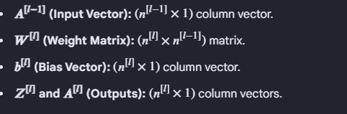
1. Layer Brackets vs. Unit Subscripts
Superscripts with Square Brackets [l]: Represent the layer number
Example: W^{[1]} means the weights for layer 1.
Subscripts -1:Represent the neuron unit index within that layer
Example: b₁^{[1]} means the bias for layer 1, neuron 1.
Standard Forward Propagation Formulas
re-activation Linear Combination:
Z^{[1]} = W^{[l ]} A^{[l-1]} + b^{[l]}
2. Post-activation Vector:
A^{[l]} = g( Z^{[1]} )

Slide 58
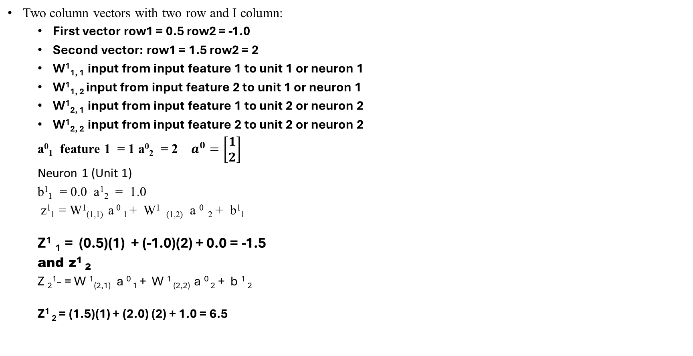
Compute Each Neuron’s Pre-Activation
Two column vectors with two row and I column:
  First vector row1 = 0.5 row2 = -1.0
  Second vector: row1 = 1.5 row2 = 2
  W¹_{1, 1} input from input feature 1 to unit 1 or neuron 1
  W¹_{1, 2} input from input feature 2 to unit 1 or neuron 1
  W¹_{2, 1} input from input feature 1 to unit 2 or neuron 2
  W¹_{2, 2} input from input feature 2 to unit 2 or neuron 2
  a⁰₁ feature 1 = 1 a⁰₂ = 2 $a^{0}=\left[\begin{matrix}1 \\ 2\end{matrix}\right]$
  Neuron 1 (Unit 1)
  b¹₁ = 0.0 a¹₂ = 1.0
  z¹₁ = W¹_{(1,1)} a ⁰ ₁ + W¹ _{(1,2)} a ⁰ ₂ + b¹₁
  Z¹ ₁ = (0.5)(1) + (-1.0)(2) + 0.0 = -1.5
  and z¹ ₂
  Z ₂^{1_} = W ¹_{(2,1)} a ⁰ ₁ + W ¹ _{(2,2)} a ⁰ ₂ + b ¹ ₂
  Z¹ ₂ = (1.5)(1) + (2.0) (2) + 1.0 = 6.5

Slide 59
Summary of what each number means
Symbol | Meaning | Value
a ⁰ ₁ | First Input Feature | 1
a ⁰ ₂ | Second Input Feature | 2
W¹_{1, 1} | Weight from input 1 to neuron 1 | 0.5
W¹_{1, 2} | input from input 2 to neuron1 | -1.0
W¹_{2, 1} | Weight from input 1 to neuron 2 | 1.5
W¹_{2, 2} | Weight from input 2 to neuron 2 | 2.0
b¹ ₁ | Bias for neuron 1 | 0.0
b¹ ₂ | Bias for neuron 1 | 1.0

Slide 60
Why using ϴ ( ^T)?
Backpropagation Recall:
In backpropagation, we compute the error term δ^{l} for each layer l, which tells us how much each neuron in layer l contributed to the overall error.
δ ³ = ϴ ^{(3) T} δ⁴ . *g′( z⁽³⁾)
The recursive formula is:
δ^{l} = ϴ ^{T} δ ^{l +1} .* g′( z ^{l} ))
If you're using sigmoid activation, then:
𝑔′(𝑧^{𝑙})=𝑎^{𝑙}⋅(1−𝑎^{𝑙}) for sigmoid activation
Direction of flow:
Θ^{1:} maps from layer l to layer l+1 during forward propagation
But during backpropagation, we move backward — from δ^{l + 1} to δ^{l}
So, we need to reverse the direction of the weight flow:
That’s why we use the transpose ϴ^{(l) T}.

Slide 61
This breakdown verifies that the matrix dimensions in the backpropagation equations align perfectly for valid matrix multiplication.
Core Variable Definitions
l: The current layer index.
l+1:The next layer (downstream toward the output).
n _{l} : The number of neurons in layer (l) (excluding bias).
n _{l +1}: The number of neurons in layer l+1
Step-by-Step Dimensional Breakdown:
Weight Matrix (ϴ^{l} ) : ϴ^{l} ∈ ℝ^{n}_{l+1} ^{x} ^{n}_{l}
Meaning: This matrix contains the weights connecting layer (l) to layer (l+1).
Dimensions: It has n_{l+1} rows and n_{l} columns
Note: If your notation includes a bias unit, the column dimension becomes n_{l} + 1. The prompt assumes dimensions without the bias column for simplicity.

Slide 62
Transposed Weight Matrix (ϴ^{lT})
ϴ^{lT} ∈ ℝ ^{n}_{l} ^{x} ^{n}_{l +1}
Meaning: Transposing flips the rows and columns of the weight matrix.
Dimensions: The rows(n_{l+1} ) and columns(n_{l} ) swap, resulting in(n_{l}) rows and n_{l+1} columns.
3. Error Vector δ ^{l+1}:
δ ^{l+1} ∈ ℝ ^{n} _{l +1} ^{x 1}
Meaning: This is the error vector belonging to the next layer (l + 1).
Dimensions: It is a column vector with n_{l+1} rows and 1 column.
The Final Element-Wise Step
The complete backpropagation equation is:
δ^{l} = ϴ^{lT} δ^{l+1} .* g’(z^{l})
We just proved that (ϴ^{lT} δ^{l+1} ) is of size (n_{l} + 1) (one value per neuron in layer l).

Slide 63
Number of neurons(n₀ ): the input layer has exactly 3 features/neurons.
Activation Vector(a⁰ ):The "activation" of the input layer is simply the raw input data vector x.
Dimension(ℝ³): Because there are 3 neurons,a⁰ is a 3-dimensional real-valued column vector (3 x 1).
Moving to Layer 1:
If your next hidden layer (Layer 1) has, for example, n₁ = 5 neurons:
ϴ⁰ will have dimensions n₁ x n₀ = 5 x3.
The net input z¹ = ϴ⁰ a⁰ will multiply (5 x 3) x(3 x1) = 5 x1, matching the 5 neurons of Layer 1 perfectly.
Note:
layer 0 input: n_0 3 neurons.
a^0 ∈ℝ^n_0 =ℝ ^3

Slide 64
Continued Notation
ϴ⁰ ∈ ℝ^{n_1 x n_0} = ℝ ^{5x3}
ϴ^{0 :} A weight matrix (commonly used in machine learning and neural networks).
n₁ =5: The number of rows (typically representing the number of neurons in the current layer).
n ₀ = 3: The number of columns (typically representing the number of inputs or neurons in the previous layer).
Means:
There are 5 neurons in layer 1 (the next layer)
Each of those 5 neurons is connected to all 3 inputs from layer 0
So, the weight matrix ϴ⁰ has:
  5 rows -> one for each neuron in layer 1
  3 columns -> one for each input feature from layer 0
“Times”
Each neuron in layer 1 receives a weighted sum of all 3 inputs from layer 0-so, it’s “connected to”all n₀ = 3 inputs

Slide 65
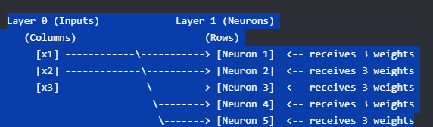
The Physical Meaning of "5 times 3"

Slide 66
Back propagation and partial derivatives
Calculating 𝛿 error output layer and then backward calculating:
δ³ ⁼ ϴ ^{(3) ^T} δ⁴ . *g’( z⁽³⁾) a⁽³⁾ .* (1- a⁽³⁾ )
δ²⁼ ϴ ^{(2) ^T} δ^{3 .} g’( z⁽²⁾) a(2) .* (1- a(2) )
Derivation of the partial derivatives is given by activation term a^{l} _{j} and δ^{l}_{i} ⁺¹
𝛿/𝛿 ϴ^{l} _{ij} J(ϴ) = a^{l} _{j} δ^{l}_{i} ⁺¹ ignoring λ; if λ =0
Put all things together and implement the backpropagarion and calculate the derivatives with respec to parametersand considering a large training set not jus a simple and single training set.
Back propagation algorithm:
Sppose that m training set are given:
training set :{(x⁽¹⁾,y ⁽¹ )), (x²,y² ) , ..., x (m ) , (y^{(m)})}
Set Δ_{ij} ^{l} = 0 for all l, i j Δ is used to compute the partial derivative of 𝛿/𝛿 ϴ^{l} _{ij} J(ϴ) = a^{l} _{j} δ^{l}_{i} ⁺¹
Δ will accumulator and slowly adds the all-partial derivatives.

Slide 67
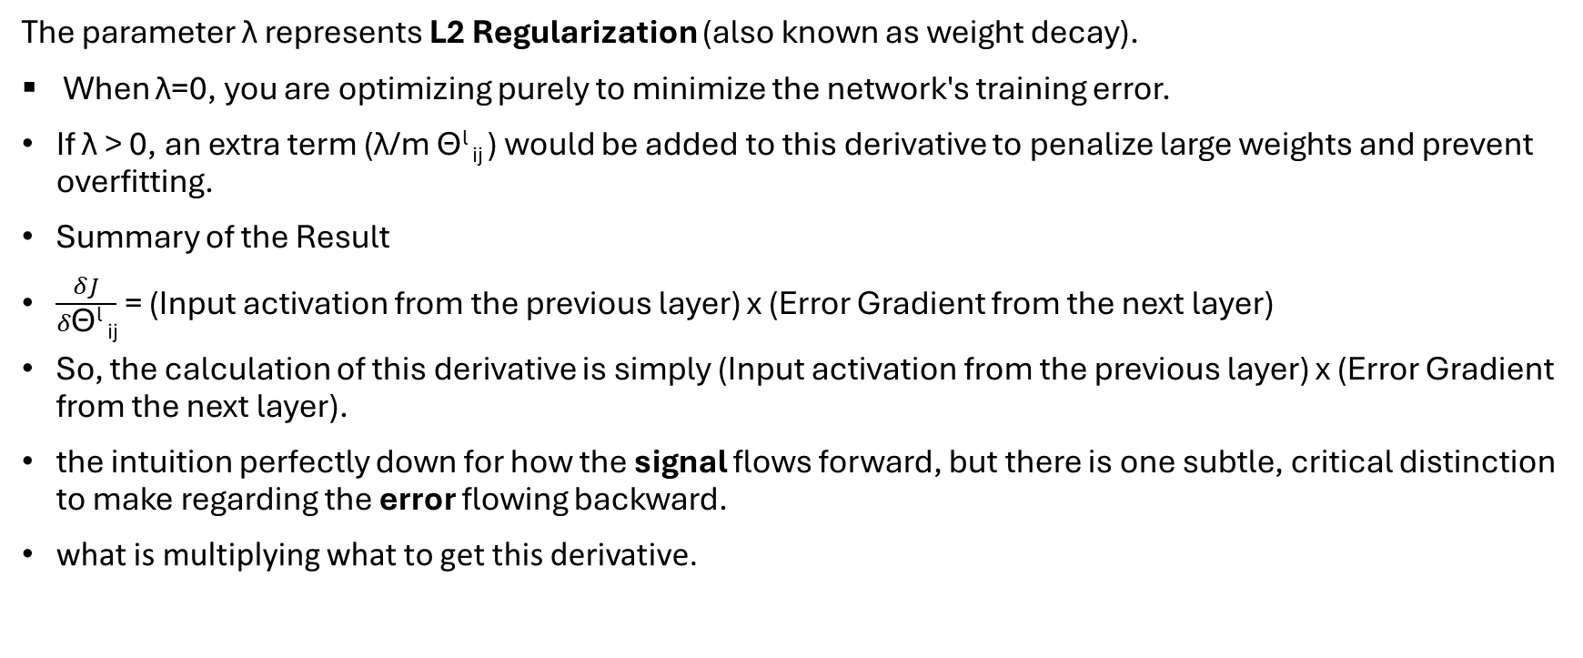
What "Ignoring λ means?
The parameter λ represents L2 Regularization (also known as weight decay).
When λ=0, you are optimizing purely to minimize the network's training error.
If λ > 0, an extra term (λ/m ϴ^{l} _{ij} ) would be added to this derivative to penalize large weights and prevent overfitting.
Summary of the Result
$\frac{δJ}{δ\text{ϴ}\text{l }\text{ij}}$ = (Input activation from the previous layer) x (Error Gradient from the next layer)
So, the calculation of this derivative is simply (Input activation from the previous layer) x (Error Gradient from the next layer).
the intuition perfectly down for how the signal flows forward, but there is one subtle, critical distinction to make regarding the error flowing backward.
what is multiplying what to get this derivative.

Slide 68
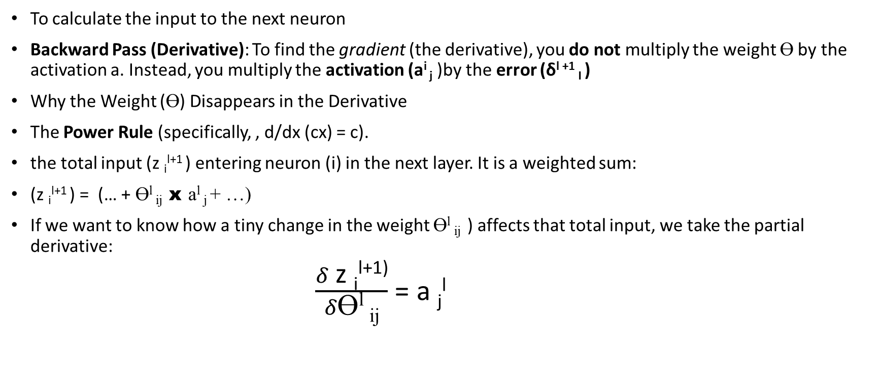
Forward Pass (Signal): ϴ^{l} _{ij} x a^{l} _{j}
To calculate the input to the next neuron
Backward Pass (Derivative): To find the gradient (the derivative), you do not multiply the weight ϴ by the activation a. Instead, you multiply the activation (a^{i} _{j} )by the error (δ^{l +1} _{I} )
Why the Weight (ϴ) Disappears in the Derivative
The Power Rule (specifically, , d/dx (cx) = c).
the total input (z _{i}^{l+1} ) entering neuron (i) in the next layer. It is a weighted sum:
(z _{i}^{l+1} ) = (… + ϴ^{l} _{ij} x a^{l} _{j} + …)
If we want to know how a tiny change in the weight ϴ^{l} _{ij} ) affects that total input, we take the partial derivative:
$\frac{δ \text{z }\text{i}\text{l+1}\text{)}}{δ\text{ϴ}\text{l }\text{ij}}$ = a _{j}^{l}

Slide 69
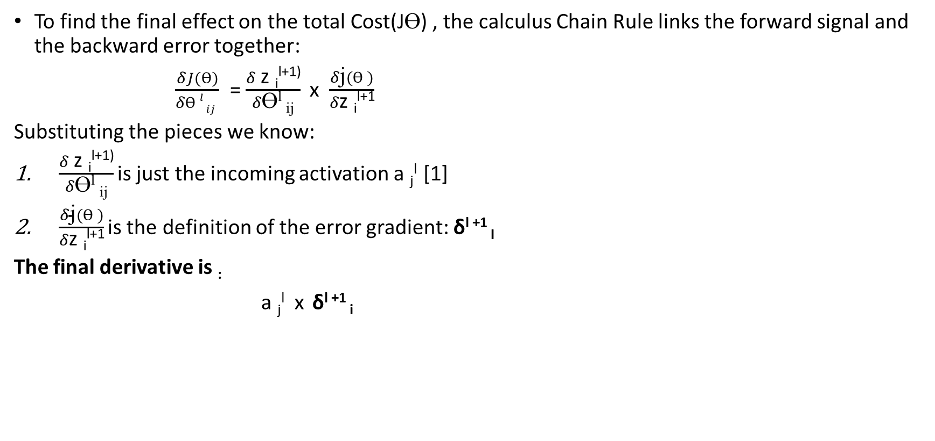
Putting the Chain Rule Together
To find the final effect on the total Cost(JƟ) , the calculus Chain Rule links the forward signal and the backward error together:
$\frac{δJ(Ɵ)}{δƟ l ij }$ = $\frac{δ \text{z }\text{i}\text{l+1)}}{δ\text{ϴ}\text{l }\text{ij}}$ x $\frac{δ\text{j}(Ɵ )}{δ\text{z }\text{i}\text{l+1}}$
Substituting the pieces we know:
$\frac{δ \text{z }\text{i}\text{l+1)}}{δ\text{ϴ}\text{l }\text{ij}}$is just the incoming activation a _{j}^{l} [1]
$\frac{δ\text{j}(Ɵ )}{δ\text{z }\text{i}\text{l+1}}$is the definition of the error gradient: δ^{l +1} _{I}
The final derivative is :
a _{j}^{l} x δ^{l +1} _{i}

Slide 70
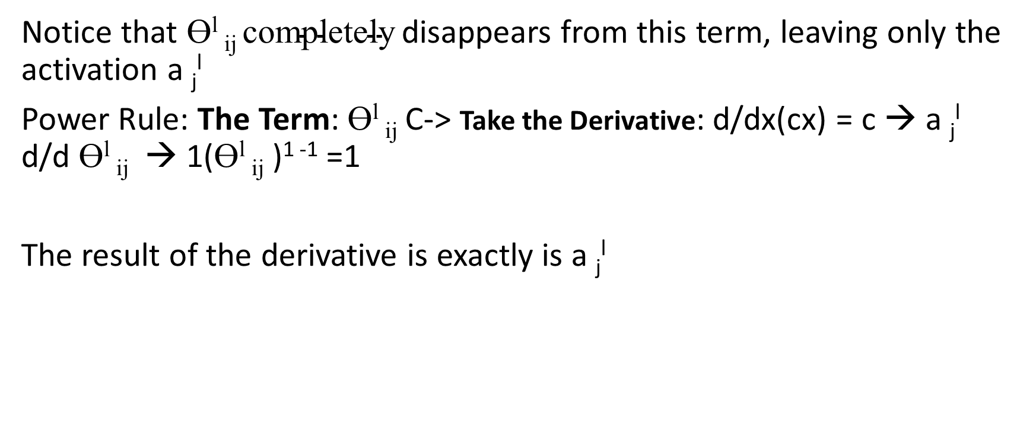
$\frac{δ \text{z }\text{i}\text{l+1)}}{δ\text{ϴ}\text{l }\text{ij}}$is just the incoming activation a _{j}^{l} [1]
Notice that $\text{ϴ}\text{l }\text{ij }\text{completely}$disappears from this term, leaving only the activation a _{j}^{l}
Power Rule: The Term: $\text{ϴ}\text{l }\text{ij}$ C-> Take the Derivative: d/dx(cx) = c → a _{j}^{l} d/d $\text{ϴ}\text{l }\text{ij}$ → 1($\text{ϴ}\text{l }\text{ij}$ )¹ ⁻¹ =1
The result of the derivative is exactly is a _{j}^{l}

Slide 71

$\frac{δ\text{J}(Ɵ )}{δ\text{z }\text{i}\text{l+1}}$is the definition of the error gradient:δ^{l +1} _{I}
If total unactivated input(z) to neuron I in layer l+1 changes a tiny amount, how much the total final error(J) will change?
J(Ɵ): The total error of the network.
Z _{i}^{l+1:} raw, weighted input value right before right before it passes through the activation function(like sigmoid or ReLU)
We call δ the "error term" because it captures exactly how much a specific neuron is to blame for the network's bad guess.
1. If δ^{l +1} _{I} is near zero; it means this neuron is perfectly balanced and its current state isn't hurting the network's performance.
To see how the derivative results in δ^{l +1} _{I} we have to unpack what δ^{l +1} _{I} actually stands for. It a definition or a shortcut symbol invented by mathematicians to avoid writing a massive chain rule fraction over and over again,
Here is the exact step-by-step breakdown of how that derivative expands into its final calculable form.

Slide 72

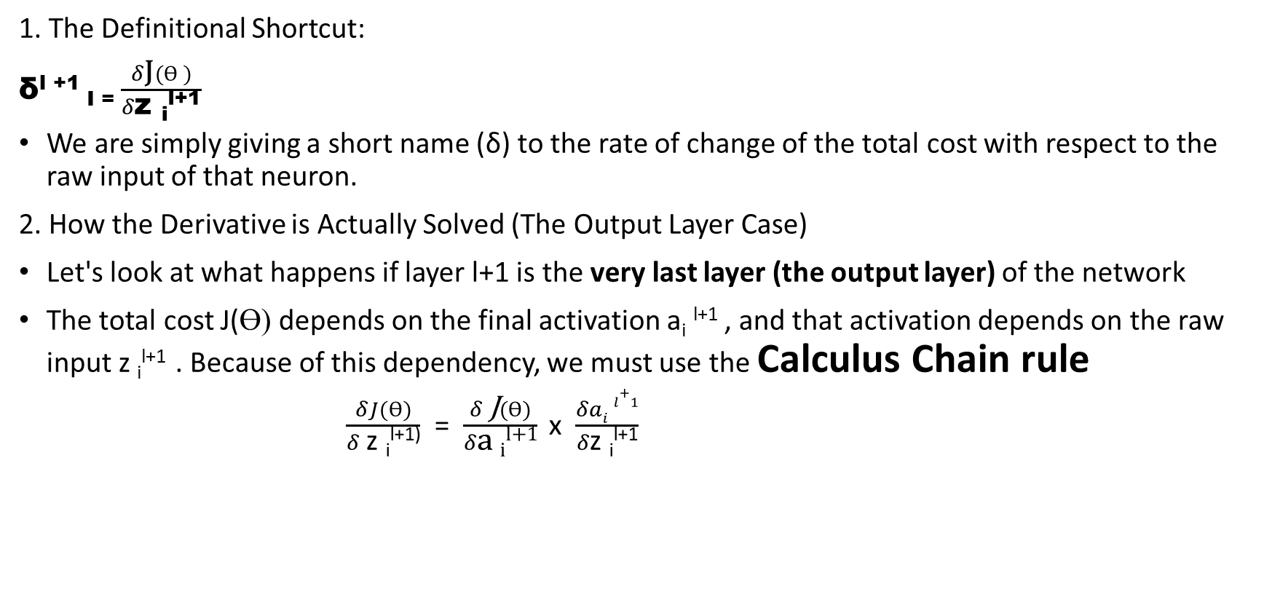
1. The Definitional Shortcut:
δ^{l +1} _{I =} $\frac{δ\text{J}(Ɵ )}{δ\text{z }\text{i}\text{l+1}}$
We are simply giving a short name (δ) to the rate of change of the total cost with respect to the raw input of that neuron.
2. How the Derivative is Actually Solved (The Output Layer Case)
Let's look at what happens if layer l+1 is the very last layer (the output layer) of the network
The total cost J(Ɵ) depends on the final activation a_{i} ^{l+1} , and that activation depends on the raw input z _{i}^{l+1} . Because of this dependency, we must use the Calculus Chain rule
$\frac{δJ(Ɵ)}{δ \text{z }\text{i}\text{l+1)}}$ = $\frac{δ \text{J}(Ɵ)}{δ\text{a }\text{i}\text{l+1}}$ x $\frac{δai l+1}{δ\text{z }\text{i}\text{l+1}}$

Slide 73
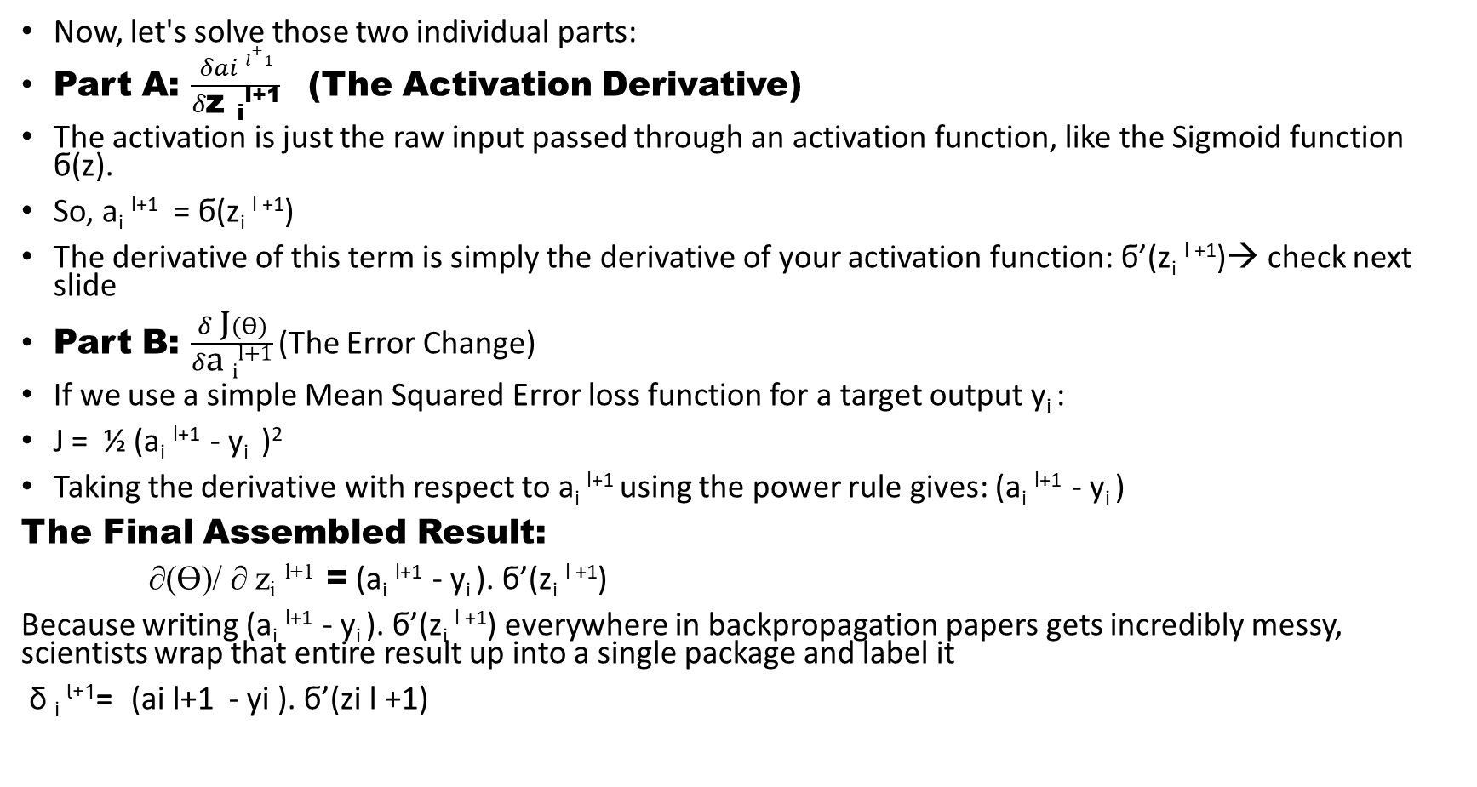
Now, let's solve those two individual parts:
Part A: $\frac{δai l+1}{δ\text{z }\text{i}\text{l+1}}$ (The Activation Derivative)
The activation is just the raw input passed through an activation function, like the Sigmoid function ϭ(z).
So, a_{i} ^{l+1} = ϭ(z_{i} ^{l +1})
The derivative of this term is simply the derivative of your activation function: ϭ’(z_{i} ^{l +1})→ check next slide
Part B: $\frac{δ\text{ J}(Ɵ)}{δ\text{a }\text{i}\text{l+1}}$(The Error Change)
If we use a simple Mean Squared Error loss function for a target output y_{i} :
J = ½ (a_{i} ^{l+1} - y_{i} )²
Taking the derivative with respect to a_{i} ^{l+1} using the power rule gives: (a_{i} ^{l+1} - y_{i} )
The Final Assembled Result:
∂(Ɵ)/ ∂ z_{i} ^{l+1} = (a_{i} ^{l+1} - y_{i} ). ϭ’(z_{i} ^{l +1})
Because writing (a_{i} ^{l+1} - y_{i} ). ϭ’(z_{i} ^{l +1}) everywhere in backpropagation papers gets incredibly messy, scientists wrap that entire result up into a single package and label it
δ _{i} ^{l+1}= (ai l+1 - yi ). ϭ’(zi l +1)

Slide 74
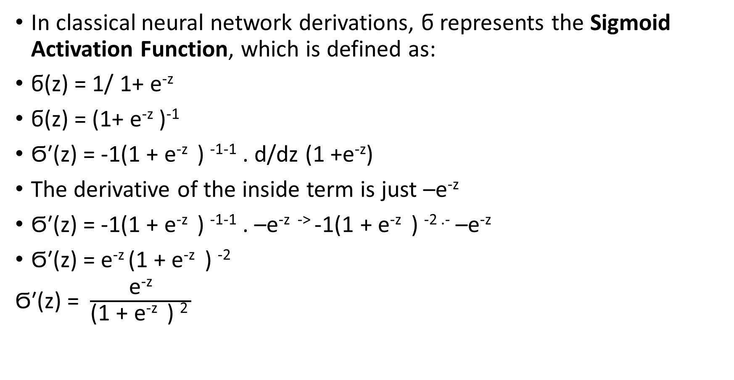
In classical neural network derivations, ϭ represents the Sigmoid Activation Function, which is defined as:
ϭ(z) = 1/ 1+ e^{-z}
ϭ(z) = (1+ e^{-z} )⁻¹
Ϭ′(z) = -1(1 + e^{-z} ) ⁻¹⁻¹ . d/dz (1 +e^{-z})
The derivative of the inside term is just –e^{-z}
Ϭ′(z) = -1(1 + e^{-z} ) ⁻¹⁻¹ . –e^{-z ->} -1(1 + e^{-z} ) ^{-2 .-} –e^{-z}
Ϭ′(z) = e^{-z} (1 + e^{-z} ) ⁻²
Ϭ′(z) = $\frac{\text{e}\text{−z}}{\text{(1 + e}\text{−z ) 2 }}$

Slide 75
Back propagation and partial derivatives
The backpropagation equations used to calculate error terms (δ)in a standard neural network.
These equations flow backward from the output layer to the hidden layers to determine how much each neuron contributed to the total error.
1. Output Layer Error
δ_{j}⁴ = a⁴ _{j} - y _{j}
Meaning: This calculates the error at the final output layer.
a⁴ _{j} is the predicted activation of output neuron j.
y _{j} is the actual target value (ground truth).
2. Hidden Layer 3 Error
δ3 = ϴ (3) T δ4 . * g’ ( z(3)) a(3) .* (1- a(3) )
ϴ (3) T is the transposed weight matrix connecting Layer 3 to Layer 4.
δ4 is the error vector from the output layer.
g’ ( z(3)) is the derivative of the activation function evaluated at the net input
3. Hidden Layer 2 Error
δ ²= ϴ ^{(2) T} δ ³ . * g’ ( z⁽²⁾ ) a ⁽²⁾ .* (1- a ⁽²⁾ )
Meaning: This passes the error backward from Layer 3 to Layer 2 using the exact same logic as the previous step.
4. There is no δ¹ because Layer 1 is the input layer. These values are fixed data points, not the results of weights or activations.

Slide 76
The Backpropagation Algorithm
Initialization
set ∆_{ij}^{(l )} = 0 for all layers l, row indices i, and column indices j.
Loop Over Training Examples
For each training example i = 1 to m
Set Input Activation
a^{(l)} = x^{(i)}
2. Forward Propagation:
Compute the activation vectors a^{(l)} for all subsequent layers l =2,3 ,…, L
3. Compute Output Error:
δ^{[L]} = a^{[L]} – y^{(i)}
4. Backpropagate Errors:
Compute the error vectors δ^{[L-1]}, δ^{[L-2]}, …, δ^{[2]} using the layer-by-layer update rules.
No delta error for input layer 1
5. Accumulate Gradients

Slide 77
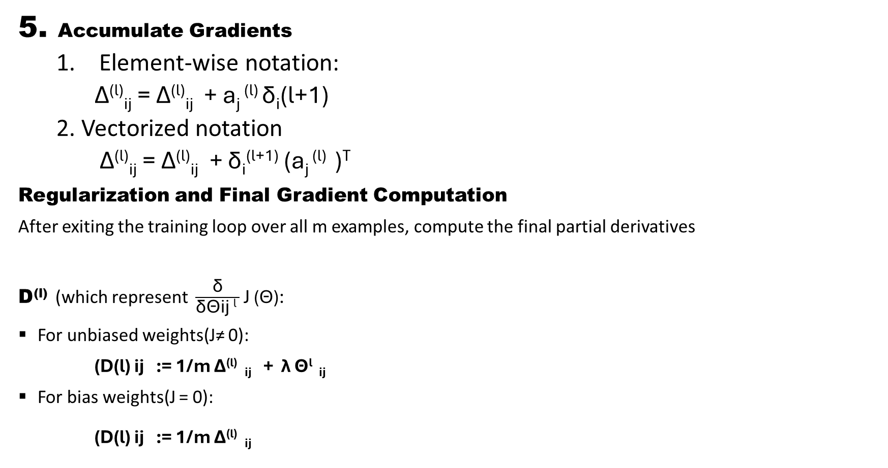
5. Accumulate Gradients
  Element-wise notation:
  ∆^{(l)}_{ij} = ∆^{(l)}_{ij} + a_{j} ^{(l)} δ_{i}(l+1)
  2. Vectorized notation
  ∆^{(l)}_{ij} = ∆^{(l)}_{ij} + δ_{i}^{(l+1)} (a_{j} ^{(l)} )^{T}
Regularization and Final Gradient Computation
After exiting the training loop over all m examples, compute the final partial derivatives
D^{(l)} (which represent $\frac{\text{δ}}{\text{δ}\text{ϴ}\text{ij }\text{l} }$ J (ϴ):
For unbiased weights(J≠ 0):
(D(l) ij := 1/m ∆^{(l)} _{ij} + λ ϴ^{l} _{ij}
For bias weights(J = 0):
(D(l) ij := 1/m ∆^{(l)} _{ij}

Slide 78

Mechanical steps of backpropagation
It is like a block with so many magical details.
Let’s look again to feedforward propagation:
Bias units
1 output unit
Two input units not counting bias units: x_{1,} x₂
Hidden units

Slide 79
Mechanical Steps of Forward Propagation
Concept: Pre-Activation vs. Activation
we must track exactly how a single node processes information during forward propagation:
Pre-activation(z^{l}):
The weighted linear combination of inputs before an activation function is applied.
𝑧 ^{𝑙} =Ɵ(^{l-1)} a^{(l-1)}
2. Activation (a ^{l}): The final output of the neuron after applying the non-linear activation function g(z)
a ^{l} = g(z ^{l})
3. Network Visual Mapping from Prof. Andrew Ng is shown in the next slide

Slide 80


Z = θ^{T} x = $\sum_{i=1 }^{n}{θi x i}$. This is a linear combination of inputa before applying any activation
a₂ ²
?

Slide 81
What is backpropagation doing
For a single output, Andrew Ng writes the cost function for (m) examples as:
J(Ɵ) = 1/m ∑_{i=1}^{m} [y^{(i)} log(h_{θ} ( x^{(i)}) + (1−y (^{i)}) log(1− h_{θ} (x ^{(i)}))]
Focusing on a single example: (x^i, y^i), J(Ɵ) will be :
y^(i)log(h_θ( x^(i)) + (1−y^(i))log(1−h_θ(x^(i))).
For a case of a single output, and ingnoring regularization(λ = 0)
So, cost(i) = y^(i)log(h_θ( x^(i)) + (1−y^(i))log(1−h_θ(x^(i)))
Think of cost(i) = ((h₀(x^{(i)} ) - y ^{(i)})^2) that is "square difference of predicted and actual value / labeled value".
In backpropagation, the network uses calculus to determine exactly how much each weight and bias contributed to the final prediction error for that specific example i.
In backpropagation for a single example, the network evaluates its error
δ^{(i)} = ((h₀(x^{(i)} ) - y ^{(i)})^2)
and passes this value backward through the network's layers using the chain rule to compute exactly how to adjust every weight and bias to reduce that specific error.

Slide 82
Intuition Behind Backpropagation
1. The Direct Correction: Cost vs. Backpropagation
What the cost function does: The formula cost(i)) determines how well the network is doing on example (i) by outputting a single number (the error).
What backpropagation does: Backpropagation determines how to fix the network's mistakes. It calculates exactly how much to change every weight and bias to make that error smaller next time.
2. How Backpropagation Works for Your Single-Output Case
When you isolate a single example (x^{(i)} , y^{(I)} ), backpropagation uses the calculus chain rule to calculate the gradient of your cos(i) with respect to the weights. Assuming a standard sigmoid activation function
h_{θ}(x^{(i)} ) = ϭ( z^{(i)} ), the math simplifies into something beautiful:
1. Calculate the Output Error
δ^{(i)} = ((h₀(x^{(i)} ) - y ^{(i)})^2)
2. Calculate the Weight Updates:
Backpropagation takes that error and multiplies it by the incoming signal (a)from the previous layer:
∂ cost(i)/ ∂ w = δ^{(l) .} a ^{(previous layer)}

Slide 83
how the gradient ∂C/ ∂w results in δ^{(l)} . a^{l-1}
1. Identify the Chain Rule Components
The weight w^{(l)} connects the activation of the previous layer a^{(l-1)} to the net input z^{(l)} of the current layer. The net input then determines the activation a^{(l)} , which finally affects the total cost (C).
To find how changes in a specific weight affect the cost, we apply the calculus chain rule: [1
∂C/ ∂w^{(l)} = ∂ C/ ∂z^{(l)} . ∂ z/ ∂w^{(l)}
2. Define the Error Term (δ)
In backpropagation, the error term for any given layer (l) is mathematically defined as the partial derivative of the cost with respect to that layer's net input (z).
δ^{(l)} = ∂ C/ ∂ z^{(l)}
Substituting δ^{(l)} back into our chain rule equation simplifies it to:
∂C/ ∂w^{(l)} = δ^{(l) )} . ∂ z/ ∂w^{(l)}

Slide 84
3. Calculate the Incoming Signal
Next, we look at the forward pass equation for the net input z in layer l:
z^{(l)} = w^{(l)} . a^{(l-1)} + b⁽¹⁾
If we take the partial derivative of z^{(l)} with respect to the weight w^{(l)} , the bias b and any other constant drop out. We are left with just the incoming activation signal:
∂ z^{(l)} / ∂ w^{(l) =} a^{(l-1)}
4. Combine the Pieces
Now, substitute the result from Step 3 back into the simplified chain rule equation from Step 2:
∂C/ ∂w^{(l) =} δ^{(l) ).} a^{(l-1)}

Slide 85
The Cost Function: Calculates the penalty size (the "how bad is the guess" score).
The Intuition (h₀(x ) - y ): Becomes the exact driver of the backpropagation step.
Backpropagation: Takes that difference, passes it backward through the layers, and calculates the exact adjustments needed for every weight and bias.

Slide 86

How well is our network doing? We calculate δ^{l}_{j} for a^{l}_{j}
Think of partial derivative and intermediate values of computations like z, activation a.
δ/ δ z^{i} _{j} cost(i) . Cost function is h_{θ} (x^{(i)} - y^{(i).} Label value

Slide 87

δ⁽⁴⁾₁ = y^{(i)} - a⁴₁ . We calculate this using Feedforward and then use δ⁽⁾₁ ⁴ in the Backpropagation
δ₂⁽²⁾ = ϴ₁₂⁽²⁾ δ₁⁽³⁾ ⁺ ϴ₂₂⁽²⁾ δ₂⁽³⁾
Hypothesis predicted value minus the label y as actual will indicate the cost function. The change in z_{j}^{l} will effect on (δ/ δ z^{i} _{j}) and on intermediate computation.

Slide 88

Using backpropagation to calculate: δ^{(l)}_{j} = y^{(i)} - a^{i} _{j}

Slide 89
Implementation of a 4-layer Neural Network and un-rolling parameters
To implement fminunc with a 4-layer Neural Network, must unroll all network weights into a single vector because fminunc only accepts an ID column vector of parameters. Inside objective function, use matrix indexing to reshape this vector back into individual weight matrices inside cost function.
1. The Cost Function Structure
The fminunc function passes a single unrolled vector (thetaVec) into your cost function.
You must immediately reshape (reshape) that vector back into the original matrix dimensions to perform forward and backward propagation.

Slide 90
Implementation and un-rolling parameters
Advanced Optimization:
function [Jval, gradVec] = nnCostFunction(thetaVec, input_layer_size, ... hidden_layer_1, hidden_layer_2, num_labels, X, y, lambda) ……
% Set optimization options (Obsolete legacy function)options = optimset('GradObj', 'on', 'MaxIter', 400);
% Modern equivalent for fminunc:
options = optimoptions('fminunc', 'SpecifyObjectiveGradient', true, ... 'MaxIterations', 400);
[optTheta, functionVal, exitFlag] = fminunc(@(t) nnCostFunction(t, ...), initialTheta, options);
optTheta = fminunc(@costFunction, initialTheta, options)
fminunc(...): Optimization solver function call.
nnCostFunction: Neural network cost function returning cost and gradient.
initialTheta: Unrolled vector of initial network weights.
Optons: The optimization configuration function

Slide 91

An example of neural network, and we like to convert the matrices to vectors:
Example
S1 = 10, s2 =10, s3 = 1
ϴ⁽¹⁾ ∈ ℝ^{10x11} , ϴ^{(2) ∈ ℝ10x11} , ϴ⁽³⁾ ∈ ℝ^{1x11}
D⁽¹⁾ ∈ ℝ^{10x11} , D⁽²⁾ ∈ ℝ^{10x11} , D⁽³⁾ ∈ ℝ^{1x11}
Take all elements of ⁽ϴ⁽¹⁾ , ϴ⁽²⁾ , ϴ⁽³) and convert to vector and store in thetaVec
thetaVec = [Theta1(:), Theta2( : ) , Theta3(: ) ];
Dvec = [D1(:) ; D2(:) ;D3(:) ];
You can also reshape and roll back to matrices:
Theta1 = reshape((thetaVec(1:110), 10, 11);
Theta2 = reshape((thetaVec(111:220), 10, 11);
Theta3 = reshape((thetaVec(221:230), 1, 11);
Last layer =1 unit output
Reshape 10X11 = 110 take this and reshape to matrix. Same to other two vectors too.
Second: 110 +110 = 220
Third : 221+ 11 = 231

Slide 92

A quick Octave demo
Using GNU Octave, version 3.2.4
Copyright ( C ) 2009 John W. Eaton and others.

Slide 93


Convert Vector back to matrices
At command line: >>> PS1(‘>>’)Type: Theta1 = ones(10, 11) and return

Slide 94
Demo
>> Theta1 = ones(10,11)
>> Theta2 = 2*ones(10,11)
>> Theta3 = 3*ones(1,11)
flatten the arrays vertically using thetaVec = [Theta1(:); Theta2(:); Theta3(:)]; or keep them separate in a cell array.
>> >> thetaVec = [Theta1(:); Theta2(:); Theta3(:)];
Cell Array Storage:
>> thetaVec = {Theta1, Theta2, Theta3};
thetaVec =
{
[1,1] = 1 1 1 1 1 1 1 1 1 1 1
[1,2] = 2 2 2 2 2 2 2 2 2 2 2
[1,3] = 3 3 3 3 3 3 3 3 3 3 3
}

Slide 95
Gradient checking
There are some unsettled errors in the neural networks. Computing delta and others intermediate parameter will result In a calculation of cost function. So, the codes that you are writing for the derivatives indeed computing of the cost function accurately.
Numerical Estimation of Gradients: Consider the J(ϴ ) and some values and ϴ is a raw data (ϴ ∈ ℝ ). The derivative is the slope of tangent to the curve. To estimate the derivatives, slope as tangent is used to approximation of the derivative and the secant line with (ϴ + ϶ ) and (ϴ - ϶ )approach to tangent line from above and underneath of the curve and look at the vertical lines. So, this double check makes you confident that you are implementing the forward and back propagation correctly and error free.

Slide 96

Gradient checking
The Goal: We use numerical gradient estimation to double-check that our backpropagation code computes derivatives accurately.
The Logic: Computing deltas and other intermediate parameters during backpropagation yields analytical derivatives of the cost function.
Numerical Estimation: Consider the cost function J(θ) for some parameter values, where θ represents the model weights (θ∊R).
The Method: The derivative is the slope of the tangent line to the curve. We approximate this slope using a secant line passing through (θ + ε) and (θ - ε), which approaches the tangent line from both sides.
The Benefit: This double-check gives you confidence that your forward and backpropagation algorithms are implemented correctly and are error-free.
$\frac{d}{dƟ} J\left(Ɵ\right) ≈ \frac{J\left(Ɵ+ ε\right)−J(Ɵ −ε )}{2ε}$
ε = 10-4
In python: J(theta + eps) – J(theta – eps) / ((2*eps).

Slide 97


Slide 98


Gradient checking
Numerical Estimation of gradients
J(Ɵ + ε)
J(Ɵ)
J(Ɵ- ε)
J(Ɵ + ε) – J(Ɵ- ε)
Ɵ ∊ ℝ
2ε
Ɵ- ε
Ɵ
Ɵ + ε
$\frac{d}{d\text{Ɵ} }$J(Ɵ) = $\frac{\text{J(Ɵ + }\text{ε}\text{)} \text{ −}\text{J(}\text{Ɵ−}\text{ ε}\text{) }}{\text{2}\text{ε} }$
ε = 10⁻⁴

Slide 99


Slide 100
Numerical Estimation &Gradient checking
Implement: only as a debugging tool to verify your backpropagation code.
Catches Bugs: Backpropagation is notoriously difficult to debug. A small mistake in calculus or array indexing can ruin your network's learning.
Gold Standard: This numerical approximation is almost always correct because it relies on high-school algebra rather than complex chain-rule calculus.
Verification: If your backpropagation vector (DVec) matches your numerical vector (gradApprox) within a tiny margin (e.g., 10⁻⁹), you can be 100% confident your code is correct.

Slide 101
% 1. DEFINE THE COST FUNCTION (J) AND DATA (theta)
use a function handle '@(x)' so Octave treats J as a math function, not a matrix.
% Example function: J(θ) = θ³
J = @(x) x.^3;
% initialize theta
theta = 2.5;
%2. INITIALIZE VARIABLES FOR NUMERICAL ESTIMATION
EPSILON = 1e-4; % The tiny perturbation step (epsilon)
n = numel(theta); % Evaluates to 1 since theta is a scalar
gradApprox = zeros(n, 1); % Pre-allocates a 1x1 column vector
%3. COMPUTE THE SLOPE OF THE SECANT LINE

Slide 102
for i = 1 : n
% Reset vectors to the original theta baseline
thetaPlus = theta;
thetaMinus = theta;
% Shift the boundaries above and underneath the curve
thetaPlus(i) = thetaPlus(i) + EPSILON;
thetaMinus(i) = thetaMinus(i) - EPSILON;
% Calculate the rise-over-run slope of the secant line
gradApprox(i) = (J(thetaPlus) - J(thetaMinus)) / (2 * EPSILON);
End
% 4. DISPLAY VERIFICATION RESULTS
disp('--- Gradient Verification Check ---');
fprintf('Theta Value: %f\n', theta);
fprintf('Numerical Gradient Estimation: %f\n', gradApprox);
% Analytical derivative of x^3 is 3*(x^2). At x = 2.5, 3*(2.5^2) = 18.75
analyticalGrad = 3 * (theta^2);
fprintf('Analytical Backprop Gradient: %f\n', analyticalGrad);

Slide 103
How to Verify Your Backpropagation
Once you compute gradApprox using the loop and DVec using backpropagation, check the relative difference between them using this formula:
Difference = ‖ gradApprox - DVec‖₂ / (‖ gradApprox + DVec‖₂ )
In Octave:
diff = norm(gradApprox - DVec) / norm(gradApprox + DVec);
If the difference <= 10⁻⁷ : Your backpropagation implementation is perfect. Turn off gradient checking and start training.
If the difference >= 10 ⁻³ :There is a bug in your backpropagation code
mportant: Always disable this loop when running actual gradient descent training. Calling the cost function J(θ) twice for every single parameter inside a loop will make your training phase take days instead of minutes.

Slide 104
%1, % DEFINE THE COST FUNCTION (J) AND DATA (theta)
theta = 2.5;
%We use a function handle '@(x)' so Octave treats J as a math function, not a matrix.
% Example function: J(theta) = theta^3
J = @(x) x.^3;
% 2. INITIALIZE VARIABLES FOR NUMERICAL ESTIMATION
% =========================================================================
EPSILON = 1e-4; % The tiny perturbation step (epsilon)
n = numel(theta); % Evaluates to 1 since theta is a scalar
gradApprox = zeros(n, 1); % Pre-allocates a 1x1 column vector
%3. for loop
for i = 1 : n
% Reset vectors to the original theta baseline
% Calculate the rise-over-run slope of the secant line
gradApprox(i) = (J(thetaPlus) - J(thetaMinus)) / (2 * EPSILON
End
% 4. DISPLAY VERIFICATION RESULTS
% Analytical derivative of x^3 is 3*(x^2). At x = 2.5, 3*(2.5^2) = 18.75
analyticalGrad = 3 * (theta^2);
fprintf('Analytical Backprop Gradient: %f\n', analyticalGrad);

Slide 105
Random initialization
When you are running gradient descent algorithm, you need to pick an initial value for ϴ.
optTheta = fminuc(@costFunction, initialTheta, options)
Consider gradient descent
Set initialTheta = zeros(n,1)
Setting your theta to all zeros will not work.

Slide 106


If you set the initialTheta to all zeros. In case of logistic regression, the parameter can be initialized to zero but not for the neural networks. If we initialize all the parameters to zeros. Both a ₁² and a ₂² computing the same function of inputs and end up identical theta for example: ϴ¹₀₁ = ϴ¹₀₂
$\frac{∂}{∂Ɵ(1) 01}$ J(Ɵ) = $\frac{∂}{∂Ɵ(1) 02}$ J(Ɵ)
After each update, parameters corresponding to inputs going into each of two hidden unitsm are identical.
Ɵ_{ij} ^{l} = 0 for all I,j,l
+1
+1
x1
a ²₁
h_{(x)} (θ)
x2
a ² ₂
Many units in the hidden layer compute the same function of inputs and repeatedly
a 12 = a 22 and δ(2) 1 = δ(2) 1

Slide 107
Alternative solution is random initialization
The fundamental concept in training neural networks calle symmetry breaking
Symmetry Breaking: Initializing weights to small random values between[ - ∊, ∊]ensures that each hidden unit starts with a slightly different function.
-∊ ≤ ϴ _{ij} ^{(l )} ≤ C
E.g.
Theta1 = rand ((10, 11), * (2* INIT_EPSILON) – INIT_EPSILON;
random 10x11 matrix between 1 and 0
Theta2 = rand(1,11) * (2* INIT_EPSILON) - INIT_EPSILON;
The Code: The matrix math formula provided is the standard way to scale a uniform random number generator (which typically outputs between 0 and 1) to a custom range: rand () x (2 ∊) - ∊
This correctly maps values from[0,1] to [- ∊, ∊]

Slide 108

Puttin all together

Slide 109

Gradient-check and optimization

Slide 110

Use gradient descent with back propagation
Hypothesis value far away from the y^{(i)}
Nice match of predicted value and actual y^{(i)}

Slide 111


Random initialization and other implementation
Radom initialization -$∊$≤ϴ ≤ $∊$ helps to solve the identical calculation by the hidden layer for ϴ¹₀₁ = ϴ¹₀₂ and other parameters. Randomly initialize weights
Implement forward propagation to get out put h_{ϴ} x^{(i)} for output unit of class y^{(i)} for any output x(i)
Write code to compute cost function J(θ )
Implement back propagation to compute the partial derivative δ/ δ ϴ^{(l )}_{jk} (J ϴ)
for i =1 to m { first do for ( x⁽¹⁾, y⁽²⁾ ) then ( x^{(i2)}, y⁽²⁾ ) until ( x^{(m)}, y^{(m)} )
perform forward-propagation and backward-propagation using examples ( x^{(i)}, y^{(i)} )
get activations a^{l} and delta terms δ^{(l)} for layer s l = 1,2,3,…, L
Δl + (δl+1 ) . ( al )^{T} // inside loop
}
compute $\frac{\text{δ}}{\text{δ}\text{ϴ}\text{j}\text{k} \text{l} }$ J (ϴ) as cost function

